Slide 1


Dry Ecosystem Services
Approaches for Valuation and Ensuring Public Support
12th International Dryland Development Conference (IDDC)
Special Session on Restoration of Degraded Dry Ecosystems: Beyond Conventional Approaches
Vinay Nangia and
Kathryn Clifton
August 22, 2016
Bibliotheca Alexandrina
Alexandria, Egypt

Slide 2
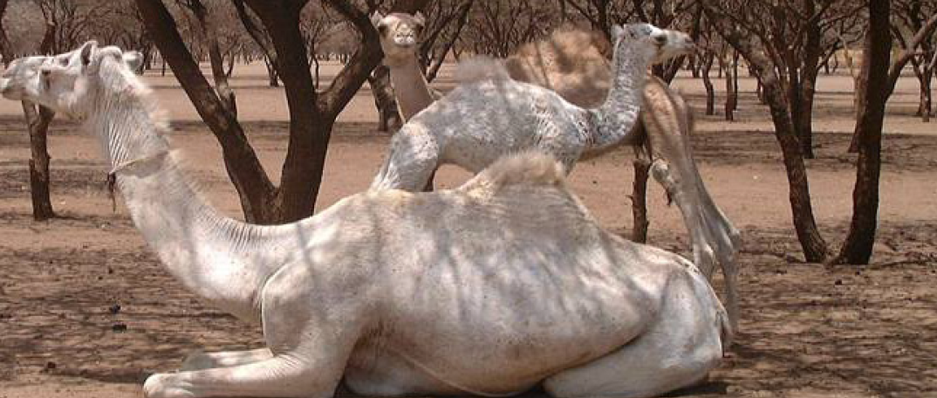
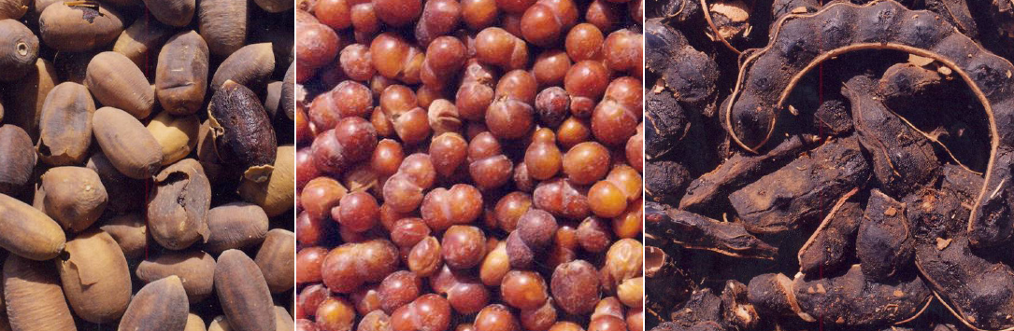
Dry Ecosystems
Dry ecosystems are home to some of the most charismatic species, support high species endemism and comprise many unique ecosystems and biomes, including savannahs, dry forest, coastal areas and deserts.
However, currently dry ecosystems are neglected, under-valued and increasingly degraded.
In order to restore the degrading dry ecosystems and to maintain the levels of ecosystem services derived from them, their true market value needs to be estimated so an action plan, which links the restoration to the beneficiaries, can be developed, funded and implemented.

Slide 3
Payment for Ecosystem Services (PES)
Humans derive a wide range of services from the natural capital, called ecosystem services, which make human life possible.
Changes to ecosystems and degradation of ecosystem services, especially in the dry areas, are increasing at an alarming rate.
Payments for Ecosystem Services (PES) is a novel conservation approach that internalizes environmental externalities through the creation of markets and quasi-markets.
Private actors are assumed to put in practice the Coase theorem, meaning that the problem of externalities can best be overcome through private negotiations between affected parties.

Slide 4
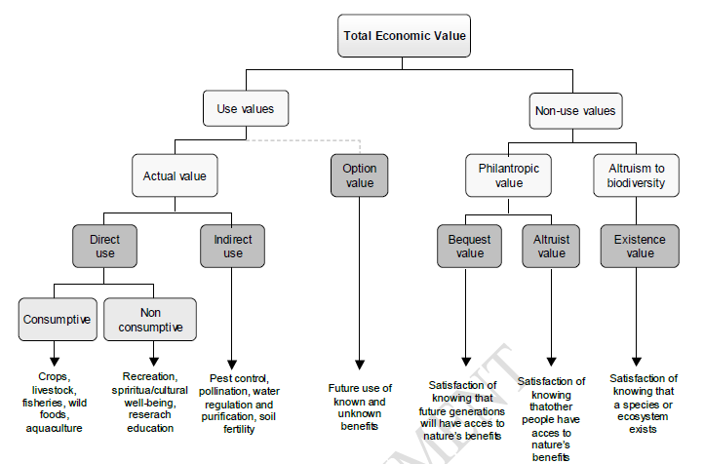
Total Economic Value (TEV) Approach

Slide 5
Steps to Follow…
Identification of the ES,
estimation of its value,
mapping of beneficiaries of the ES and
development of mechanisms that link the ES with the beneficiaries for its sustainable management.
Decision- and policy-makers in dry areas can take cues from PES studies to
  better target taxes, penalties and subsidies, and
  create enabling policies, institutions and environment for saving and rehabilitating degrading ecosystem services

Slide 6
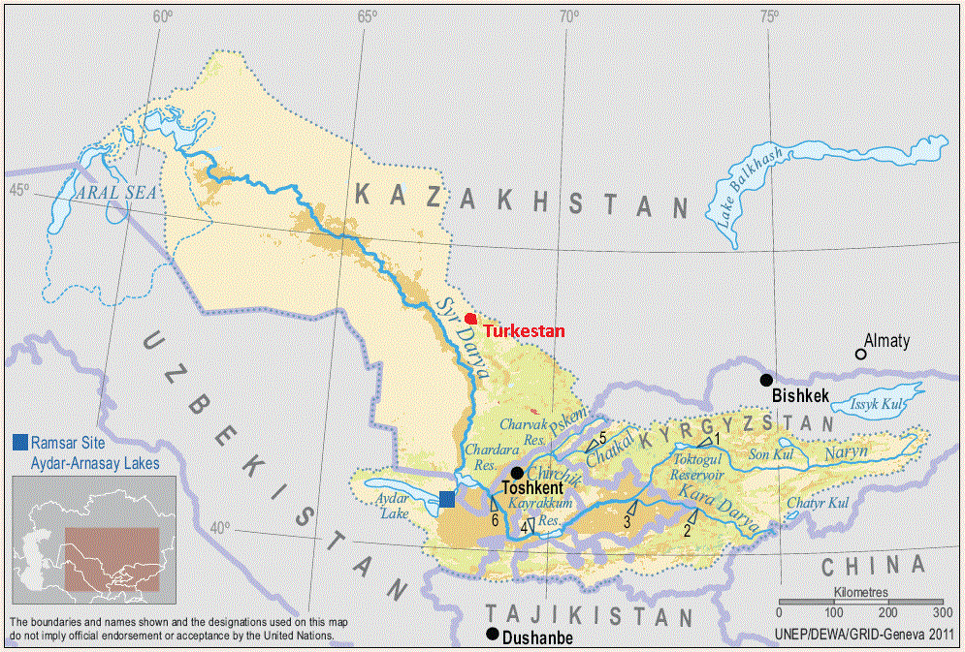


Case study #1: Valuation of Ecosystem Services to Agricultural Water Management in Aral Sea Basin, Kazakhstan

Slide 7
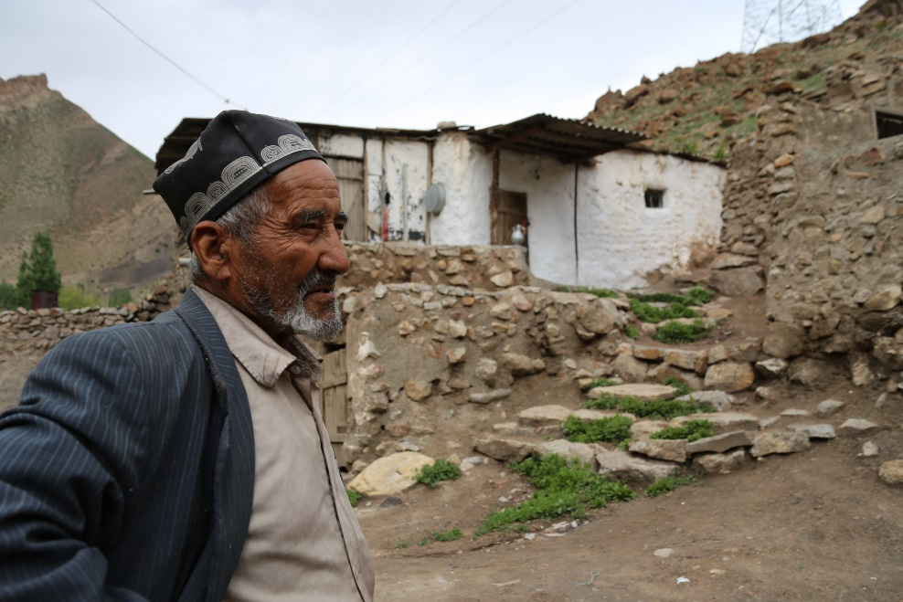

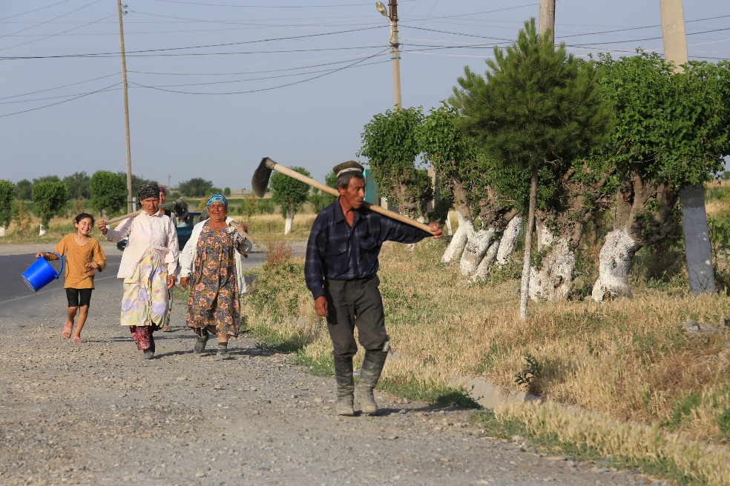
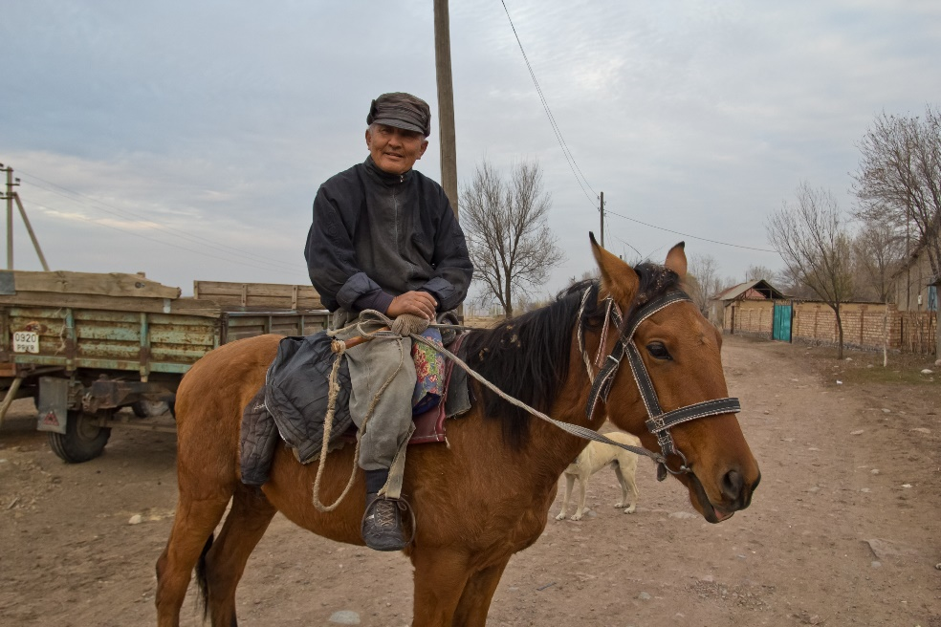
BACKGROUND
Irrigation is inefficient, primarily flood irrigation is practiced - canals lose 30% of their water supply, while field level irrigation efficiency is only 50%
Farmers over-irrigate due to an unreliable supply of water
HYPOTHESIS
Improving agricultural water management will lead to improvement of other downstream ecosystem services sharing same water, and
through the identification and valuation of main water-related ecosystem services, a plan can be developed for payment for improvement of agricultural water management

Slide 8



Methodology
Soil-Water Assessment Tool (SWAT) modeling for biophysical evaluation of water usage and other agricultural management practices and their impacts on crop yields and return flows
Resource Investment Optimization System (RIOS) modeling to identify a set of alternative land use management practices and then identify the ecosystem services that result when these practices are allocated in different ways across the landscape
RIOS also allows users to optimize selected ecosystem services for a specified level of investment by identifying where on the landscape it is best to implement a suite of management practices

Slide 9
Results
 | Net cost (Cost - Income gained)
 | Without Subsidies | With Subsidies
Cotton (flood)
Cotton (drip) | 2475 | 2293
Alfalfa (flood)
Alfalfa (sprinkler) | 2798 | 2596
Orchards (flood)
Orchards (drip) | 336

Slide 10
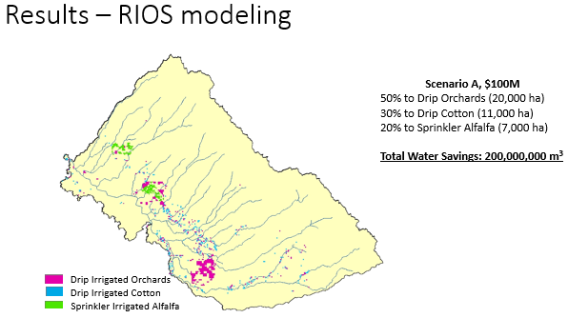
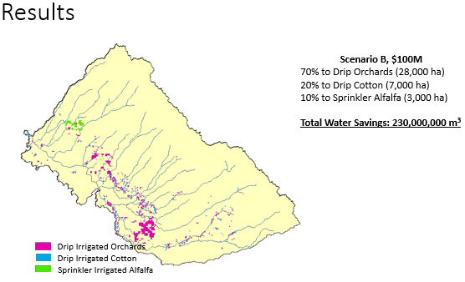
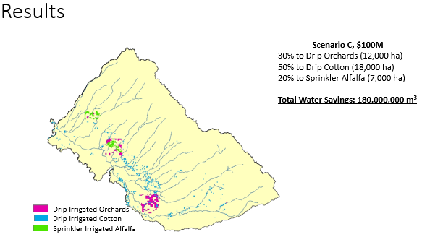

Slide 11
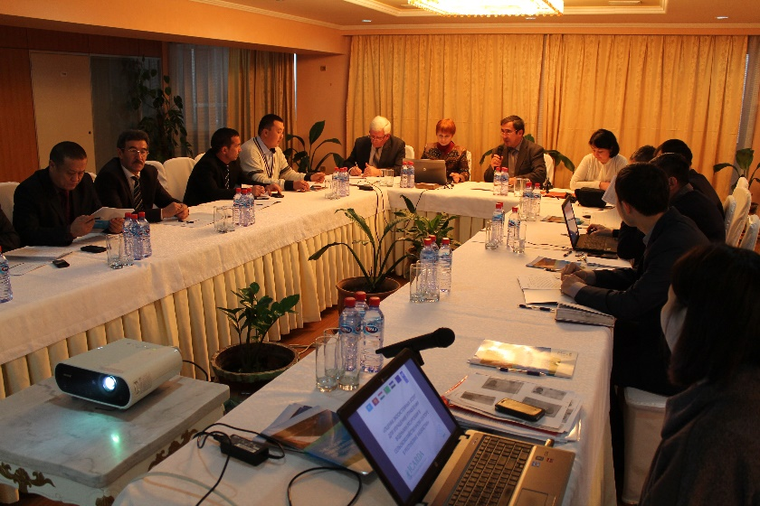
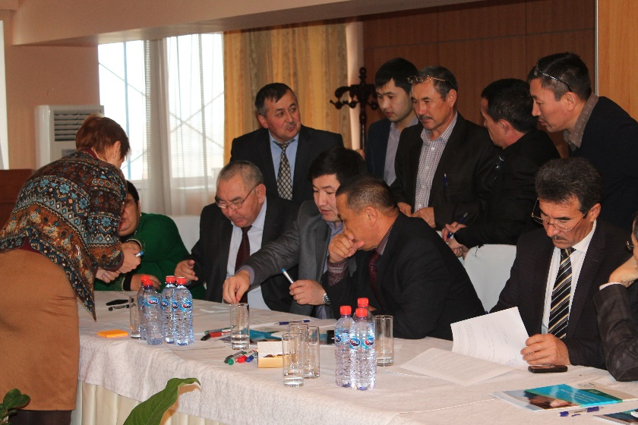
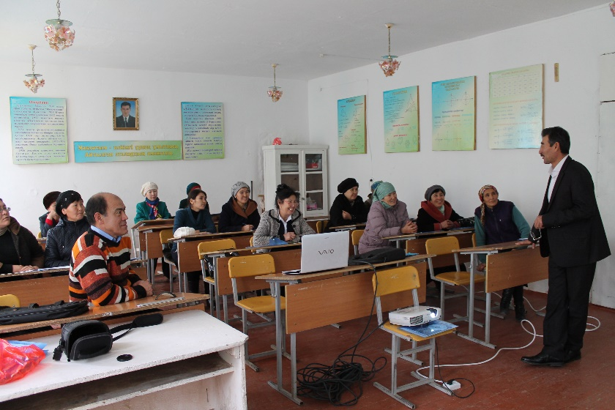
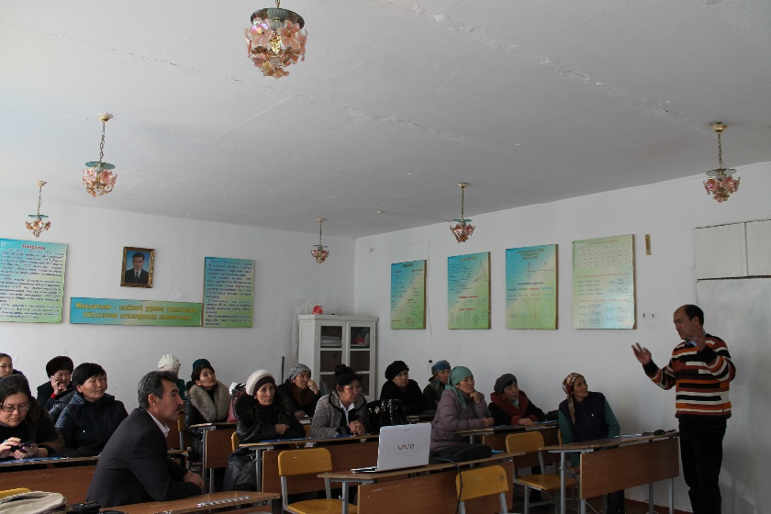
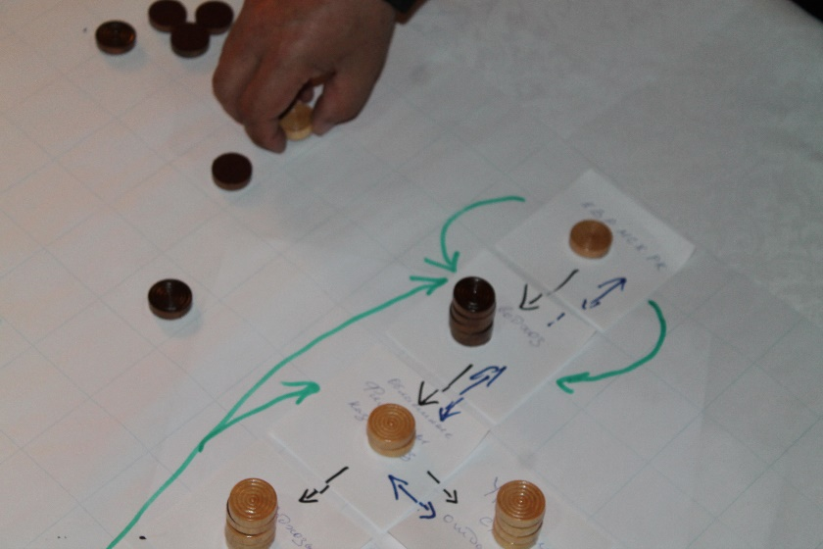
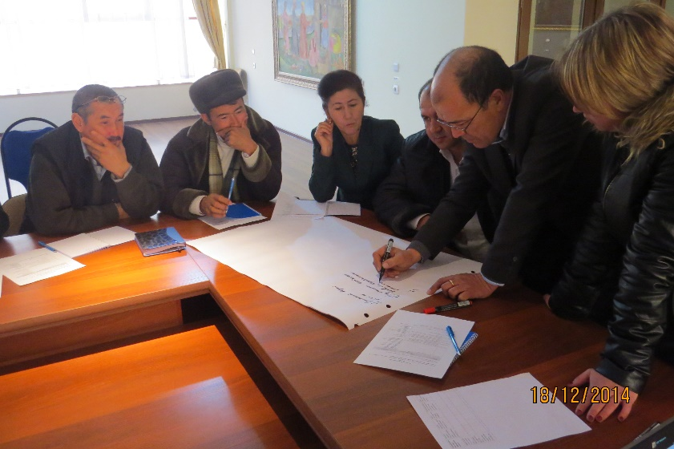
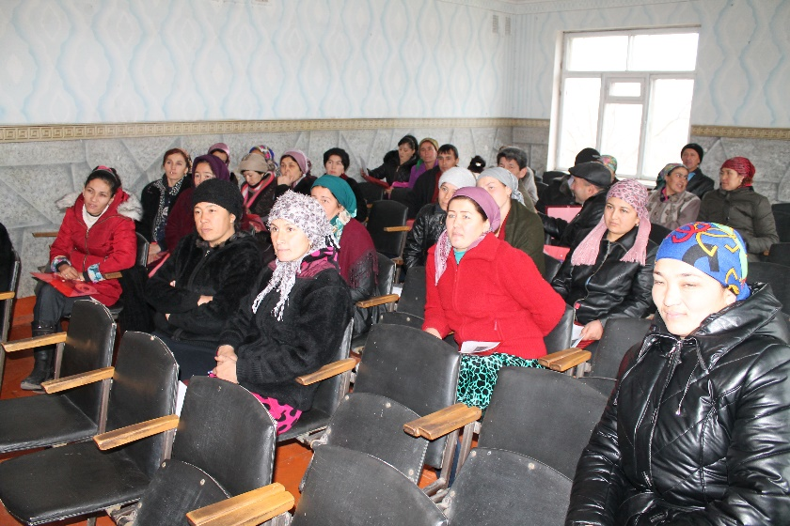
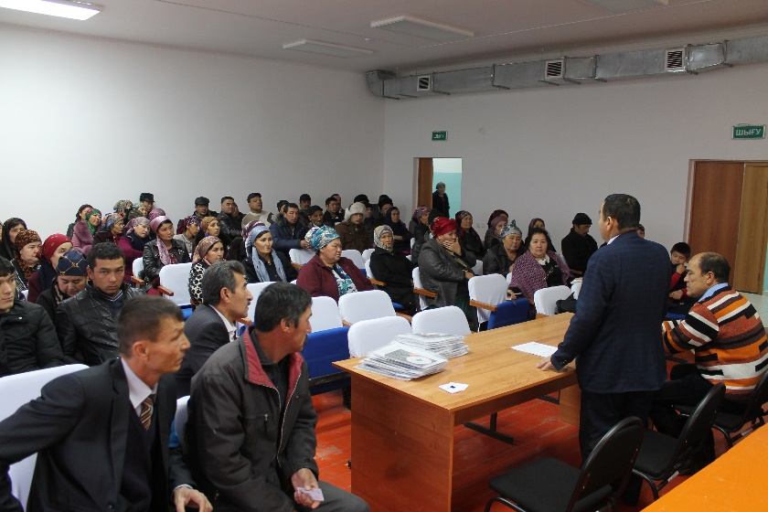
Stakeholder and Policy-maker consultation

Slide 12
Conclusions
Ecosystems services are important but often neglected part of the analysis. It’s not easy to estimate value/price of benefits drawn from nature
Agriculture cannot be managed in isolation from rest of the landscape
The more we appreciate the value of nature and benefits we draw from it, the more we will be able to manage the natural resources sustainably
There is an urgent need to understand the linkage between ecosystem management and human health, effects of producing biomass and impact on ecosystem services and ecosystem resilience

Slide 13
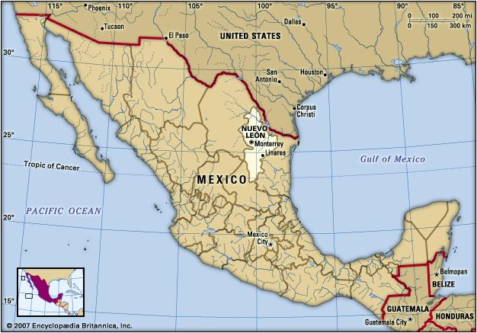
Case study #2: Linking Institutional Characteristics to Communal Natural Resource Conservation in Cumbres de Monterrey National Park, Mexico

Slide 14
Introduction
BACKGROUND
National parks help preserve nature and ecosystem services
Focus in developing countries has shifted from conservation to include aspects of human welfare allowing for local resource use
Establishment of first parks in Mexico created land tenure conflicts
Communal land management is common in Mexican national parks and is characterized for overexploitation and degradation due to open access nature
Successful communal land management inside national parks is important since resettlement schemes only work when they are voluntary
Perception of conservation must be taken into consideration when looking at successful communal land management in national parks

Slide 15
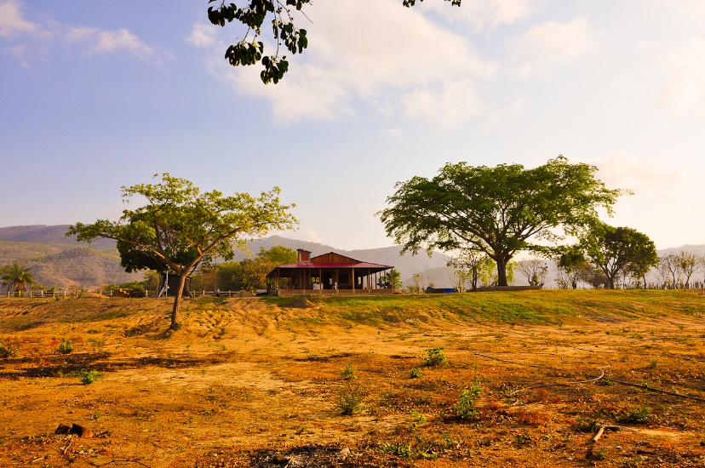
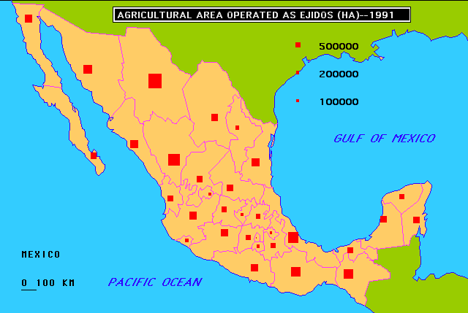
OBJECTIVES
To understand the factors that promote and deter; park promoted conservation, overharvesting, overgrazing, and trust in members to follow the rules
METHODOLOGY
Ejidos communal management system
235 respondents in 14 communities

Slide 16
Main questions asked
How establishment of park has affected NRM practices
Is your decision influenced by community decision making process
Are community rules and regulation fair for all members
Is there any limitation on using other natural resources
Are fences used for excluding grazing from different livestock owners
Does community practice rotational gazing
Do other governmental authorities and institutions support local punishments for rule breakers
Is pasture usage fair between community members
Are management rules created by community members
Are rules easy to enforce

Slide 17
Main findings
Rules that are not perceived as just do not work
89% of respondents believed overgrazing rules were just but 38% believed overharvesting rules were just
When asked how the establishment of the park has affected members’ natural resource management practices, 14.7% stated toward less conservation, 43.6% stated no impact, and 41.8% stated toward more conservation.
Incentives for a limited few can cause negative perceptions of conservation, very clear property/resource boundaries are essential for positive conservation perceptions
Land users that practice rotational grazing believe that the park has worsened conservation practices, and the number of trainings received did not significantly improve perceptions
Communities need to be included in deciding who receives payment and it needs to be perceived to be fair

Slide 18
THANK YOU

