Slide 1
Africa Rising Mali report on Year 1 (2012)
Eva Weltzien, Tom van Mourik, A. Rouamba, Vera Lugutuah, Yah Diakite, Bougouna Sogoba, Abdoulaye Diakite, Mamourou Sidibe, Joachim Binam, Augustine Ayantunde, Abdou Fall
Africa RISING West Africa Stakeholder Meeting, Accra, Ghana, 23 January 2013

Slide 2
Outline
Key events
Implementing Partners
Research Approach
Key Research questions, Results and Outputs
Conclusions and Outlook

Slide 3
Key events
Jan 2012: Inception workshop in Tamale: identification of target outcomes and target zones in Mali
Feb 2012: Stakeholder workshops in the two target zones: Identification of implementation partners and key constraints to sustainable intensification
April/May 2012: Planning meetings with all actors
May/June 2012: Training on tools for implementation of farmer managed trials
June - Dec 2012: Implementation of rainy season field experimentation
Aug/Sep 2012 Preparations for Innovation Platform on options for Crop –livestock integration

Slide 4
Implementation Partners
CGIAR: ICRISAT, ICRAF, ILRI, AVRDC
Koutiala area:
  AMASSA: Strengthening farmer groups and associations for crop/grain marketing
  AMEDD: Facilitation, Natural Resources Management, Communication
Bougouni:
  Mobiom: Organizing farmers for marketing, and improved production technologies

Slide 5
Consultants:
Moussa Djire: Experiences with of land-use conventions in Koutiala and Bougouni districts (ILRI)
Alpha Kergna: Household survey to compliment PROGEBE survey (focus on crops, additional sites) (ILRI)
Paul van Mele: Production and Translation of Farmer to Farmer videos (ICRISAT)
Moussa Noussourou: Training IPM for tomatoes (AVRDC)

Slide 6
Research Approach (1)
Identification of Research Priorities: Needs expressed by stakeholders from the target areas, and discussions in view of opportunities provided by broad- based group of researchers
Search for entry points to facilitate participatory research across the production system: provide a local institutional context for joint learning

Slide 7
Research Approach (2)
3. Address sustainability issues, while working on intensification research questions :
  Ensure that on-farm experimentation is demand driven
  Focus on building capacity in the target communities
  Monitoring natural resources indicators
  Targeting women's priorities
  Initiate research on household typologies

Slide 8
Main results:
Entry points for participatory research
Characterization of key elements in the target production systems
Options for increasing crop productivity
Options for improving nutritional status of young children
Options for enhancing natural resources (not reported today)

Slide 9
1. Entry points for participatory research on SI with multiple partners
Strengthening existing seed and grain production cooperatives in the target areas:
Interest in a wide range of crops, Capacity to produce seed, Motivated to increase seed and/or grain sales,
Opportunities: identify varieties and crop management options for SI with the full range of crops, and a wide range of potential customers.
Sustainability focus: Building farmer and cooperative’s capacity for choosing varieties for multiplication/sale; for testing SI options; for communicating SI options
Partners: AMASSA, Mobiom, ICRISAT, AVRDC, ICRAF

Slide 10
1. Entry points for participatory research on SI with multiple partners (2)
Innovation Platform for crop-livestock integration:
  Local governments involved, as well as actors along the whole value chain for livestock, and forestry products, landscape scale, NRM issues
  Opportunities: Addressing land management issues constructively; strengthening negotiation skills of a wide range of partners; local marketing issues considered, fodder availability options from the whole range of land types and for different types of livestock can be researched
  Sustainability: attracting interest from other development actors, strengthening negotiation skills of a wide range of partners;
  Partners: Mobiom, ILRI, ICRAF

Slide 11
1. Entry points for participatory research on SI with multiple partners (3)
3. Community Health Centers to facilitate work with women’s groups
Health with support for treating malnourished children; they have a responsibility for providing preventive care and advice
Opportunity: Supporting health centers with advice to prevent malnutrition, a wide diversity of crops, including vegetables and trees are adapted to the ecology
Sustainability: TOT with women’s groups, producing visuals as training material, joining training on nutrition with cooking lessons and crop production
Partners: AMEDD, ICRISAT. AVRDC, ICRAF

Slide 12
1. Entry Points for participatory research an SI with multiple partners
Each entry point provides a framework for collaboration with target communities with a specific purpose
Each entry point ensures that the research activities generate benefits for participating farmers from year 1
Creating opportunities for immediate impacts
Entry points could be compared and sequenced for studying specific outcomes

Slide 13
2. Characterization of target zone

Slide 14
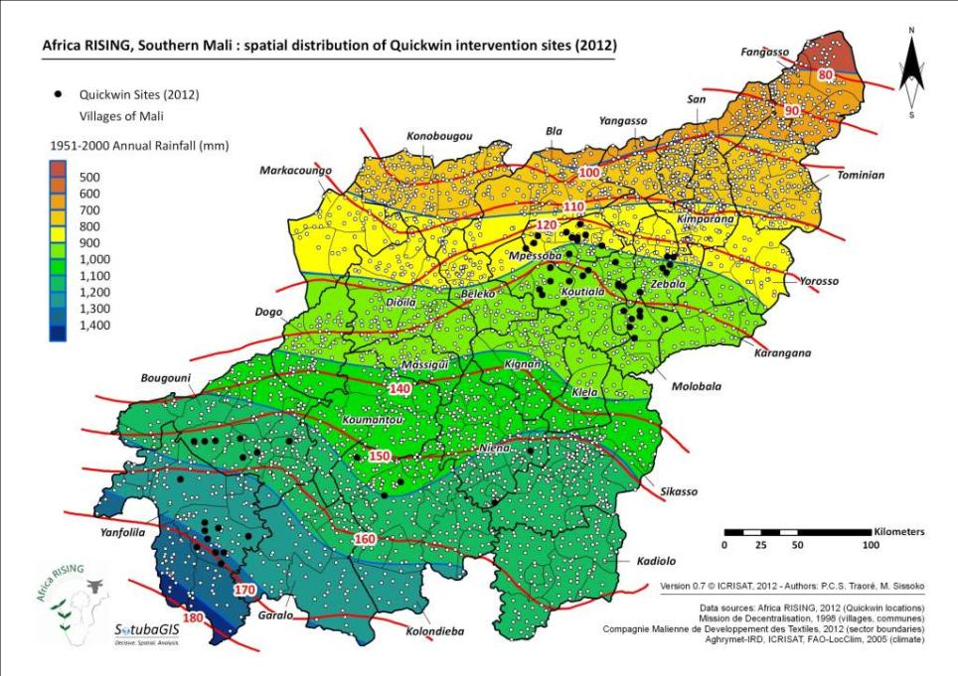
Notes:
Contrastingly, the length of growing season spans a lower range than Ghana’s Africa RISING domain, in Southern Mali here from 80 to 180 days.

Slide 15
Population pyramid of Garalo “commune” in Koutiala in 2009/2010

Slide 16
Principal Sources of household income in Koutiala and Bougouni (% of households )
Income source | Koutiala (% of household interviewed) | Bougouni (% of household interviewed)
Sale of crops | 60 | 65
Sale of animals | 18 | 11
Off-farm activities (small-scale commerce, remittances, salaried work) | 15 | 10
Vegetable production | 5 | 2
Forest products | 2 | 9
Others (e.g. fishing) | 0 | 3

Slide 17
Use of crop produced by the households in Koutiala and Bougouni in 2011
Crop | Household consumption (%) |  | Sale (%)
 | Koutiala | Bougouni | Koutiala | Bougouni
Millet | 79 | 75 | 12 | 23
Maize | 76 | 72 | 16 | 22
Sorghum | 77 | 77 | 14 | 16
Rice | 75 | 60 | 20 | 29
Cotton | 9 | 0 | 91 | 100
Groundnut | 49 | 41 | 40 | 52
Cowpea | 84 | 55 | 16 | 40

Slide 18
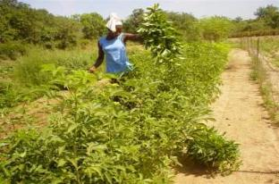
Key issues for Sustainable Intensification from survey results
Access to agricultural implements and inputs, credit
Risk mitigation to cope with climate variability, and market shocks
Information systems and training on improved agronomy, quality control of drugs and pesticides
Value addition particularly cereals
and livestock value chains
Adequate feed for traction animals

Slide 19



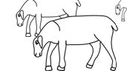
Farm typology : establisment (1/2)
IER SEP dataset : 30 farms of 3 village of the Koutiala area monitored from 1994 to 2011 on structural characteristics (household composition, assets)
Cluster Analysis on 6 parameters : Cropland size, number of workers, Household total size, TLU, Oxen, Draught tools
4 Farm types :
Big mixed farms with large herds,
Big mixed farms with medium herds,
Medium mixed farms,
small farms with very small herds

Slide 20




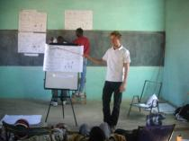
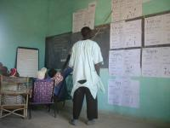
Farm typology : Farmers’ feedback (2/2)
Presentation of the typology to a group of 23 farmers involved in Icrisat activities. Each farmer can recognize himself in a type
Farmers recognize strategies to move ‘up’ to a type of better resource endowment :
    Crop livestock integration and better soil fertility management
    Management of working calendars, Agreement between family members on activities and income repartition
    Diversification activities (livestock fattening, vegetables, banana plantation, activities out of agriculture)

Slide 21
3. Options for increasing crop productivity and farmers’ incomes

Slide 22
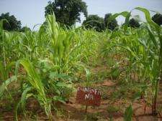
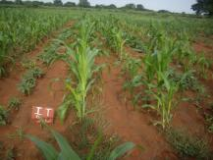
1. Maize-cowpea intercropping
12 on farm participatory trials in two villages of the Koutiala region.
2 intercropping patterns with 4 cowpea varieties (local+3 improved varieties)
Patern 1 : Additive pattern
Pattern 2 : Maize 2 rows, Cowpea 1 row
Notes:
Cowpea is green dot, maize is grey dot

Slide 23
Maize-cowpea intercropping : preliminary results on « high potential fields »
-> Intercropping pattern 1 with Cowpea variety « Dunanfana » shows very interesting LER for fodder production.
Notes:
Bold is yield, italic is standard deviation

Slide 24
2. Sorghum varieties: Grain Yield
Village | Nombre de tests | Varieties tested
 |  | Douajè | Village check | N’Golofing | Pablo | Yamassa
Koutiala | 6 | 1017 | 1069 | 998 | 1310 | 752
Namponsela | 4 | 1154 | 931 | 1132 | 1195 | 938
Gantièsso | 5 | 1199 | 1583 | 1658 | 1659 | 1092
Karangana | 4 |  | 697 | 814 | 1128 | 838
N’Golonianasso | 4 |  | 828 | 766 | 1548 | 993
Moyenne de tous les villages |  | 1123 | 1021 | 1074 | 1368 | 923

Slide 25
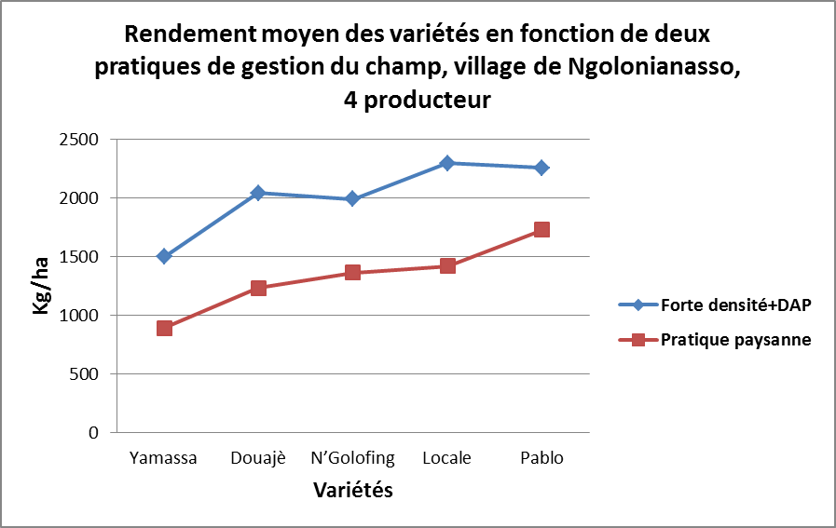
3. Sorghum variety x agronomy trials

Slide 26
4. Soybean variety performance in 4 villages
Village/type de testeur | Nombre de tests | G196 | Temoin | TGX1908-8F | TGX1935-3F | SE
Farakala (Femmes) | 4 | 1133 | 1171 | 1330 | 1237 | 5
Karangana (Femmes) | 4 | 980 | 918 | 973 | 928 | 5
Sirakele (Femmes) | 4 | 991 | 864 | 973 | 948 | 7
Sougoumba(Hommes) | 4 | 1241 | 1476 | 1305 | 1394 | 9
Moyennes de tous les villages |  | 1086 | 1107 | 1145 | 1127 | 6

Slide 27
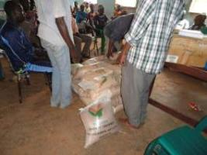
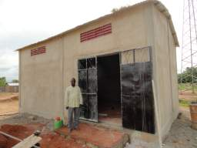
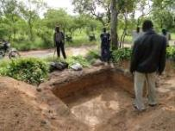
Summary of experiments and training conducted with seed cooperatives in Yr1
Variety trials (Sorghum, Millet, Maize, Cowpea, Groundnut, Soyabean, Okra and Roselle, with and without agronomic options) implemented by partners in Koutiala (11 types, ~160 trials, 17 villages/ cooperatives) and Bougouni (~5 types, 9 villages)
Seed production fields installed for certification by farmers in Koutiala (>20) and Bougouni for sorghum, pearl millet, maize, cowpea and soyabean
Video showings on ISSFM have trained at least 3100 men, 2260 women and 2280 children in the target villages
27

Slide 28
4. Options for improving nutritional status of young children

Slide 29
4 Training Modules developed: Preventing Malnutrition
Module 1 : Alimentation des enfants de 6 mois à 2 ans ; Option : Bouillie enrichie à base de produits locaux + Conseils pratiques
Module 2 : Nutrition et santé des femmes enceintes et allaitantes ; Option : Sauce de feuilles vertes & Sauce d’arachide avec feuilles vertes + Conseils pratiques
Module 3 : Alimentation des enfants malades ; Option : Bouillie enrichie à base mil, soja, arachide + sucre + jus de fruits + Conseils pratiques
Module 4 : « Prévention des carences alimentaires (vitamine A, iode et fer) ; Option : Soupe de légumes + Conseils pratiques

Slide 30
Indication of outcomes
Monthly reporting for each of 36 villages of number of participating women using recipes
Collection of ‘stories’ on experiences with using recipes
Monitoring of sale of seed mini-packs from health centers
Plan to collect medical records, to verify statements that less malnourished children arrive at health centers than from villages who did not participate in the training

Slide 31
SWOT analysis conducted with nutrition partners
Strengths: Women are key target group Improved use of local products Linking nutrition and use of local crops Participatory development of modules and training materials Great level of interest from participants and other family members | Weaknesses Roads/distances make it difficult for women form some villages Delayed start of activities Trainers have tendency to focus on recipes, and les on other messages
Opportunities/Potential: Good working relationships established Confidence of women in the locally chosen trainers Local radio station interested to contribute | Threats/Risks: Climatic conditions limit some activities CSCOM have many activities, understaffed

Slide 32
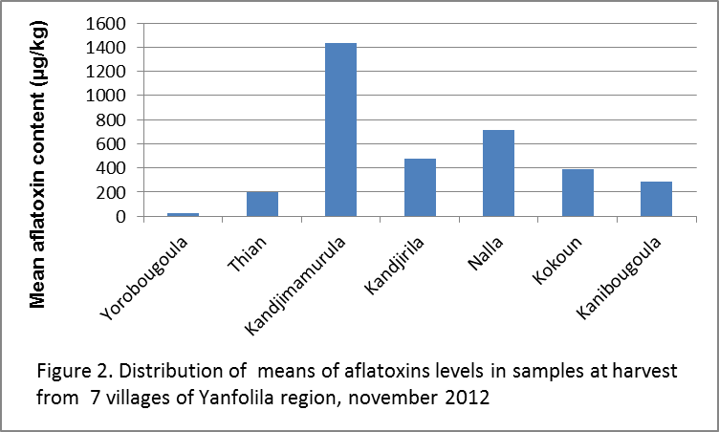
Food Safety issues: Aflatoxin contamination of groundnut samples

