Slide 1
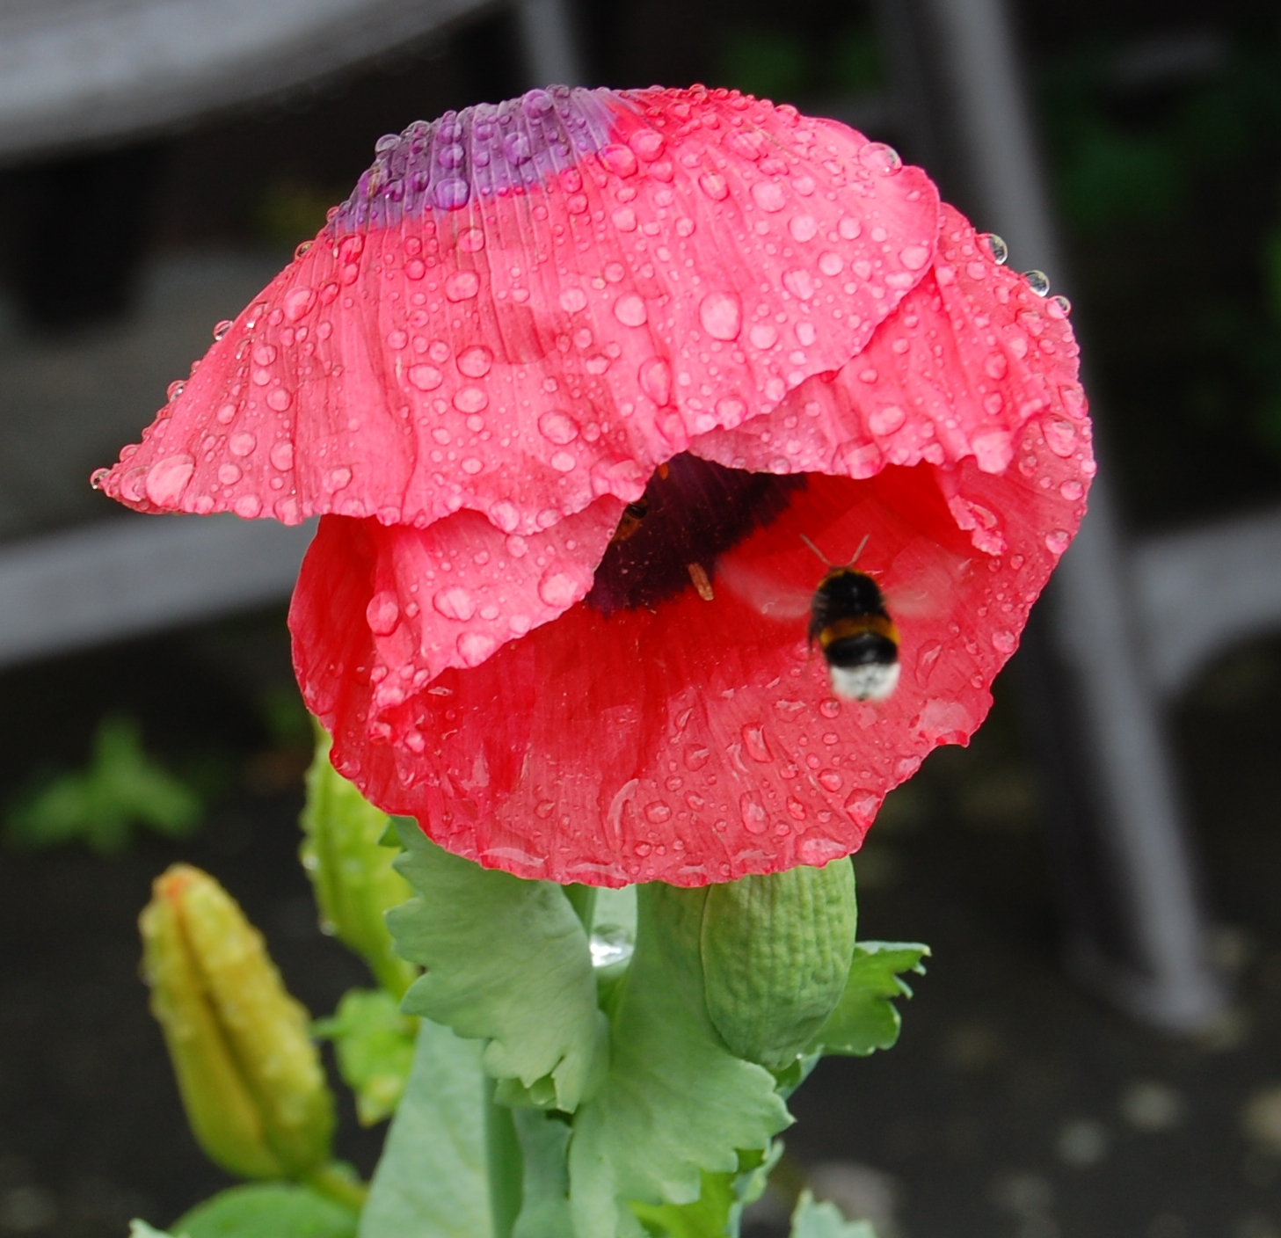
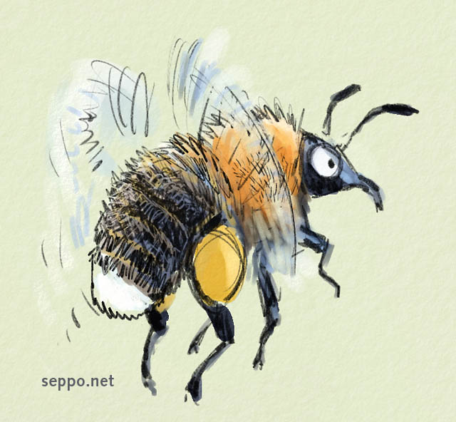
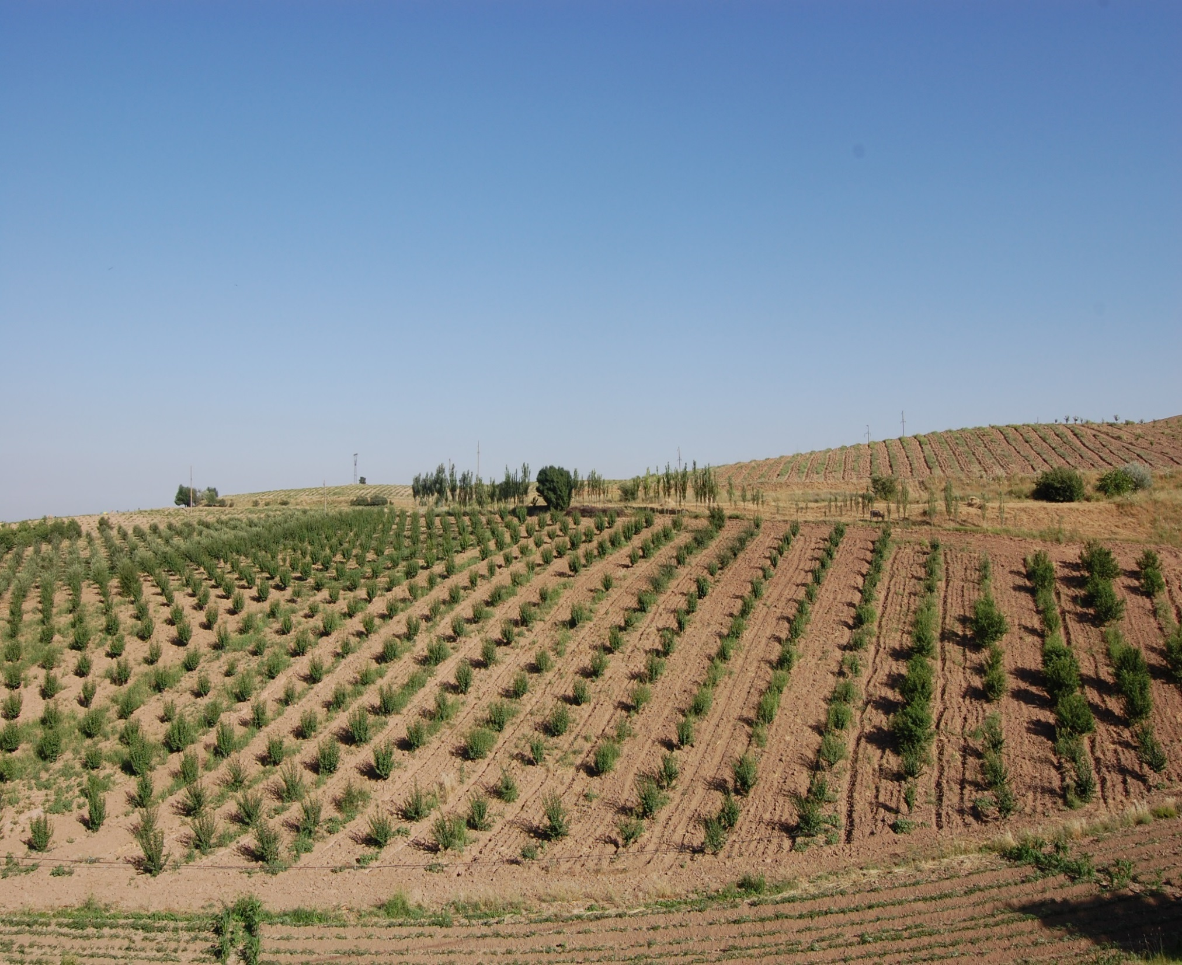
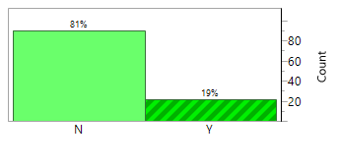
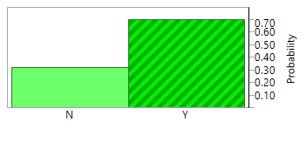
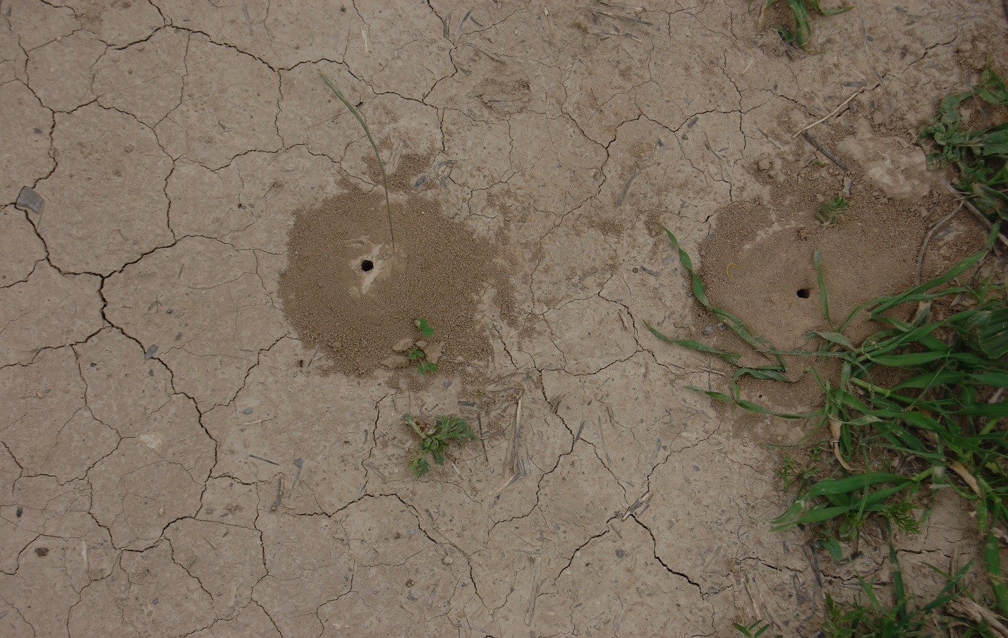
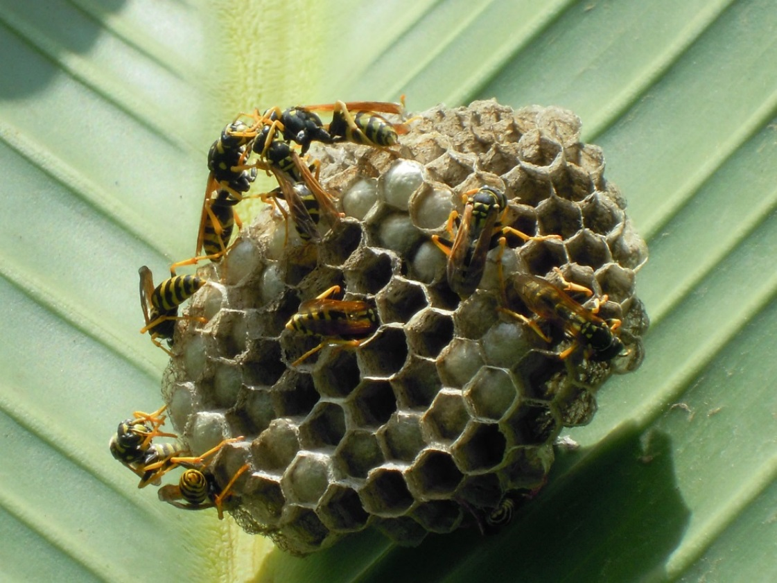
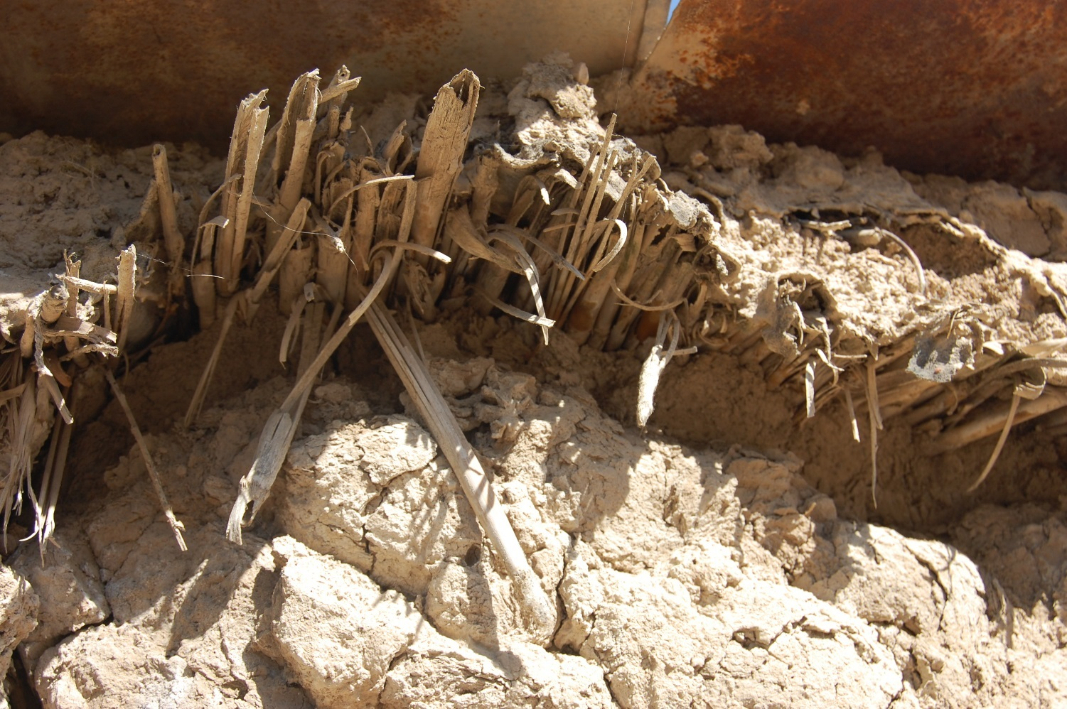
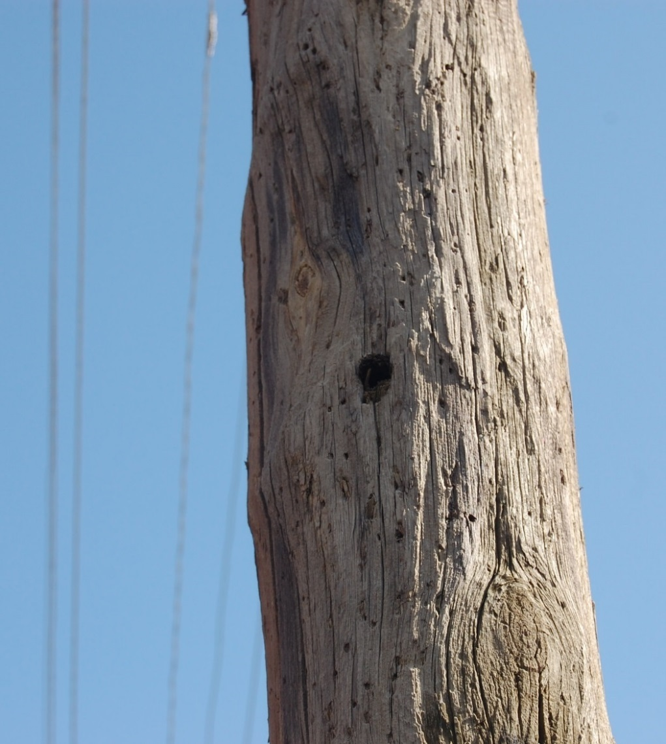
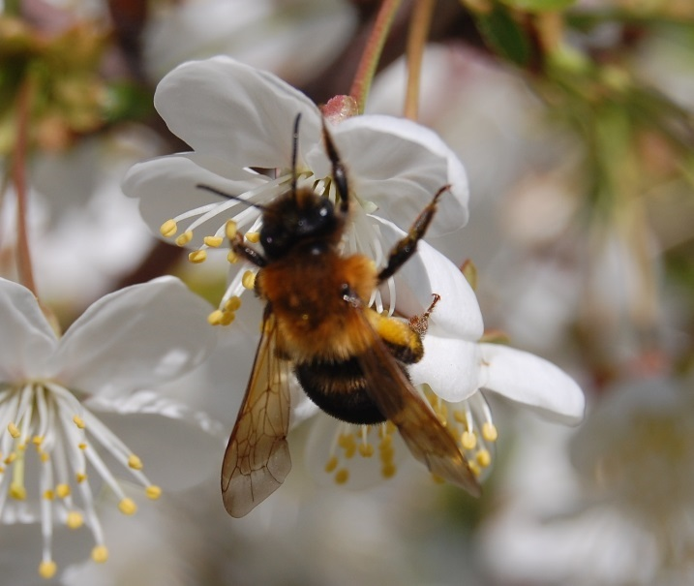

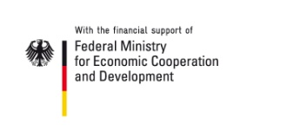
Farmers Have Too Low Knowledge to Protect and Benefit from Native Pollinators – Insight from Morocco
Dr. Stefanie Christmann¹, Dr. Athanasios Tsivelikas¹, Abdellah Benbya²
1) ICARDA, POB 6299, 10112 Rabat, Morocco, e-mail: s.christmann@cgiar.org
2) University Mohammed-V, Dept. of Biology, Laboratory of Plant Physiology and Biotechnology, Morocco
Introduction
In 2016 The Intergovernmental Science-Policy Platform on Biodiversity and Ecosystem Services (IPBES) showed that agricultural production is now twice as dependent on pollinators than five decades ago, but pollinator decline accelerates globally, in particular in agricultural lands. Farmers cannot protect, what they do not see or recognize or value. Farmers‘ knowledge on pollinators is the bottleneck for protection.
Methodology
In 2016 the knowledge of 110 male and female smallholder farmers (0.4-2.5 ha) in the Rabat-Salé-Kenitra region (Morocco) has been assessed by a standardized questionnaire. Additionally, in 2017 we conducted the same survey with 100 female and male smallholder farmers in the mountainous Sefrou region (Morocco), where cherry production is common, diversity of bumblebees is rich, but the number of beekeepers decreases for years.
Results
Kenitra region:
Lack of knowledge was similar among illiterate and literate farmers. On average, farmers know less than 2 pollinator species except honeybees. 23 out of 110 farmers had collaborated with beekeepers, but not for improved pollination of their crops. They had invited the beekeepers to bring hives, because according to local arrangements a farmer providing flowers gets a share of the honey as in kind payment.
Despite availability in their agricultural lands no farmer is able to recognize nests of pollinators or predators. They did not know for which crops pollination is essential, for which crop pollination has great, modest or little impact. Farmers were e.g. much more concerned about pollination of tomato (impact: little) than of apple (impact: great). As apple flowers in early spring, pollination by honeybees is often hampered by rain or cold days without sun.
All farmers enlarged fields and thus reduced valuable pollinator habitats in field edges since the year 2000. Also the farmers increased the use of insecticides and fungicides on average by 54% since 2000, so they increased the risks for pollinators significantly.
Sefrou region:
Knowledge of literate farmers was slightly higher than of illiterate producers. Also in Sefrou, no farmer ever recognized a pollinator nest, though the region is rich in bumblebees (nesting in the ground, exposed to tillage). No farmer knew wild bees or bumblebees, they don’t recognize their most effective pollinators as pollinators at all. Female farmers knew even less pollinator species than men. Only 6% of farmers noticed a pollination deficit (mostly for fruit trees), 32% collaborated with a beekeeper (23% to enhance pollination of fruit trees, 9% for the only reason to receive honey for better price).
59% merged fields into one (on cost of field margins) since 2000, but as the average farm size is 2 ha, this is a habitat degradation, but not yet a serious threat like the average increase of pesticides by 55,4 % since 2000.
Discussion
There is very little literature on farmers’ knowledge on pollinators (Christmann et al. 2017; Hanes et al. 2013; Kasina et al., 2009; Munyuli 2011), but according to the samples the knowledge in Morocco is comparatively low. Farmers lacking knowledge might take wrong decisions in case of crop failure. Knowledge is crucial for pollinator protection and higher benefit from their services.
Conclusion
As there was nearly no difference between literate and illiterate farmers in both regions, obligatory lessons on pollinators are recommended for primary and secondary schools. Change of curricula might be the most effective and the most economical way to enhance the knowledge of all social groups. Involvement of mass media would be useful.
Photo 1: Bumblebee (Bombus terrestris) working also under rough conditions.
We cannot survive in such landscapes!!!
Wild pollinators work in a radius of 50-2000 m, how to get the active contribution of so many local people to enhance habitats?
→ Pollinator protection requires a mass basis of knowledgeable farmers, staff in local administration and politicians
Figure 1: Kenitra (left) and Sefrou (right) - though all farmers produced at least one pollinator dependent crop, only 19% (Kenitra) or 69% (Sefrou) were aware that they need pollinators in their fields.
Photos 2-5: Nesting material and areas close to crops are crucial for wild pollinators.
Figure 2: Sefrou - Gap between farmers‘ knowledge and real pollinator dependency of crops
Figure 3: Sefrou – farmers‘ knowledge on pollinator diversity gender-segregated; farmers don‘t recognize the most effective pollinators in their fields: bumblebees and wild bees
Photo 6: Pollinators have great impact on the yield of cherry
Tropentag Bonn, 20 September 2017, poster session „Biodiversity and underutilized species“

