Slide 1
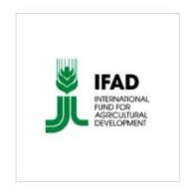


CLCA Post-Phase I Prospects and Opportunities: Tajikistan
IFAD - ICARDA CLCA Grant Project 1393 “Integrated Crop-Livestock Conservation Agriculture for Sustainable Intensification of Cereal-based Systems in North Africa and Central Asia”
Aziz Nurbekov (ICARDA), Tolibek Bukhoriev (Tajikistan)
Nurali Asoev (Tajikistan), Tanzila Ergasheva (Tajikistan)
3rd Coordination and Project Closing Meeting (CPCM)
04th – 06th April 2016, Amman, Jordan

Slide 2
Prospects
  Rapid growth of population followed by increasing demand for food and feed
  Arable land per capita is declining and competition for land and water is increasing
  Rising prices of inputs (fuel, fertilizer, seed, pesticides, etc.) as a result farmers’ income is decreasing
  Yield of main crops is declining due and lack of superior varieties

Slide 3
Prospects
  Lack of crop diversification
  Lack of modern knowledge and technology
  Land degradation (soil erosion, salinity and etc.)
  Lack of extension services
  Lack of farmer expertise.
  Generation gap and lack of qualified experts

Slide 4
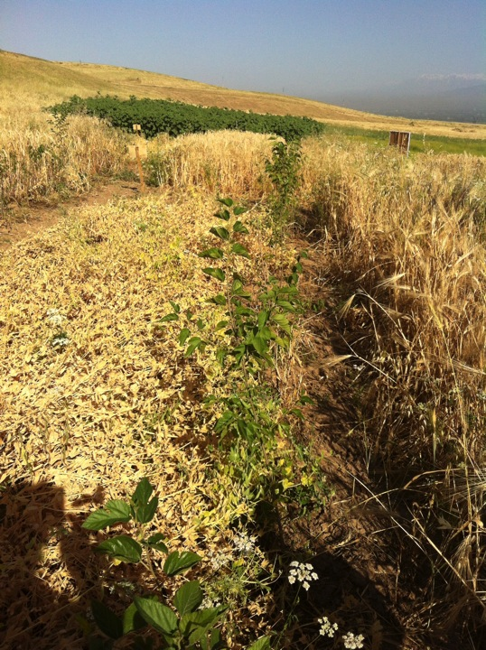
Opportunities
Alley cropping to increase fodder production in rainfed conditions

Slide 5
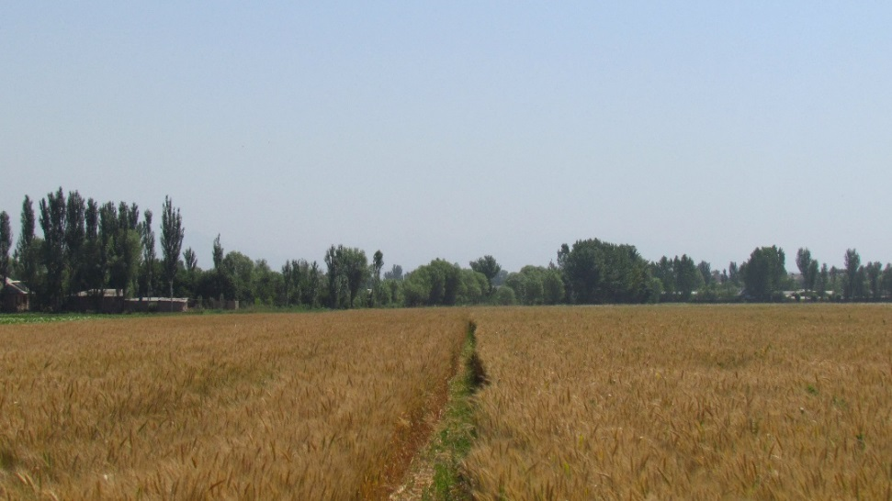
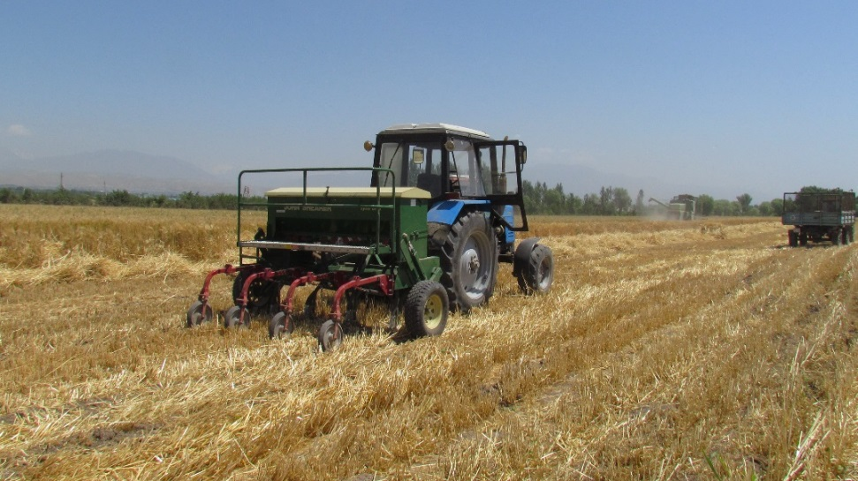
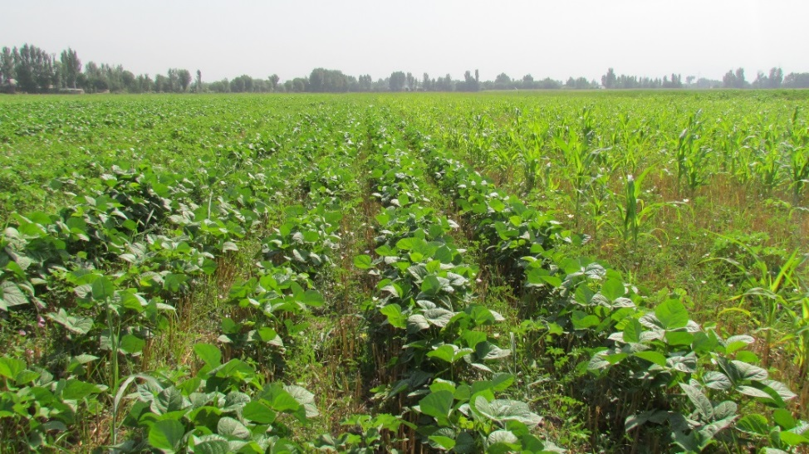
Opportunities
Wheat-Legume Rotation
(Other second crops can also used as well)
New Crop rotation
Winter Wheat
Double crops
15 Oct |  |  |  |  |  | May | Jun |  |  | Sep | 15 Oct
Early maturing varieties
Planting of wheat (no-till) in standing cotton
Mungbean, kidney bean, corn, sorghum, potato, forage pea and forage crops etc

Slide 6
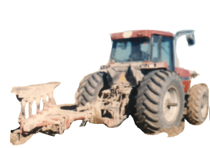
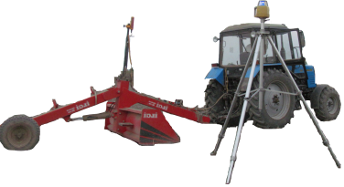
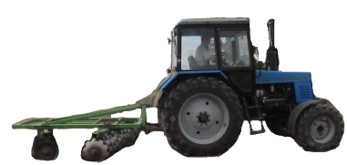
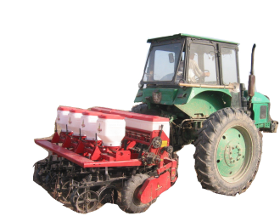

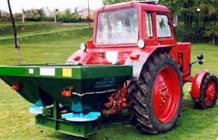
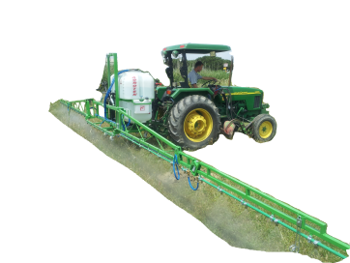

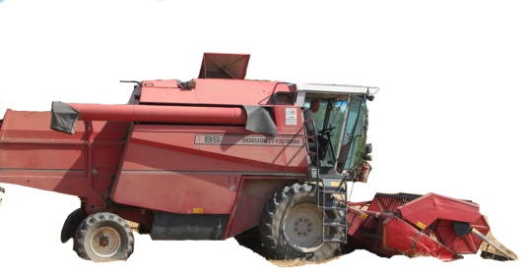

Opportunities
Farm power and energy for field production can be reduced by up to 60%

Slide 7



Opportunities
Several collaborative research and development projects are started to promote CA practices in Tajikistan.

Slide 8
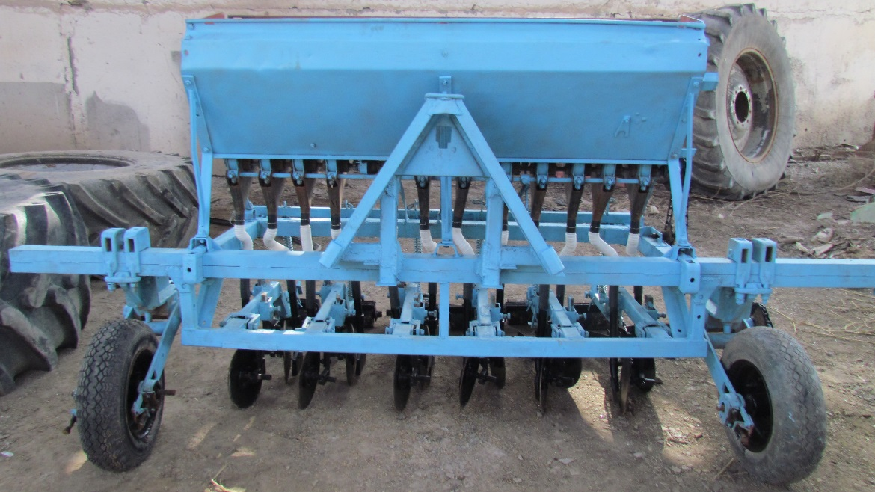
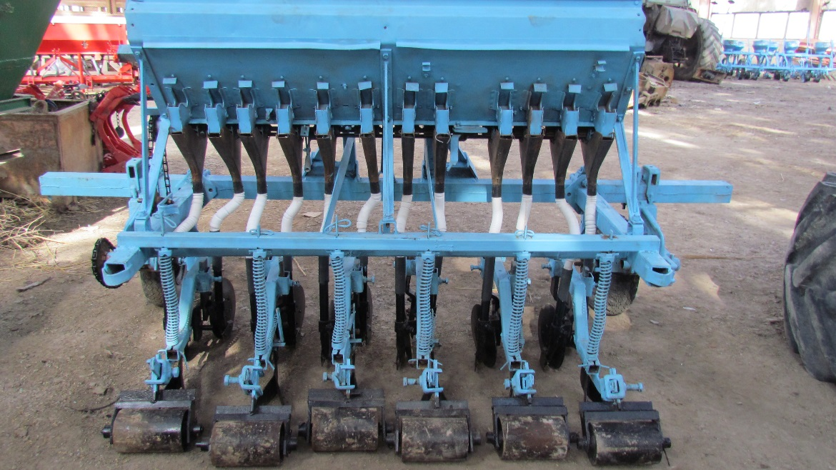
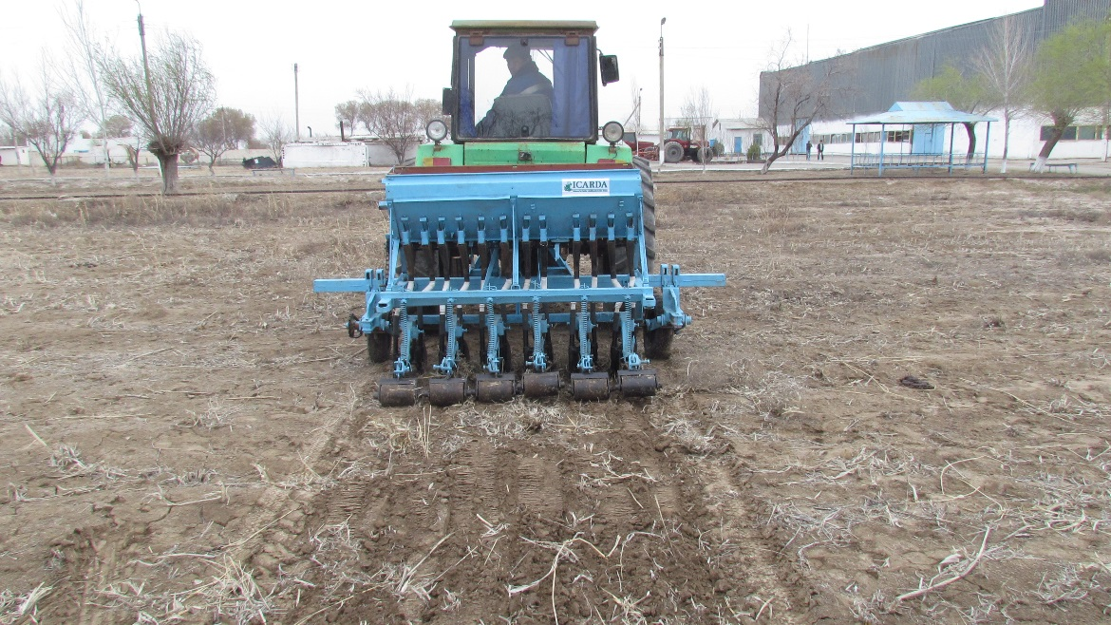
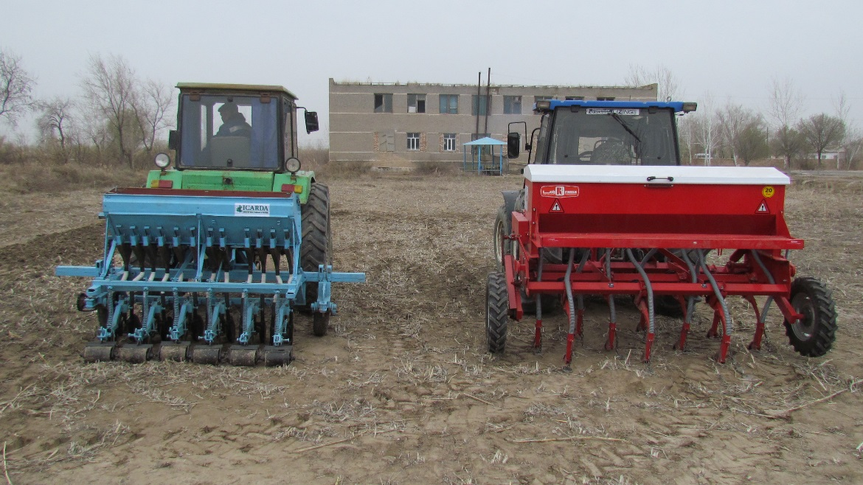
Opportunities
Development of local no-till drill

Slide 9
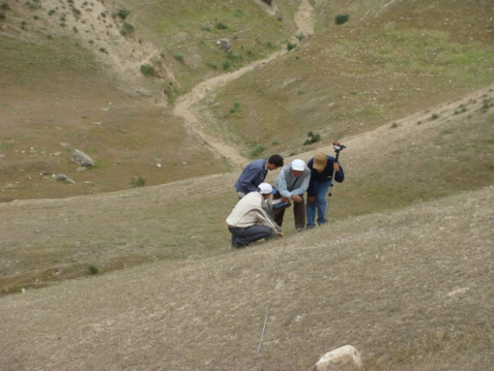
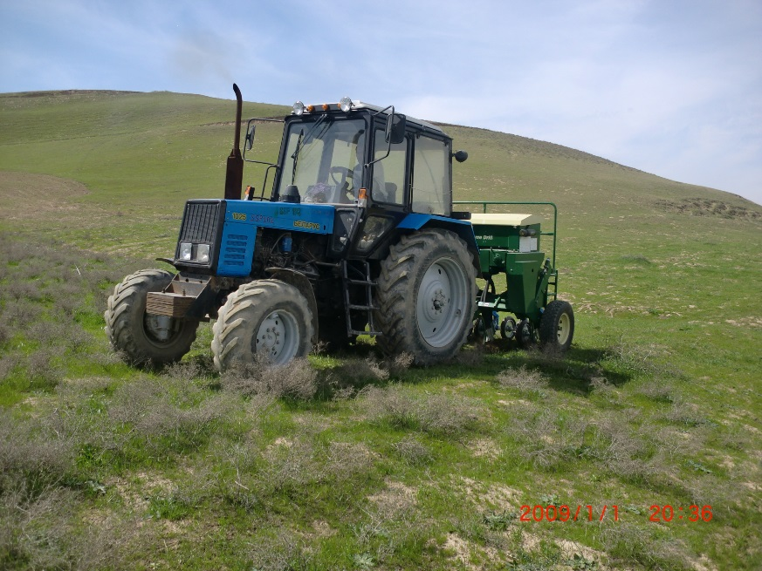
Opportunities
Rehabilitation of degraded rangelands

Slide 10
Opportunities
Further research on CA in Tajikistan is necessary:
  on weed, nutrient, pest and water management;
on sowing depth, dates, density;
on fertilizer and irrigation rates;
on crop residue management;
on species of shrubs for alley cropping
on the impact to livelihoods and environment.
Where necessary, livestock should be integrated with Conservation agriculture systems;

Slide 11
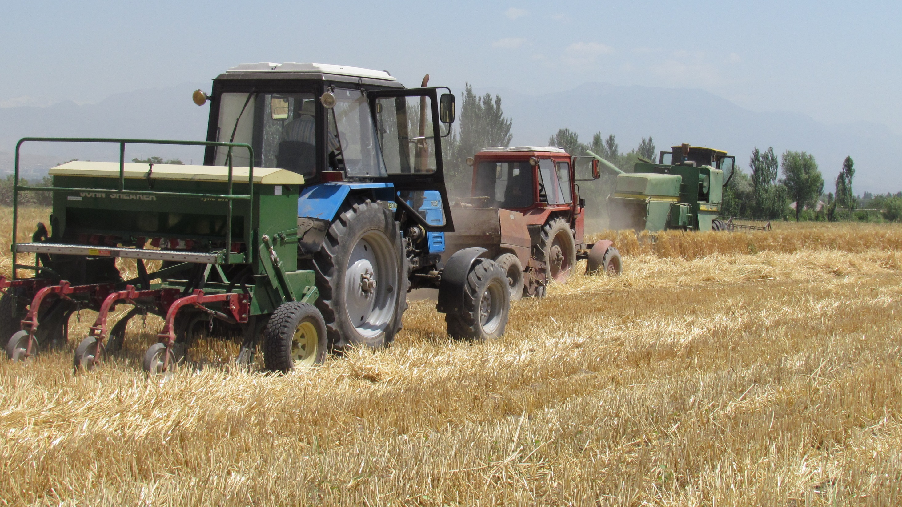
Thank you

