Slide 1
How to plan outputs
Learn how to plan outputs in MEL
in 1 minute
VERSION 1

Slide 2

Go to mel.cgiar.org and login to your account
Use your email and password to login
Click on «Forgot password?» if you need to change your credentials

Slide 3
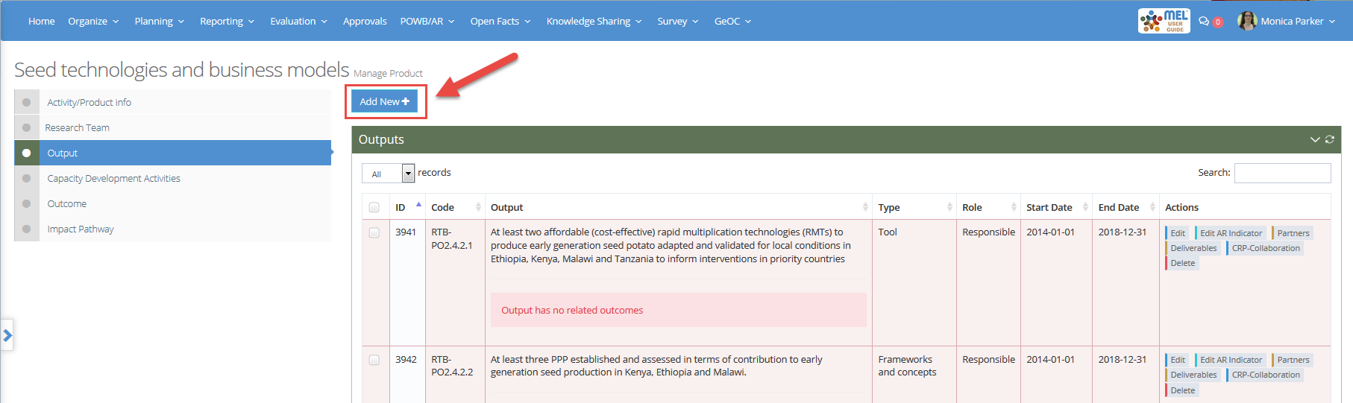
Before you start
Remember that:
1) Only cluster leaders and co-leaders and product leaders and co-leaders may create new outputs
The “Add New” button will only appear in their pages
2) Output leaders and co-leaders have the right to edit the information related to the outputs under their responsibility

Slide 4
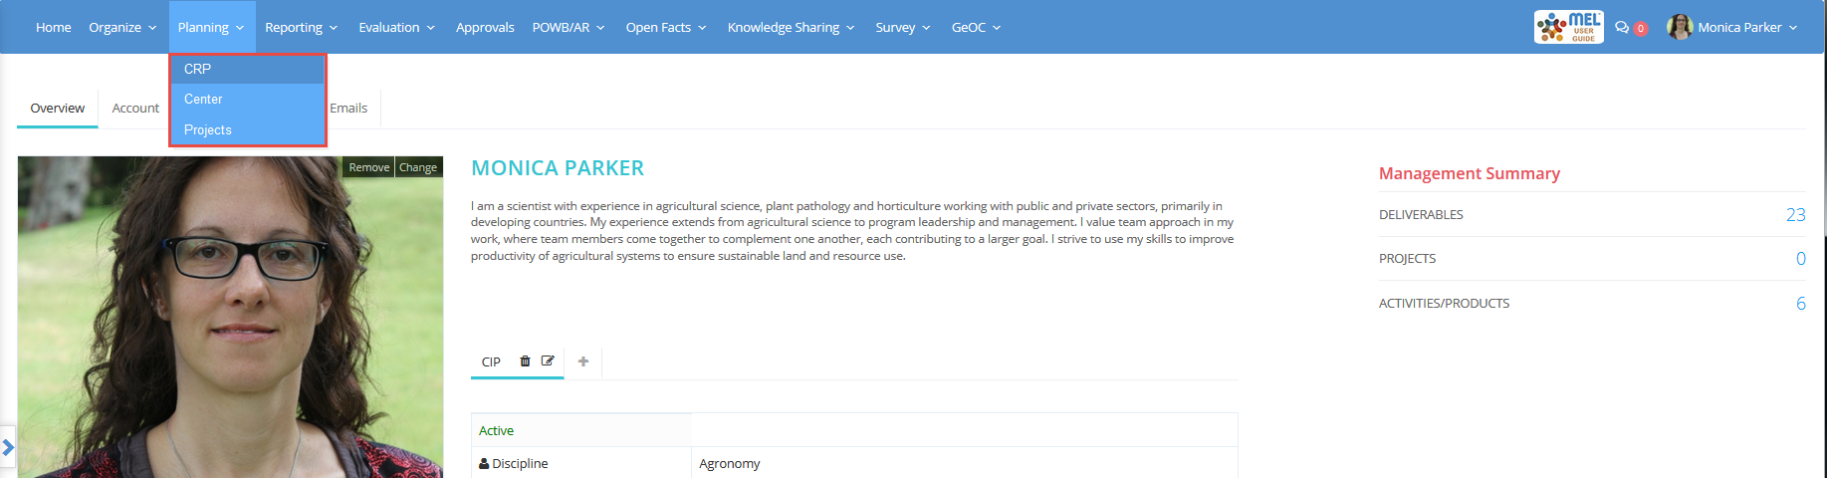
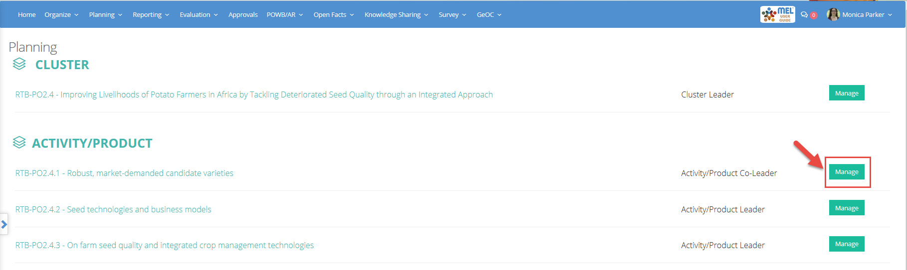
Click on the Planning menu and select the framework
You may select CRP, Center or Projects depending on the framework under which you have to create/edit your output
If you have the right and you want to create a new output, select the related Activity/Product and click on «Manage»

Slide 5
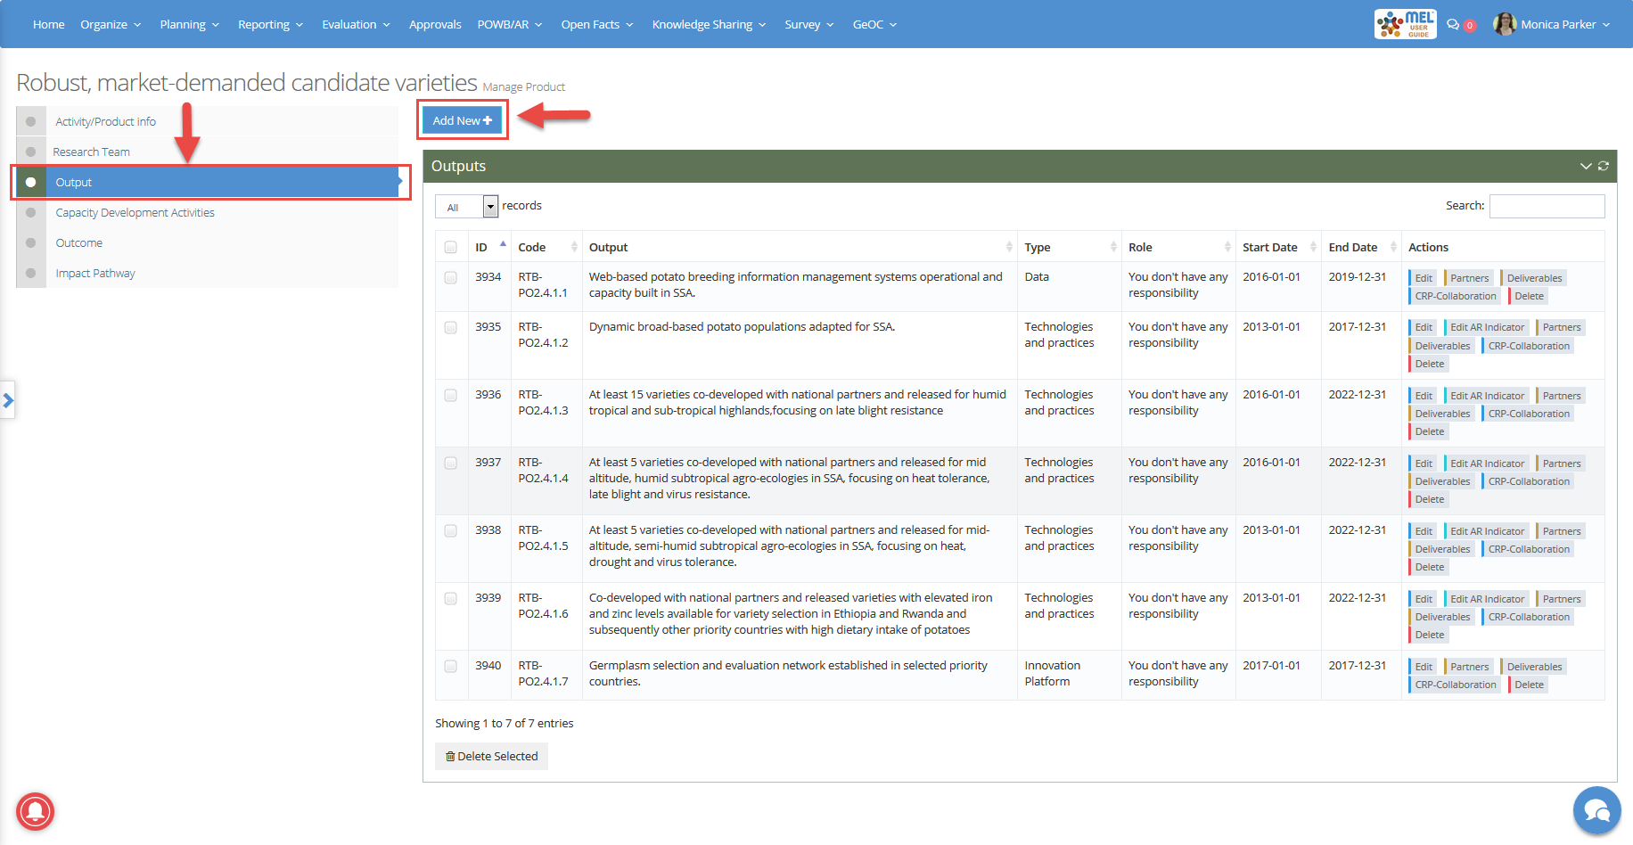
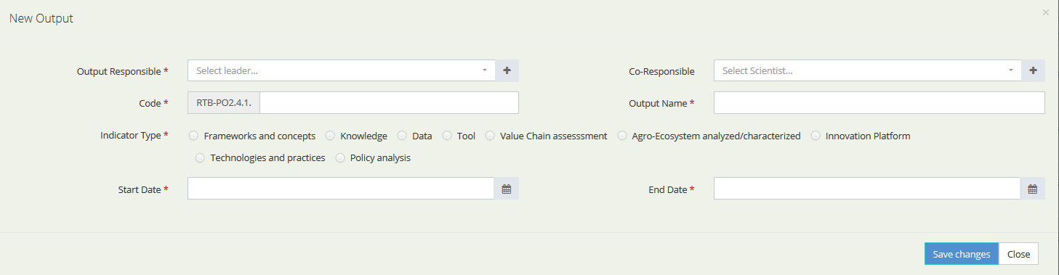
Select the «Output» tab and click on «Add New»
Provide the needed information to characterize the new output and then save the changes

Slide 6
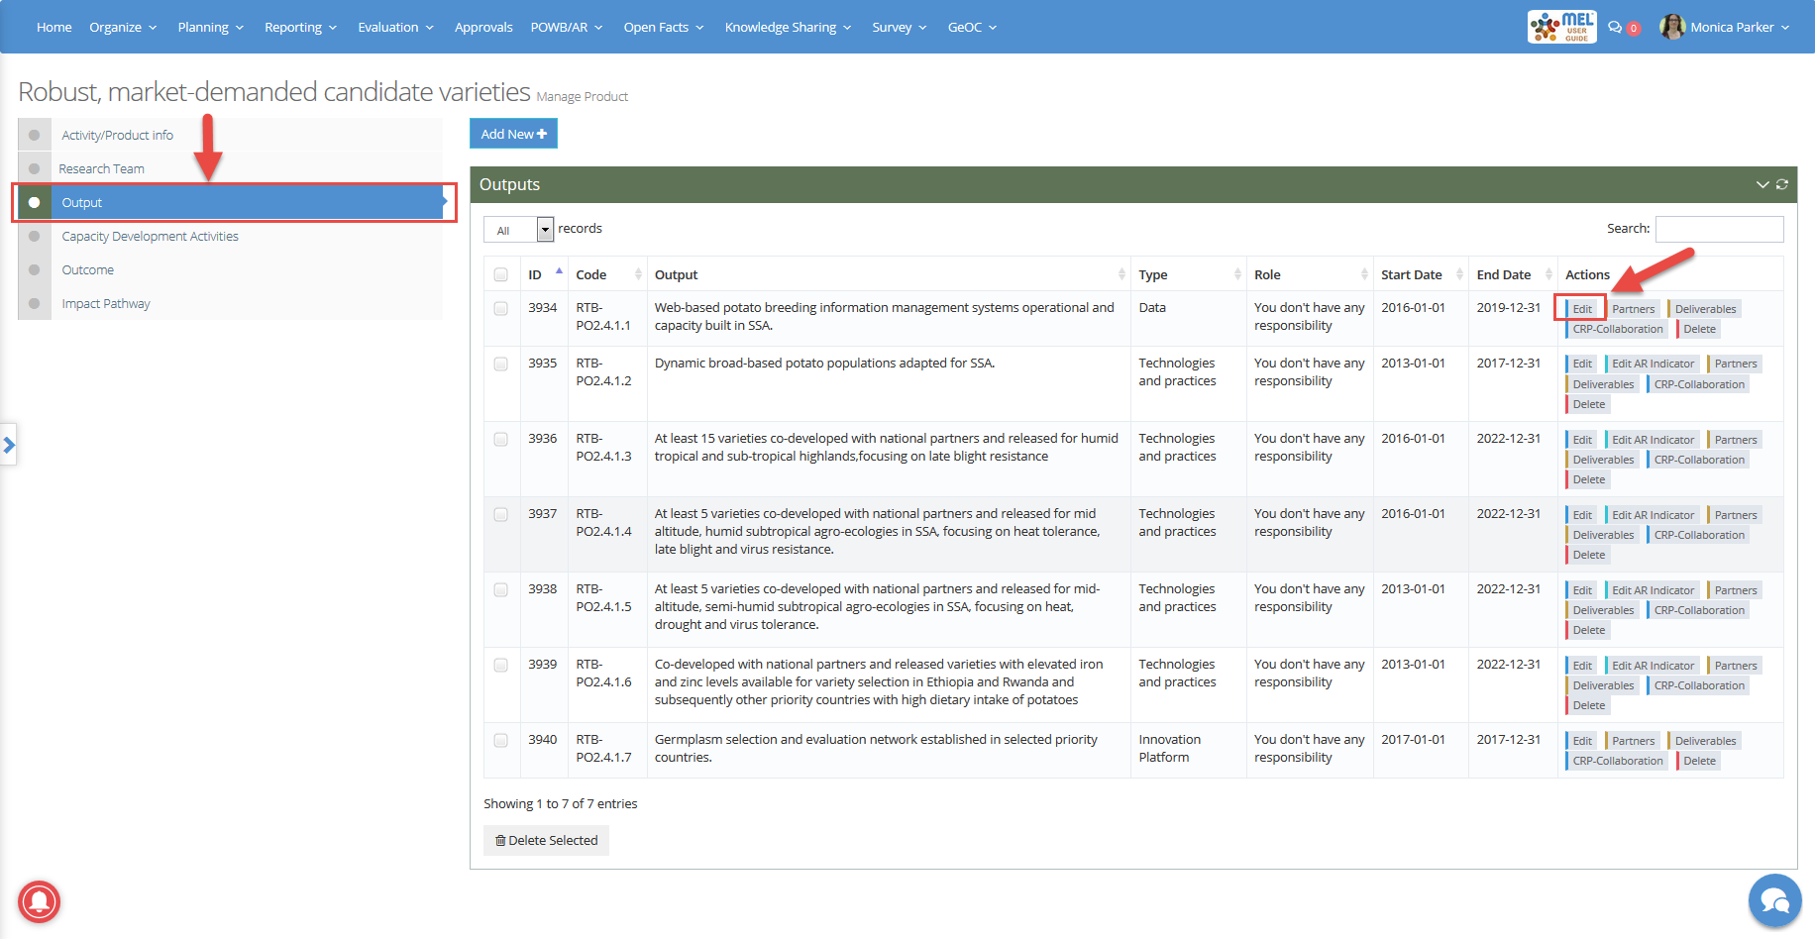
The steps for editing new and existing outputs are the same. Leaders of outputs, products and clusters may follow the same instructions
In the «Output» tab, identify the output you want to update and click on «Edit»

Slide 7
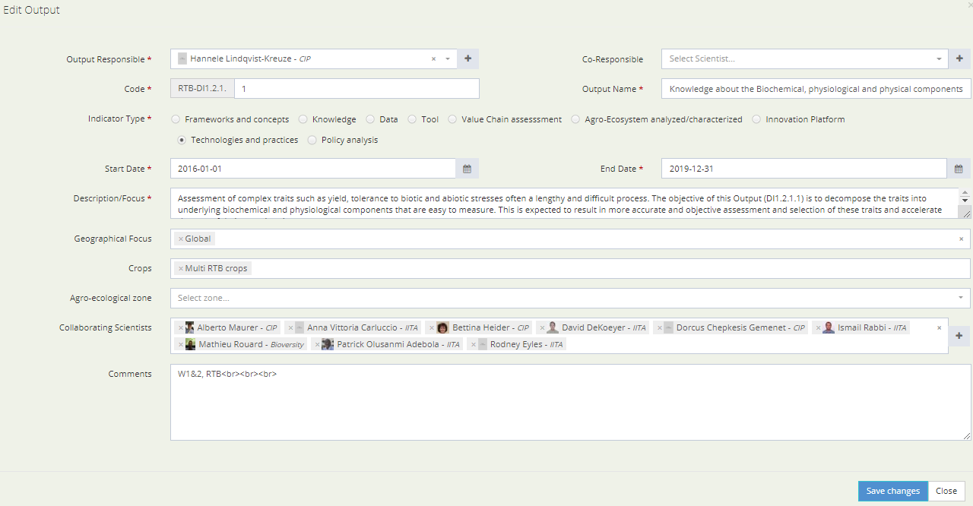
Revise and complete all the information related to the output
In particular, revise: 1) start and end date, and 2) list of collaborating scientists
When you’ve updated the information, click on «Save changes»

Slide 8



For more detailed information on how to use MEL please use the online guide
You need support?
Chat with us or send us and email
Thanks for using MEL

