Slide 1
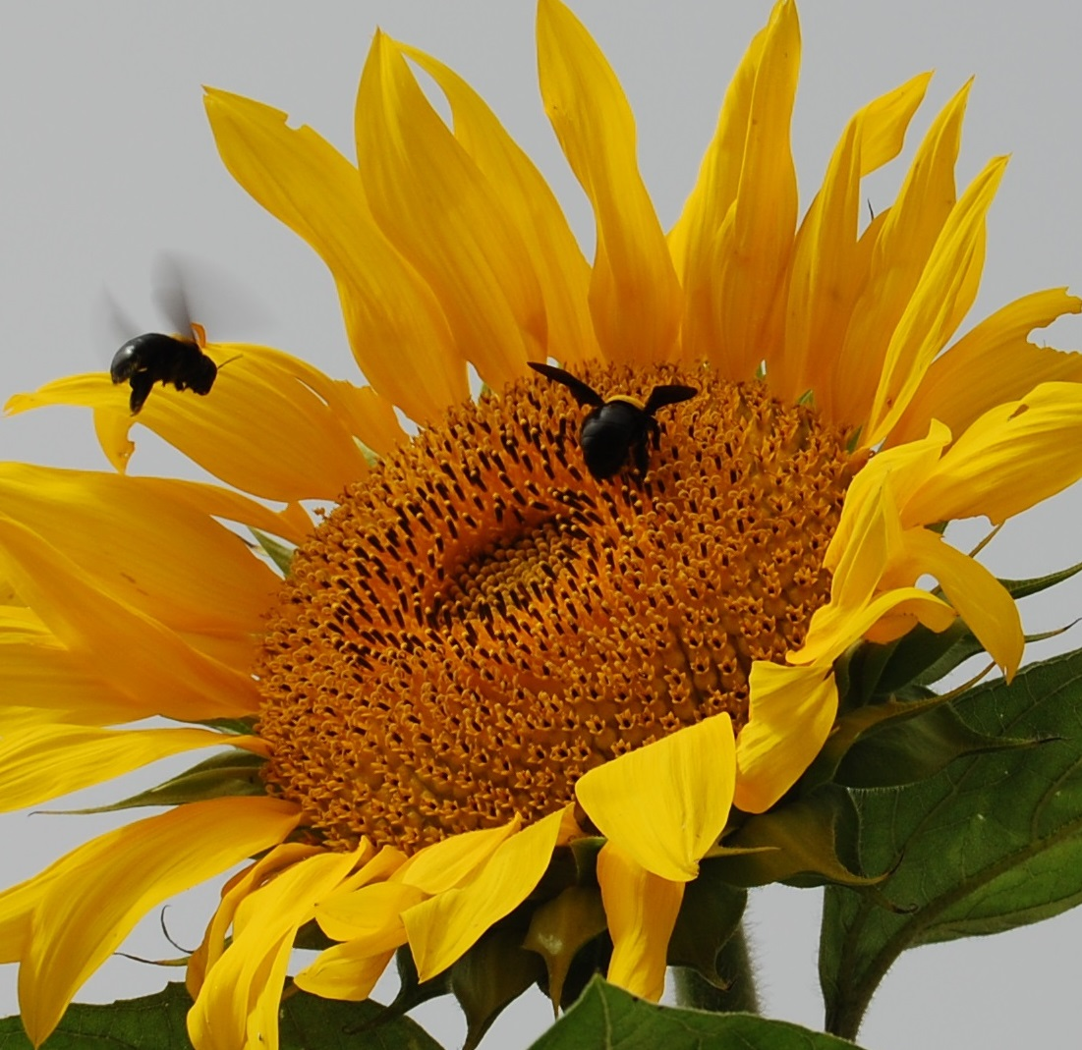
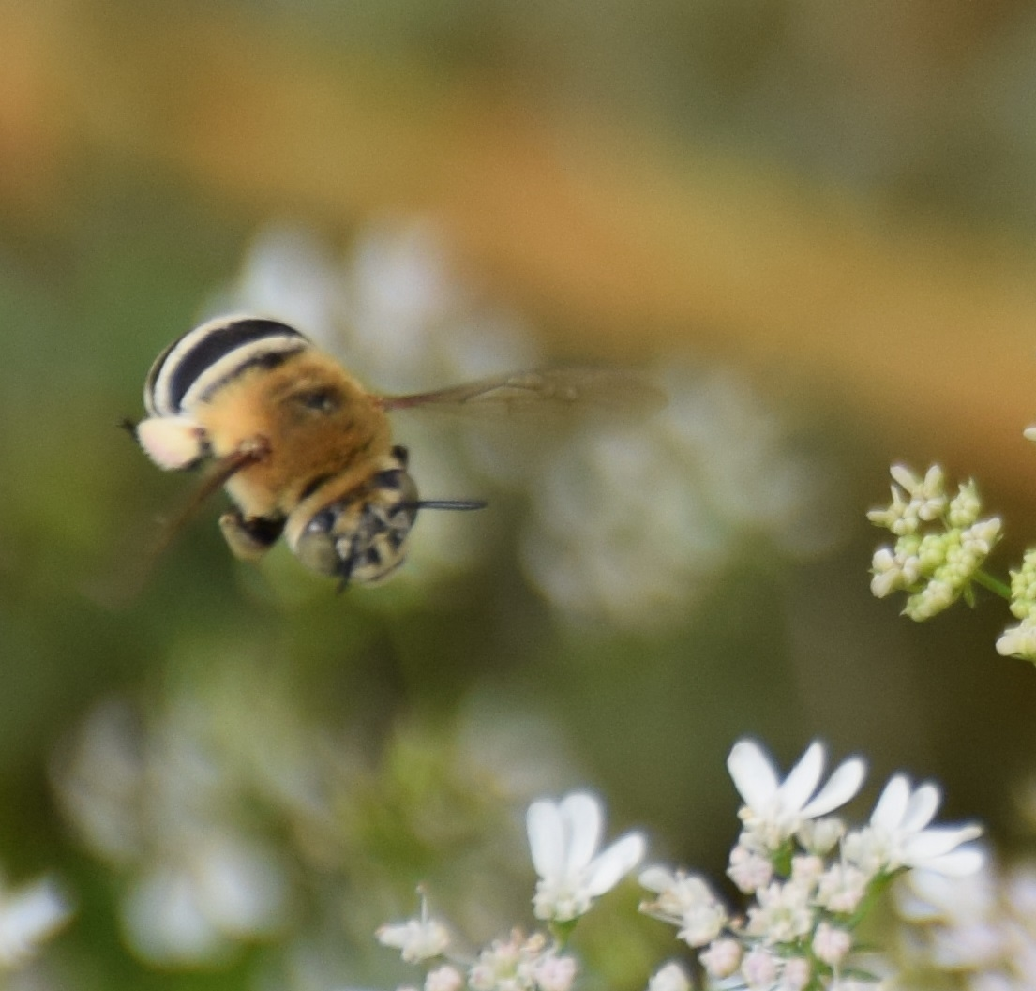
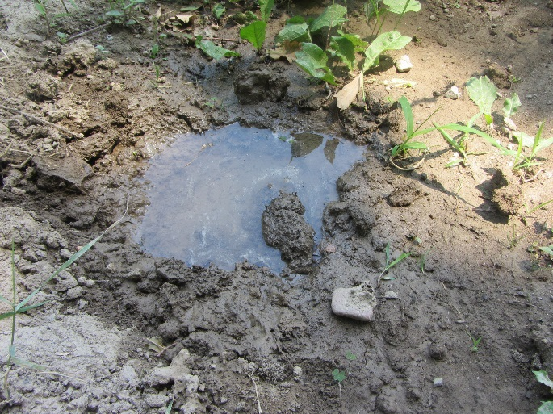
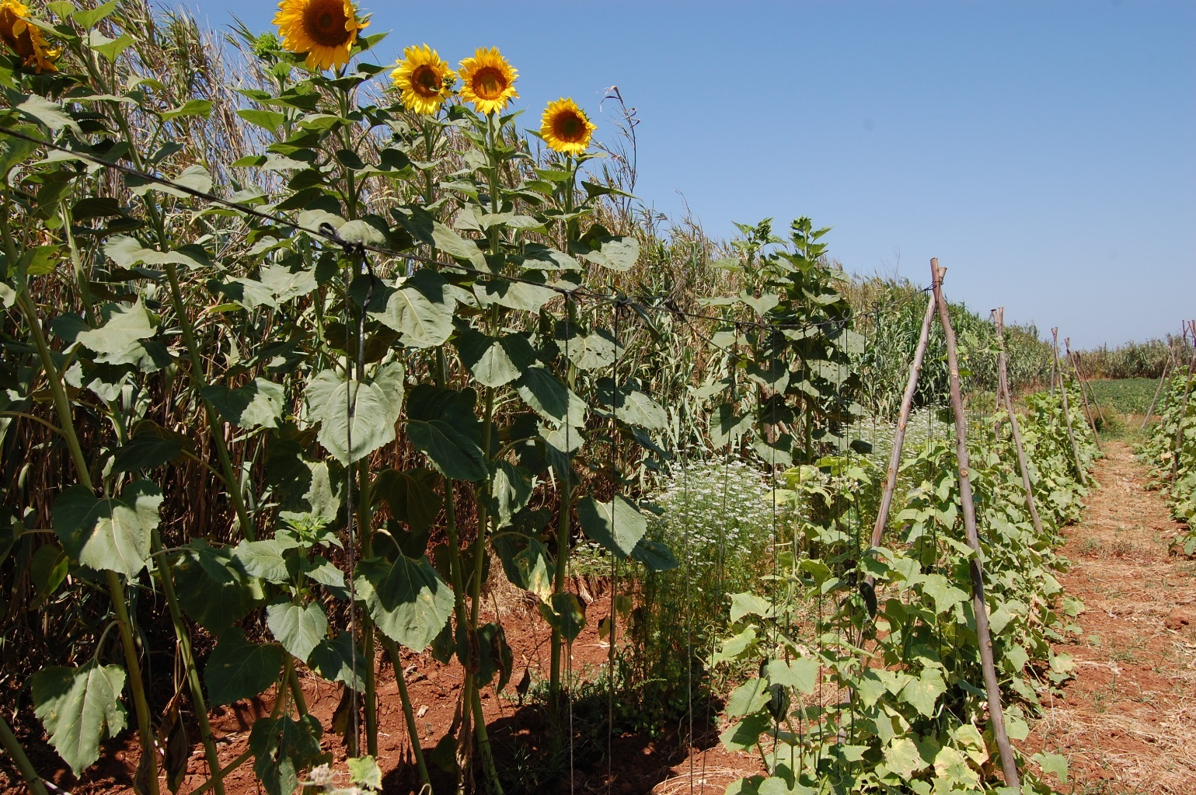

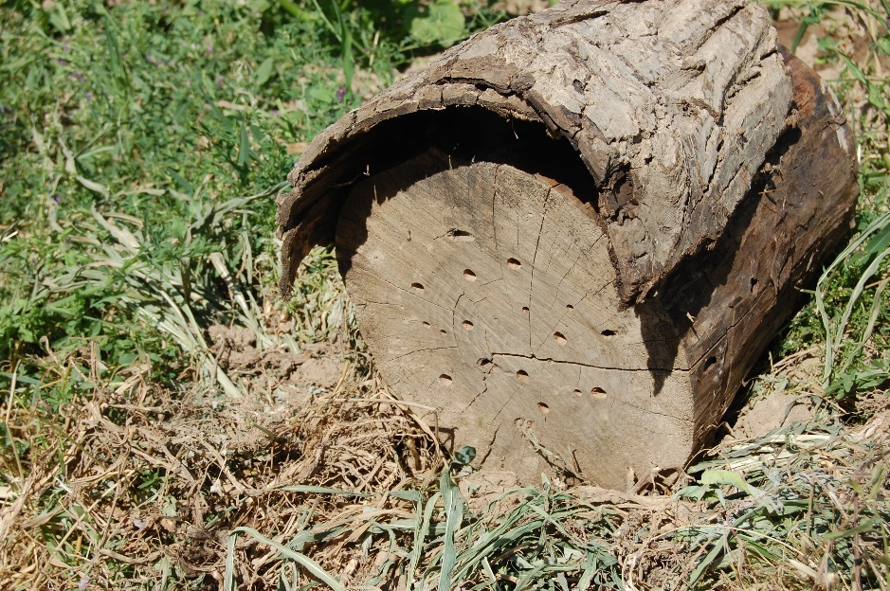
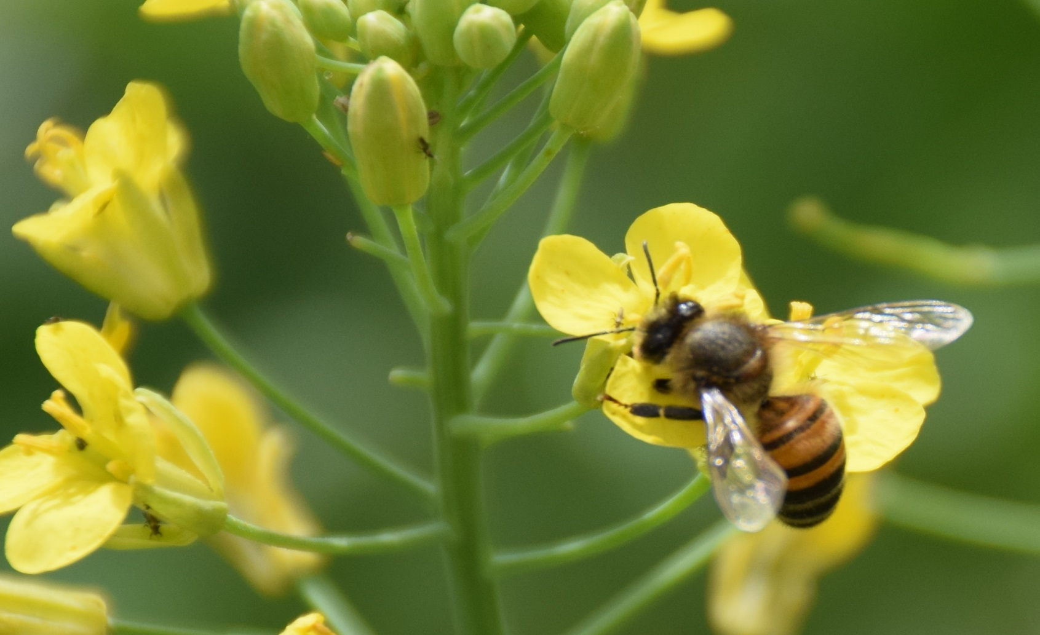
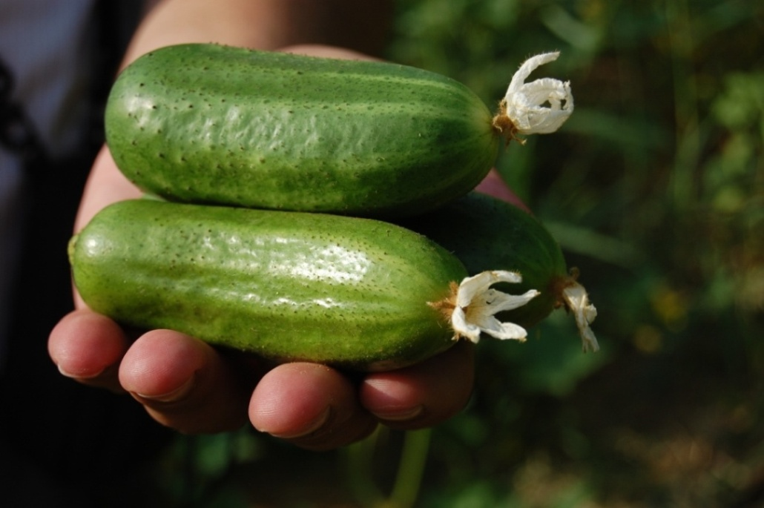
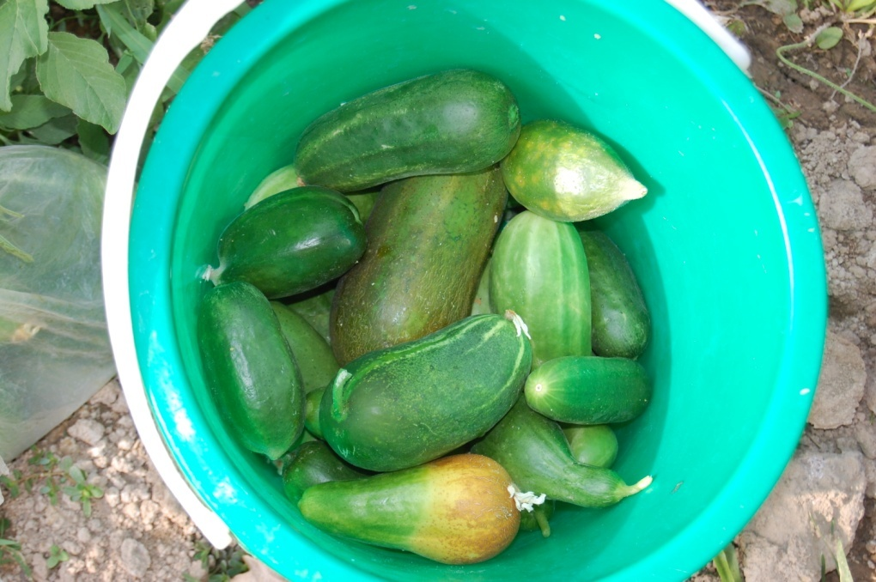
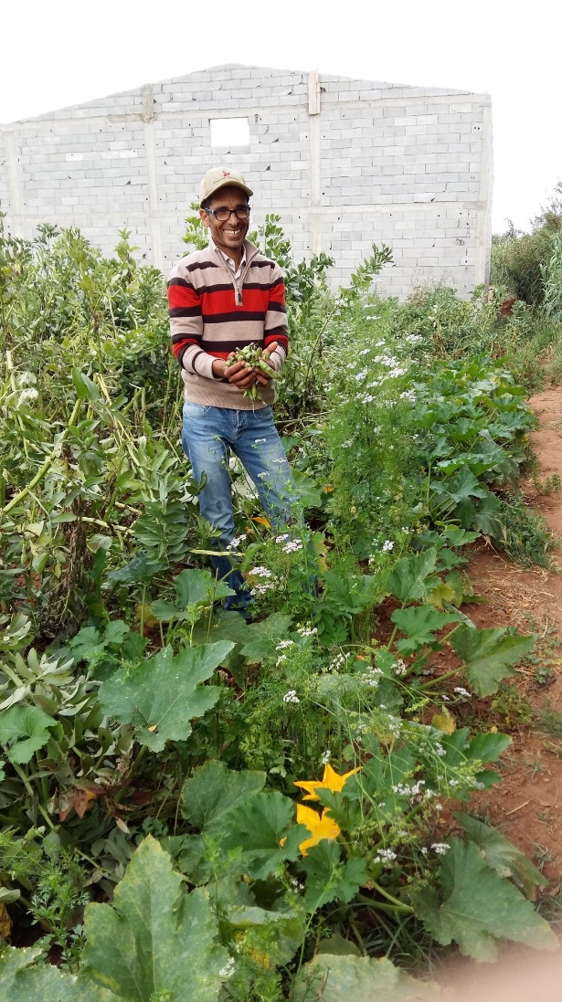
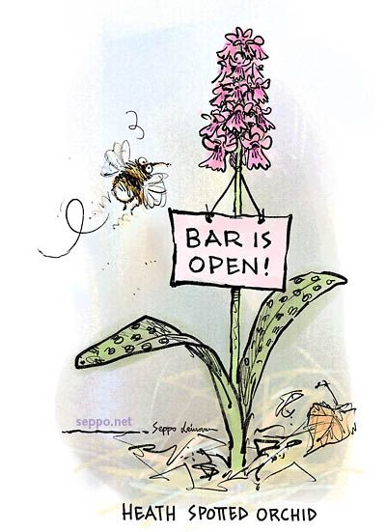
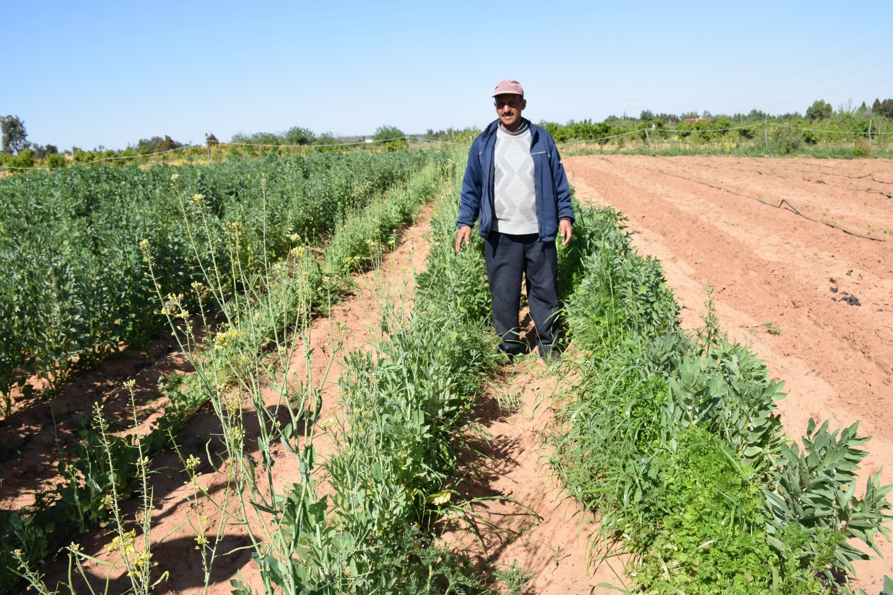




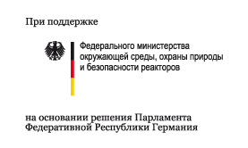

Farming with Alternative Pollinators (FAP) Creates High Incentives for Farmers for Pollinator Friendly Agriculture
Christmann, Stefanie¹, Smaili, Moulay Chrif², Benbya, Abdellah³, Rajabov, Toshpulot⁴, Tsivelikas, Athanasios¹
1) ICARDA, POB 6299, 10112 Rabat, Morocco, e-mail: s.christmann@cgiar.org
2) Institut National de la Recherche Agronomique (INRA), Laboratoire d’Entomologie, BP 257, 14000 Kenitra, Morocco
3) University Mohammed-V, Dept. of Biology, Laboratory of Plant Physiology and Biotechnology, Morocco
4) Samarkand State University, 140104 Samarkand, Uzbekistan
Introduction
Currently, environmental research on pollinator decline does not trigger broad protection of pollinators in particular in agricultural landscapes. Prevailing environmental recommendations, e.g. seeding wildflower strips in and between fields, don’t take farmers’ interests into account. Farmers prefer income from the entire area and they regard wildflowers as weeds potentially spreading their seeds all over the field.
The Farming with Alternative Pollinators (FAP) approach
Whereas the new agricultural Farming with Alternative Pollinators (FAP) approach uses marketable plants for habitat enhancement and avoids spread of weeds. FAP triggers farmers’ motivation to enhance habitats in fields based on evidence of increased income. FAP measures the impact of enhanced habitats (25% of the field) on the diversity of pollinators and predators and on the total net income in comparison to control fields having the main crop on 100% of the field. The habitat enhancement includes (1) marketable plants (crops, berries, medicinal plants, spices, forage) to attract more pollinators during the flowering of the main crop and sustain pollinators after the main crop ended flowering,(2) shelter plants like sunflower or raspberry against wind, (3) nesting support, (4) water.
Figure 1 and 2 and photos: FAP field sketches for small and large fields, dark green: the main crop, bright green: the habitat enhancement
Results
Pilot projects in Uzbekistan with cucumber and sour cherry as main crops and in Morocco with cucumber as main crop proved high increase of yields of the main crop and higher income per surface based on higher diversity and abundance of pollinators and predators in FAP-fields. In total income from FAP fields was more than double in comparison to control. As insect species highly differ in Central Asia and North Africa the approach proved replicability.
Discussion
The incentive of large income gain makes FAP scalable. FAP obviates the need to reward farmers for pollinator-friendly practices. Different to current recommendations of The Intergovernmental Science-Policy Platform on Biodiversity and Ecosystem Services (IPBES; Potts et al. 2016) – rewarding farmers, Payments for Ecosystem Services – FAP is an option for pollinator protection also in Middle and Low Income Countries.
Conclusion
Trials on more crops are recommended. In case they demonstrate substantial income increases as well, FAP might have high potential to protect pollinators and simultaneously enhance food security. Currently, the increase of horticulture production is mainly based on increase of area, whereas FAP increases the productivity per ha. Thus FAP might reduce the loss of forests and rangelands for establishment of additional fields and orchards. FAP is applicable also in low income countries, which cannot afford subsidies as e.g. the European Union pays.
References
Christmann, S. Aw-Hassan, A., Rajabov, T., Khamraev, A.S., Tsivelikas, A. 2017. Farming with Alternative Pollinators increases yields and incomes of cucumber and sour cherry. Agron. Sustain. Dev. DOI: 10.1007/s13593-017-0433-y
Christmann, S., Aw-Hassan A.A., 2012. Farming with Alternative Pollinators (FAP) – an overlooked win-win-strategy for climate change adaptation. In: ‎Agric. Ecosyst. Environ. 161, 161-164.
Potts, S.G., Imperatriz-Fonseca, V., Ngo, H.T. & Aizen, M.A. 2016. The assessment report on Pollinators, Pollination and Food Production. Summary for Policymakers. IPBES, Bonn. http://www.ipbes.net/sites/default/files/downloads/pdf/spm_deliverable_3a_pollination_20161124.pdf
Photo 1: Xyolocopa pollinating sunflower
Figure 1: FAP impact on the procuctivity of sour cherry, 2014 Uzbekistan
Photo 2: Coriander is by now the most effective habitat plant
Figure 2: FAP impact on total net income from cucumber, Uzbekistan 2013
Photo 3: Wild pollinator attracted to canola, habitat plant for faba bean
Figure 3: FAP impact on total net income from cucumber, Morocco 2016
Photos 4 (FAP) and 5 (control): FAP increases mainly the quantity, but enhances also quality of crops
Tropentag Bonn, 20 September 2017, poster session
„Biodiversity and uderutilized species“

