Slide 1



Universität für Bodenkultur Wien
Department für Wasser-Atmosphäre-
Umwelt
Application of soil erosion models
in the Gumara-Maksegnit watershed
Andreas Klik, Hailu Kendie, Nigus Melaku, Roman Schiffer, Stefan Strohmeier, Chris Renschler, Omotayo Akinjiyan, and Claudio Zucca
Institute of Hydraulics and
Rural Water Management
University of Natural Resources and Life Sciences, Vienna
Final Project Meeting
Bahir Dar,
June 20-21, 2016

Slide 2
Why do we use simulation models?
Advantage of soil erosion modeling (Bork, 1991)
Efficient and fast assessment of short-, mid- and long-term impacts
of different land use and land management scenarios
Analysis and evaluation of interactions between processes
Identification of research gaps
Evaluation of climate change impacts on runoff and erosion
Model requirements
Applicable to the problem
consistent and repeatable results
cover full range of conditions (climate, soils, vegetation, management,....)
can be used with available resources
quality of results adequate and comparable
transferability to other regions
Applied soil erosion models
SWAT Soil and Water Assessment Tool
WEPP Water Erosion Prediction Project
Partly physically based, partly stochastic
Large river basins (several 1000 km²)
Continuous simulation
Physically based
Small catchments (> 10 km²)
Continuous and single storm simulation

Slide 3
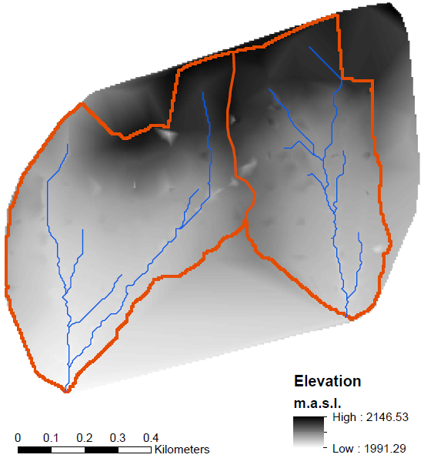
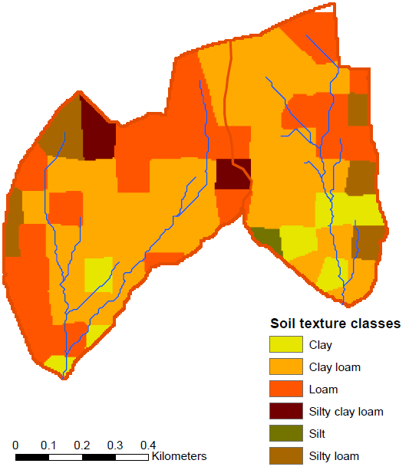
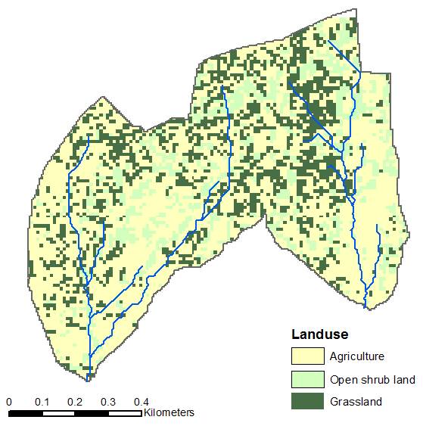
SWAT model input
Digital elevation model
Soil texture classes
Landuse
Five soil texture classes based on field sampling
Derived from satellite images
Climate data 1997 - 2013
Two crop rotation were implemented in the model: sorghum – chickpea - teff
sorghum - faba bean - barley

Slide 4
SWAT calibration data

Slide 5
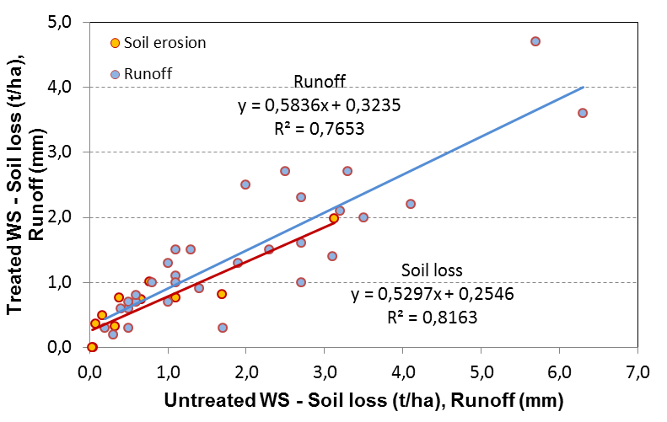
Results
Influence of the soil conservation measures in Ayaye
Ayaye (treated WS) delivers 42% less runoff and 47% less sediment yield than Aba Kaloye

Slide 6
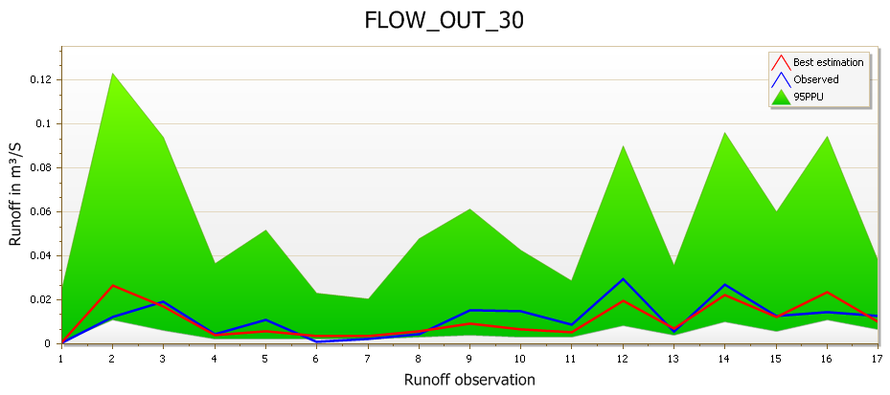
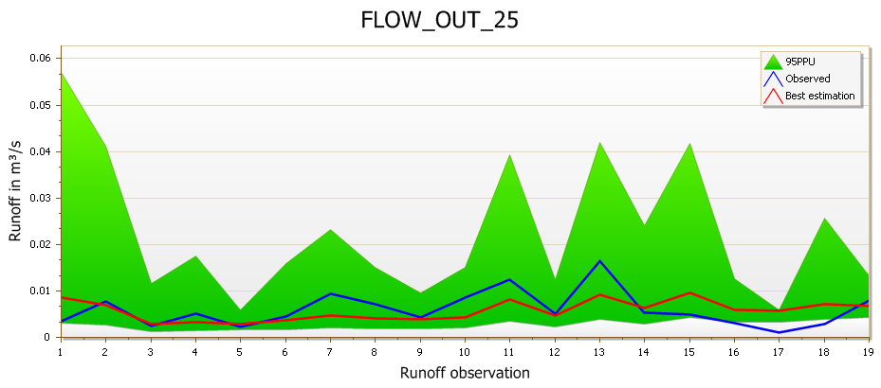
Results
Calibration results Aba-Kaloye – calibration period 2012
Observed and estimated runoff Aba-Kaloye 2012
Observed and estimated runoff Ayaye 2012

Slide 7
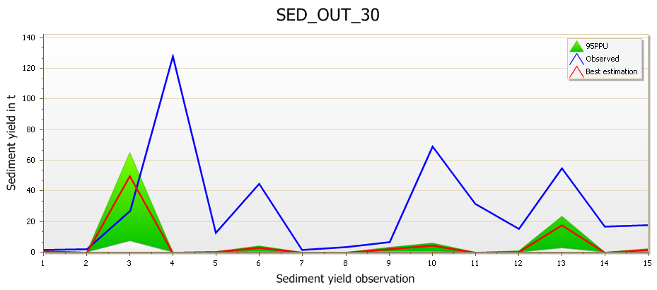
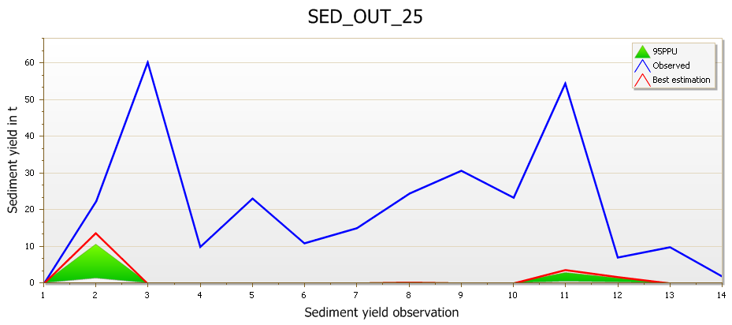
Results
Calibration results Aba-Kaloye – calibration period 2012
Observed and estimated sediment yield Aba-Kaloye 2012
Observed and estimated sediment yield Ayaye 2012

Slide 8
Seasonal budget sediment yield
Model period 2001-2012, warm up period 5 years
 | Precip mm | Untreated t/ha | Treated t/ha
2006 | 1482 | 30.9 | 19.1
2007 | 1480 | 29.7 | 13.3
2008 | 1206 | 32.8 | 24.5
2009 | 1041 | 34.6 | 27.5
2010 | 1119 | 40.3 | 30.8
2011 | 1397 | 77.9 | 105.3
2012 | 942 | 18.4 | 6.5
Average |  | 37.8 | 32.4
-14%
Mean crop yield – model period 2001-2012
 | Teff | Sorghum | Barley | Wheat | Chickpea | Faba Beans
 | kg/ha | kg/ha | kg/ha | kg/ha | kg/ha | kg/ha
Goal | 1700 | 1200 | 2400 | 2500 | 2600 | 3000
Simulation | 1512 | 898 | 2248 | 2576 | 2398 | 2951

Slide 9
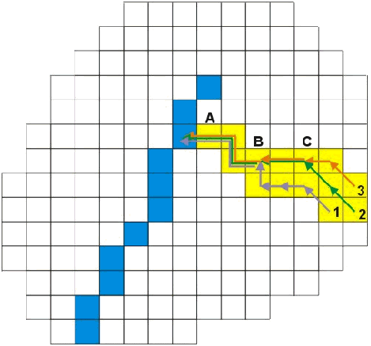
GeoWEPP - Watershed simulation
Off-site Assessment
Watershed Method
On-site Assessment
Flowpath Method
Representative processes
for hillslopes and channels
(aggregation before WEPP run)
Representative processes for distributed flowpaths
(aggregation after WEPP run)

Slide 10
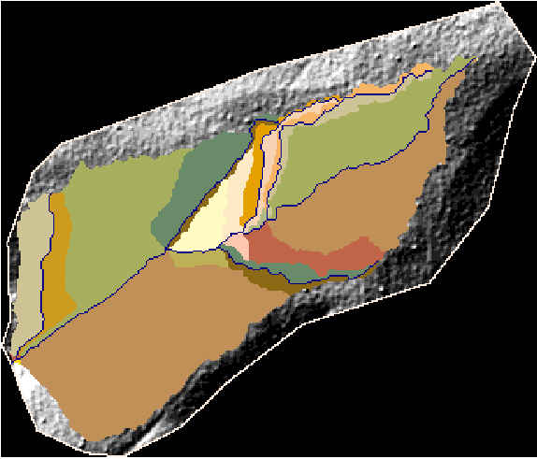
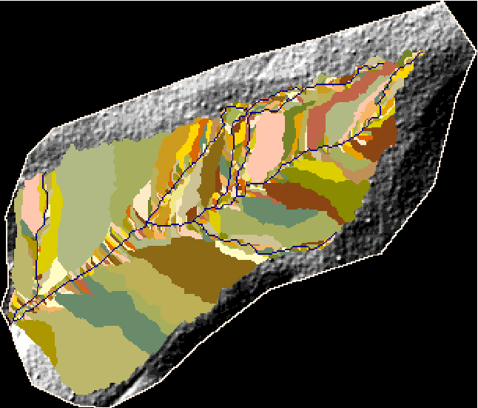
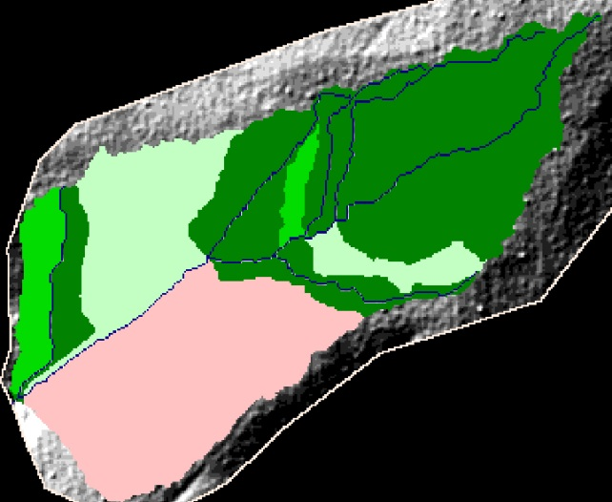
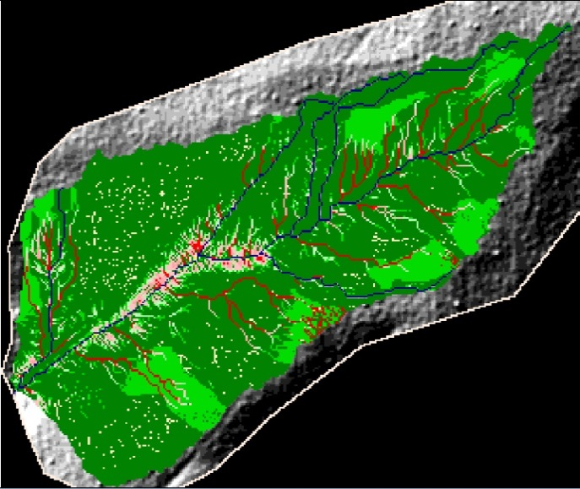
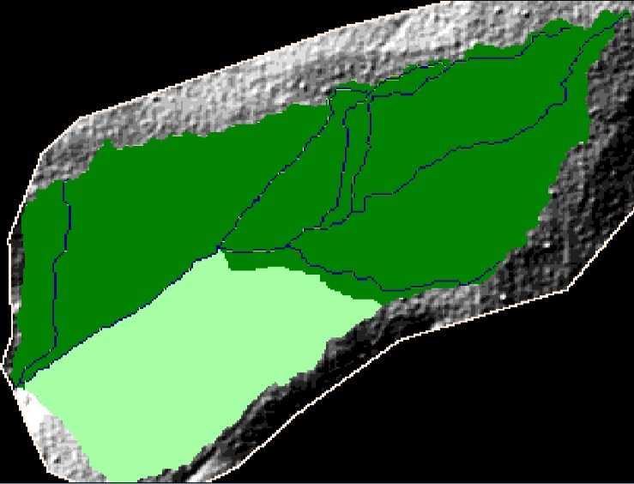
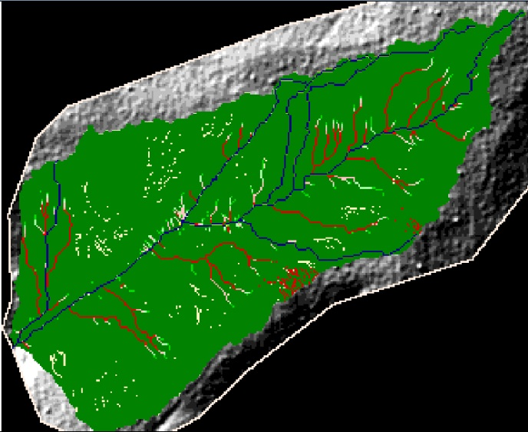
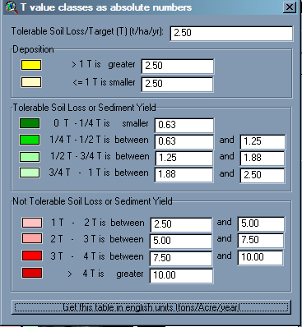
WEPP Watershed Model
Off-site Assessment
Watershed Method
On-site Assessment
Flowpath Method

Slide 11
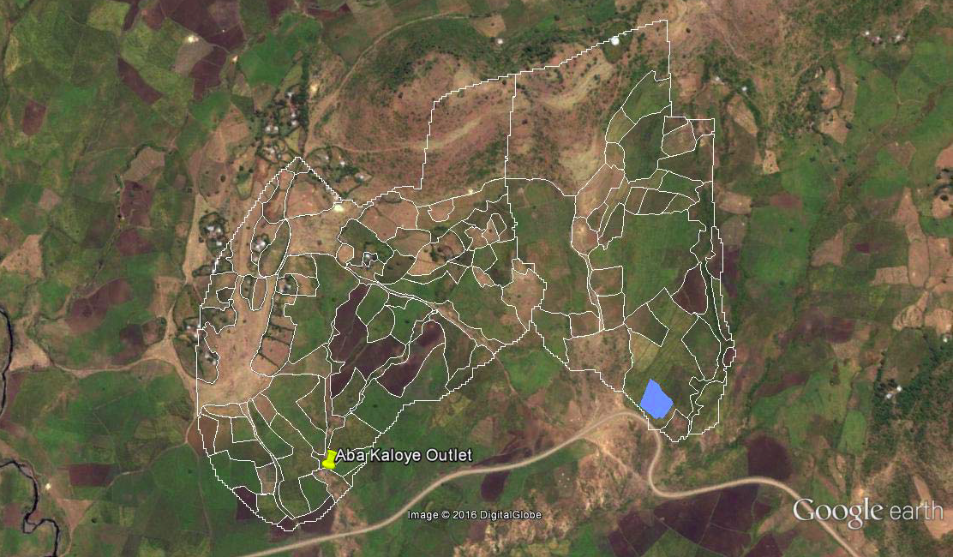
WEPP inputs – Land use
Google Earth – October 2011
Land use map derived from Google Earth

Slide 12
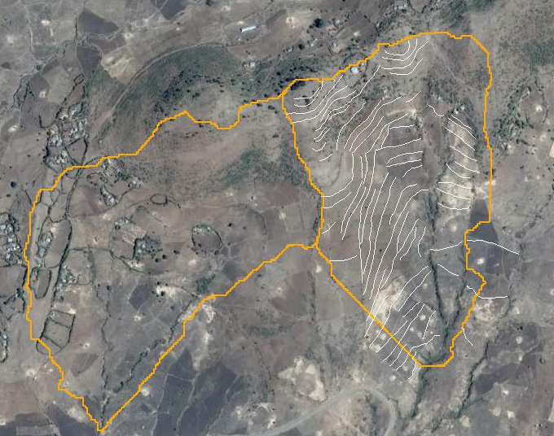
WEPP inputs – Stone bunds

Slide 13
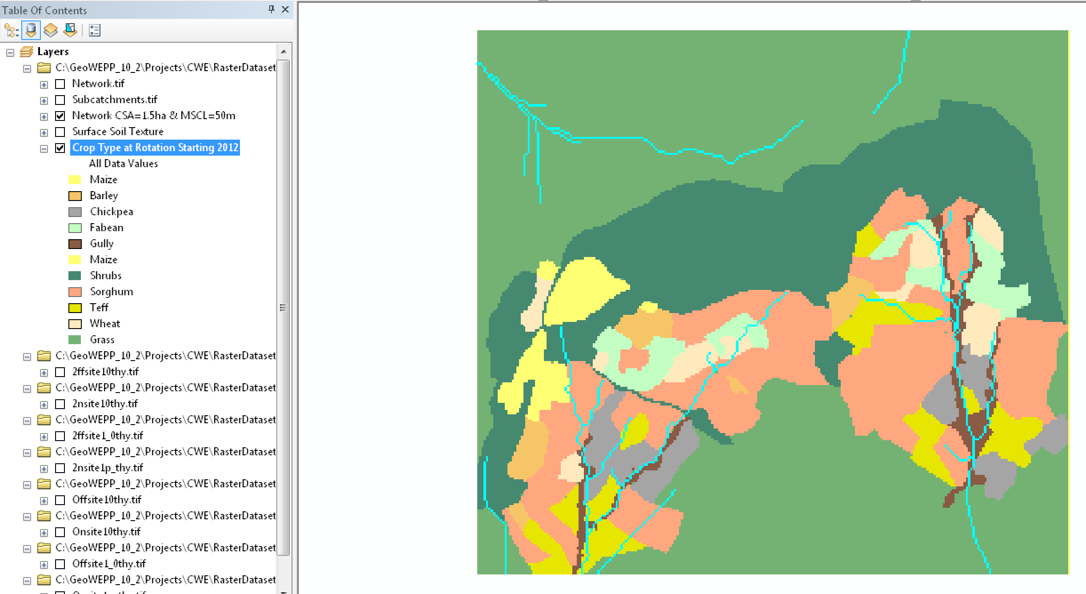
WEPP inputs
Crop and mnagement files from WEPP data base and adapted to Ethiopian conditions (e.g. crop height, crop coverage, crop density, max. crop yield, tillage depth, surface roughness,…)

Slide 14
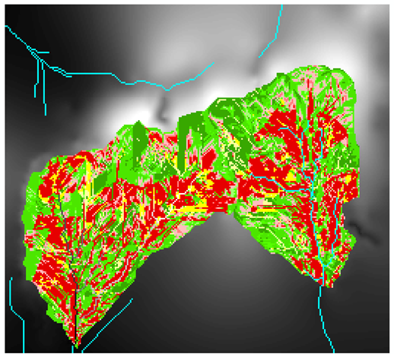
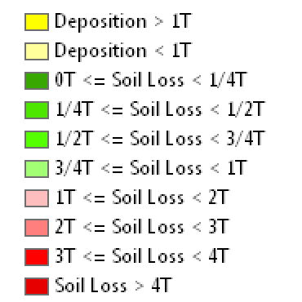
WEPP results - On Site
Spatial soil erosion and deposition pattern within the watershed
Period 2012-2014
1 T = 10 t / ha / yr

Slide 15
Gumara Maksegnit Watershed, Ethiopia
71 storms produced 808.53 mm.
Aba Kaloye (without stone bunds)
43 events produced 146.7 mm of runoff
Total contributing area to outlet = 31.80 ha
Avg. Ann. total hillslope soil loss = 3284 tonnes/yr
Avg. Ann. total channel soil loss = 623 tonnes/yr
Avg. Ann. sediment discharge from outlet = 2230.3 tonnes/yr
Avg. Ann. Sed. delivery per unit area of watershed = 70.1 T/ha/yr
Sediment Delivery Ratio for Watershed = 0.571
Ayaye (with stone bunds)
40 events produced 150.2 mm of runoff
Total contributing area to outlet = 25.83 ha
Avg. Ann. total hillslope soil loss = 2337 tonnes/yr
Avg. Ann. total channel soil loss = 334 tonnes/yr
Avg. Ann. sediment discharge from outlet = 1253 tonnes/yr
Avg. Ann. Sed. delivery per unit area of watershed = 48.5 T/ha/yr
Sediment Delivery Ratio for Watershed = 0.469
No change in runoff but 31% less sediment yield in Aba Kaloye than in Ayaye

Slide 16
Comparison – Ayaye with and without stone bunds
Ayaye with stone bunds
40 events produced 150.2 mm.of runoff
Total contributing area to outlet = 25.83 ha
Avg. Ann. total hillslope soil loss = 2337 tonnes/yr
Avg. Ann. total channel soil loss = 334 tonnes/yr
Avg. Ann. sediment discharge from outlet = 1253 tonnes/yr
Avg. Ann. Sed. delivery per unit area of watershed = 48.5 T/ha/yr
Ayaye without Stonebunds
40 events produced 148.8 mm. of runoff
Total contributing area to outlet = 24.08 ha
Avg. Ann. total hillslope soil loss = 1728 tonnes/yr
Avg. Ann. total channel soil loss = 425 tonnes/yr
Avg. Ann. sediment discharge from outlet = 1345 tonnes/yr
Avg. Ann. Sed. delivery per unit area of watershed = 55.9 T/ha/yr
Appr. 14% reduction in sediment yield due to stone bunds

Slide 17
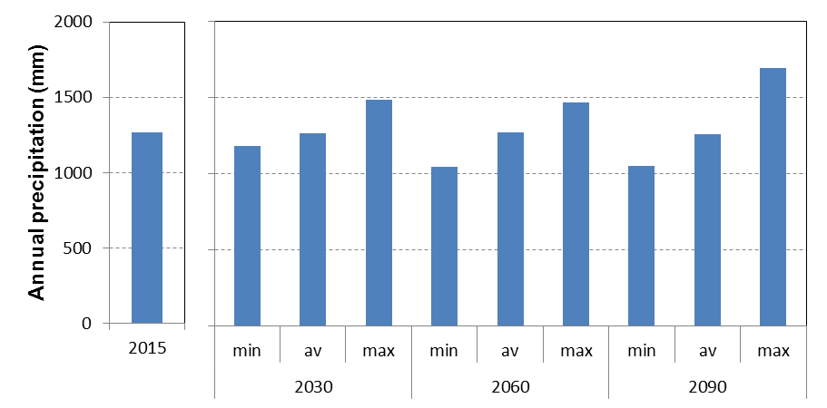
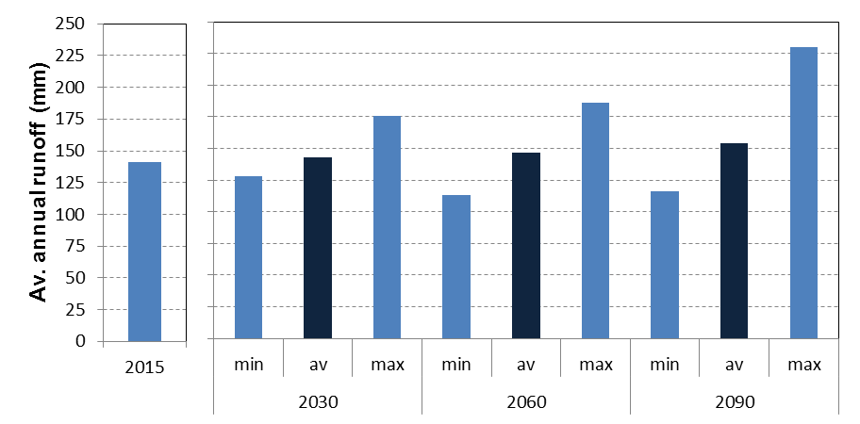
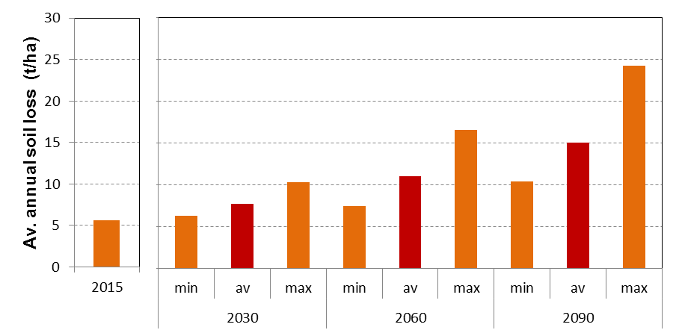
Impact of Climate Change
WEPP hillslope model
50 m length
9% slope
no stone bunds considered
Climate Scenarios for Bahir Dar: 2015, 2030, 2060, 2090 (100 yrs simulation)
Climate scenarios with minimum, average and maximum precipitation
Surface runoff
average runoff coefficient increases from 0.11 to 0.12
Crop yield
No impact on faba bean but significant decrease for wheat and barley
Sediment yield
average sediment yield increases by 32% (2030), 96% (2060) and 168% (2090)
Max sediment yield increases by 84, 195, and 332%

Slide 18
Summary and Conclusions
General conclusions
Data need for distributed physically based models higher than for stochastic models
Type of model dictated by the availability of data (USLE vs. process-based)
Performance of models on a longer term basis mostly good to acceptable
Runoff prediction usually better than soil loss assessments
Most soil erosion models are developed in humid regions; crop, management and SWC parameterization need to be adapted to regional specific conditions
Quality of output depends on quality of input data and the ability of the model to represent the driving processes
Never perform simulations from your desk without knowing exactly the watershed!
WEPP
- Higher input data need (climate, crop, management,…)
+ Better understanding and representation of processes
+ Derivation of model parameters which can be implemented into large scale lumped models
SWAT
Sub-daily processes are not reflected (high intensity rainfall!)
- Capability on sub-catchment scale remains open question
+ Lower input data requirement and therefore applicable to large basins
+ Transparent calibration procedure available (uncertainty!)

