Slide 1
How to report
CapDev activities
Learn how to report CapDev activities in MEL
in 1 minute

Slide 2
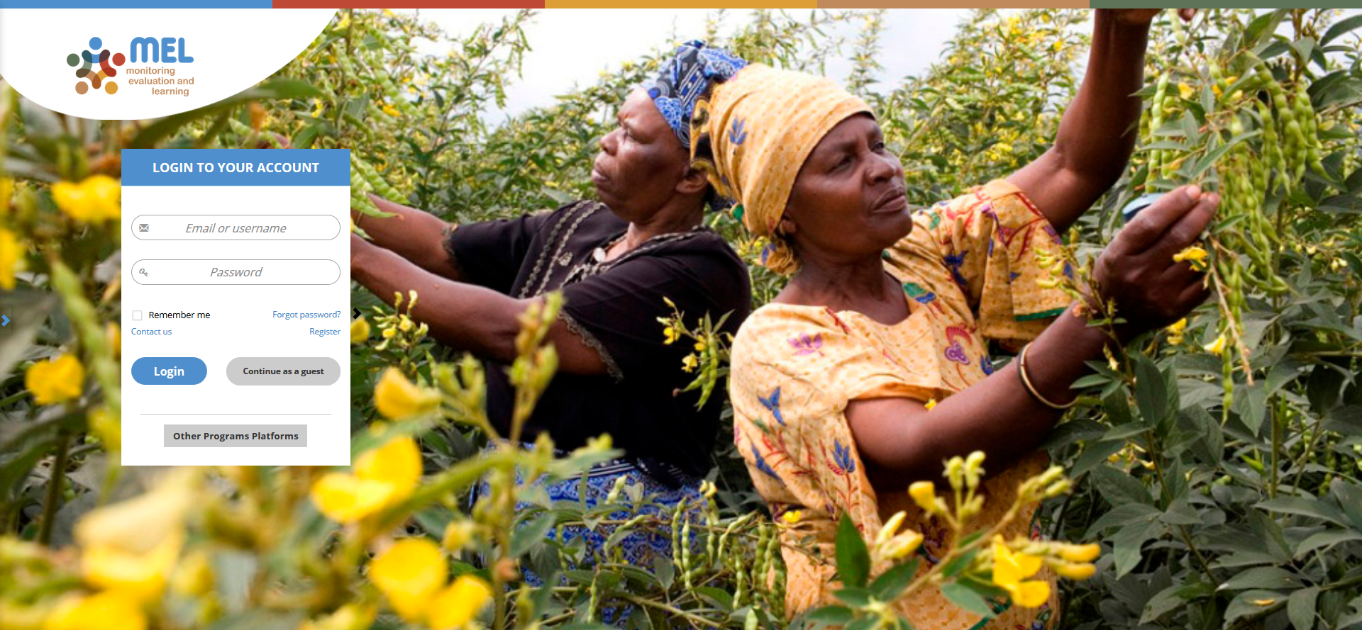
Go to mel.cgiar.org and login to your account
Use your email and password to login
Click on «Forgot password?» if you need to change your credentials

Slide 3
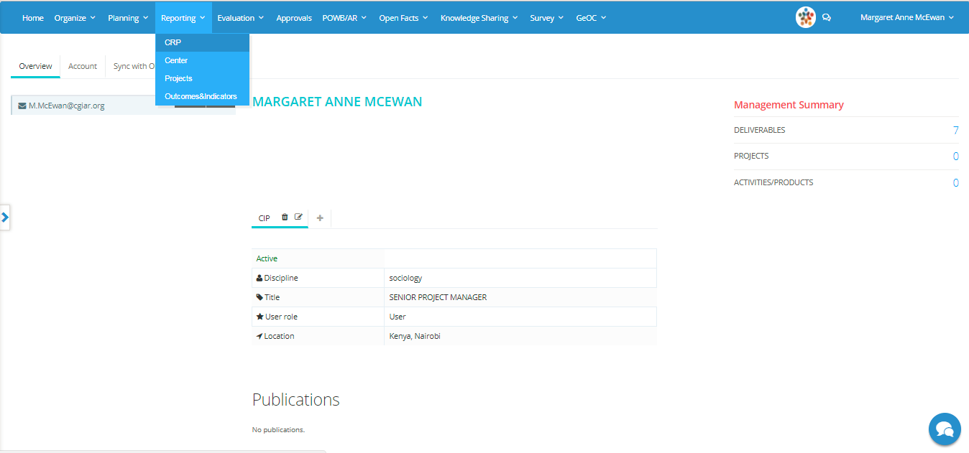
Click on the Reporting menu and select the reporting framework
You may select CRP, Center or Projects depending on the framework under which your deliverable has been planned

Slide 4
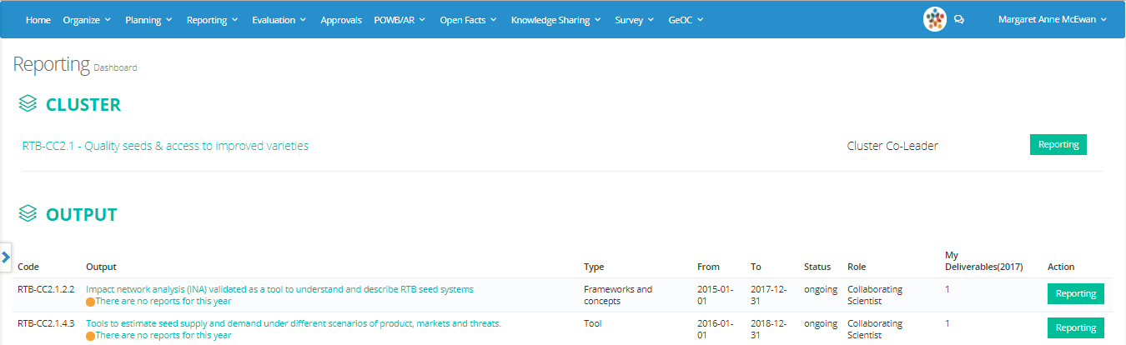
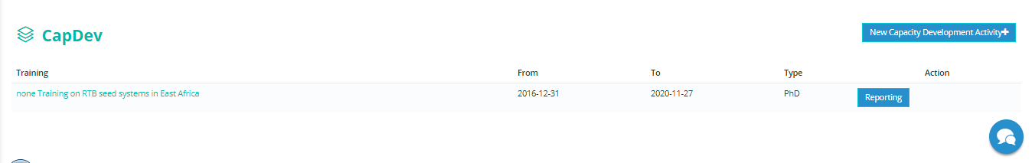
In the reporting dashboard identify the CapDev section
Click on «Reporting» if the activity was planned
Or, click on «New Capacity Development Activity» to add an unplanned activity

Slide 5
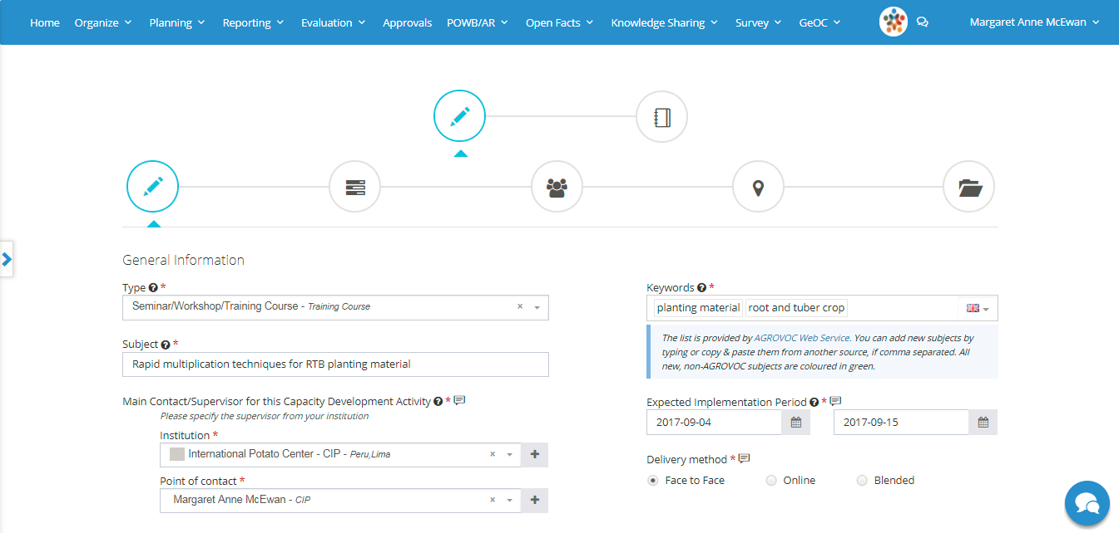
If the activity is new, you have to provide the following information
Select a Type from the predefined list and specify the subject
Add some keywords using the AGROVOC web service
Define the expected implementation period
Depending on the selected type, more details may be requested. Remember that the fields with a red asterisk * are mandatory

Slide 6
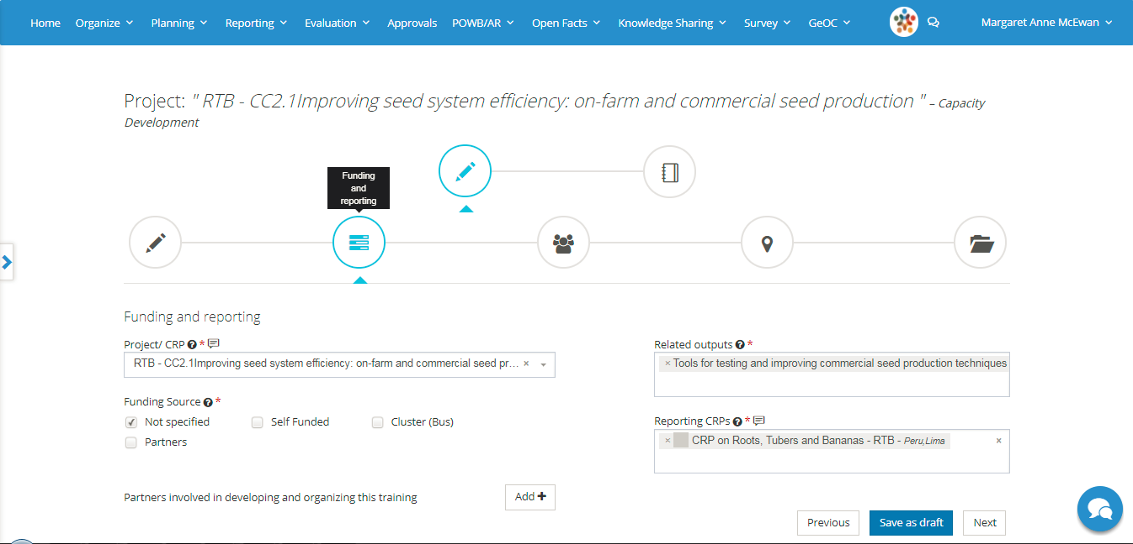
Select the project or the CRP activity/product linked with the CapDev activity
Add the output(s) related to the CapDev activity. The reporting CRP will automatically appear
Specify the funding sources
Add the partners involved in the organization of the activity
Click on «Next» and proceed to the third step

Slide 7
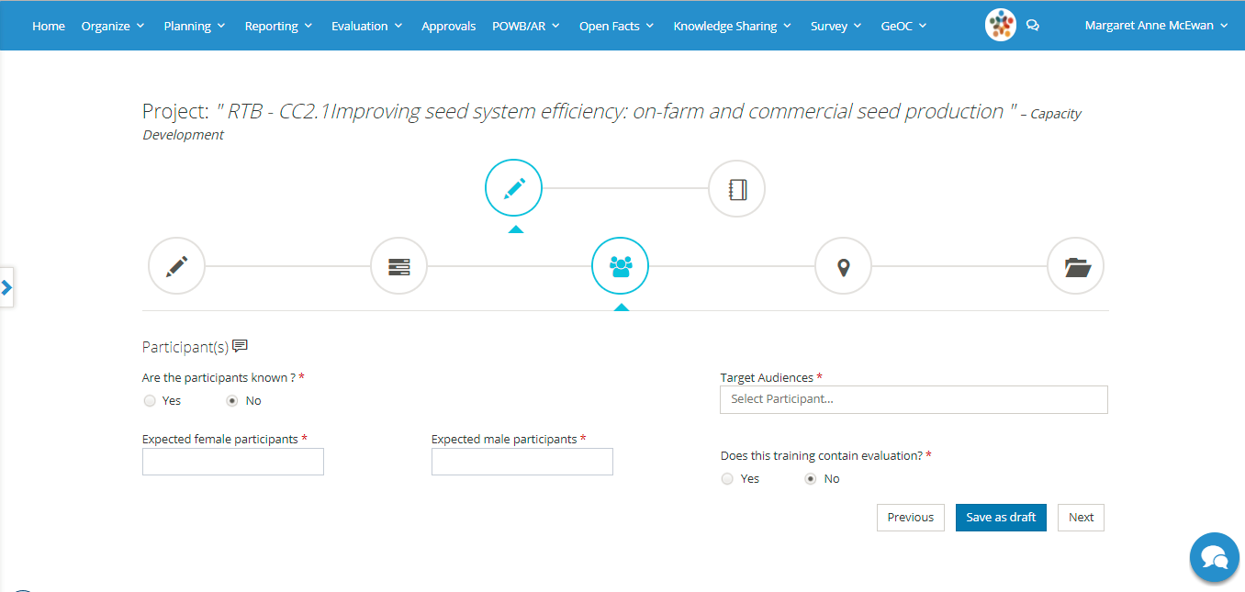
Add the expected participants
If you already know the participants you may add a detailed list
If the exact list of participants is not available add the expected number disaggregated by sex
Specify the target audience
If you are planning for an evaluation at the end of the training you may activate the online module here

Slide 8
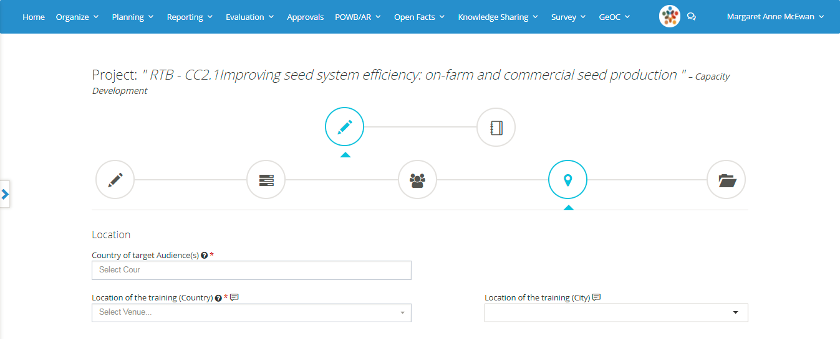
Add the information about the location
Specify the country of origin of the participants and the venue of the training

Slide 9
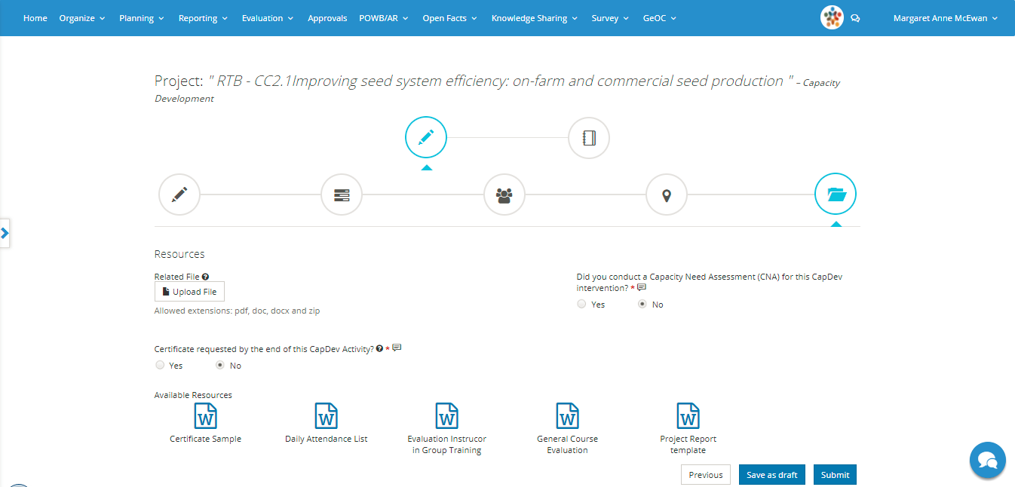
Upload files related to the CapDev activity
Or download the available resources and templates
Click on submit to finalize the planning process

Slide 10
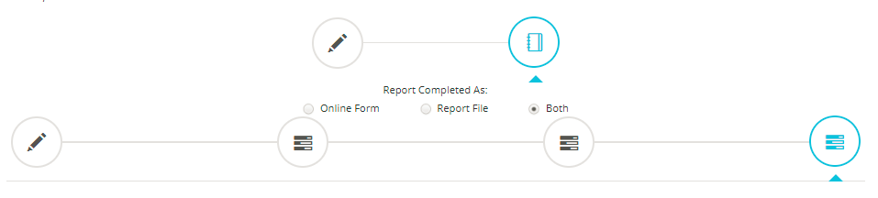
When the planning information has been submitted you may directly continue with the reporting
Click on the reporting icon and select how you want to report. You have three options
Online form: fill the boxes that will appear on your screen to complete the process
Report file: upload the capdev report, training materials, list of participants and other relevant documents
Both: combine option 1 and 2

Slide 11
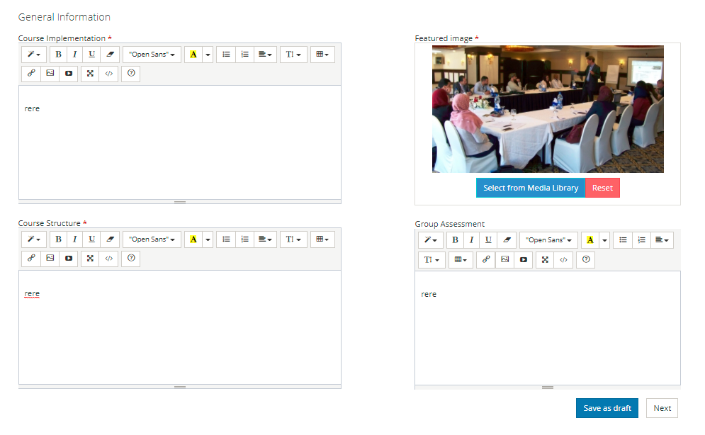
Option 1: Online form
Complete the section with the general information and click on «Next»

Slide 12
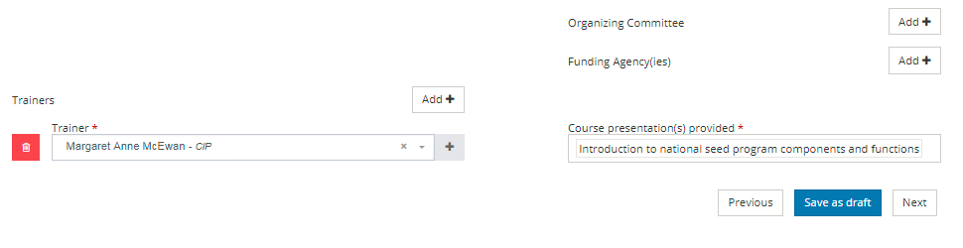
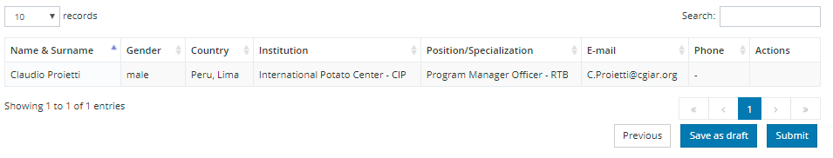
Option 1: Online form
Complete the section on Organizers and Trainers
Verify the list of participants and Submit

Slide 13
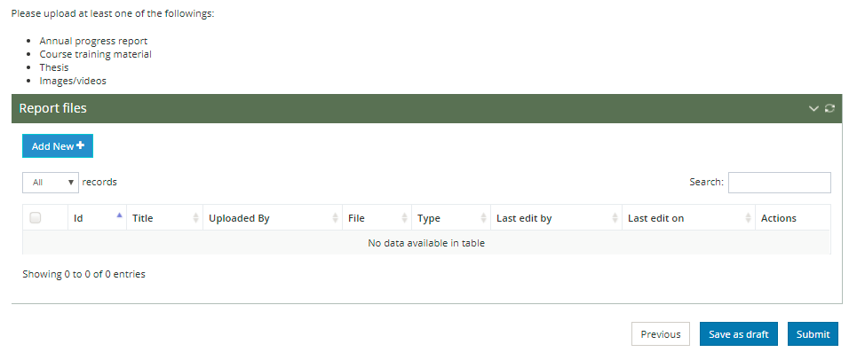
Option 2: Report file
Click on «Add New» and upload all the relevant documents then click to Submit

Slide 14



For more detailed information on how to use MEL please use the online guide
You need support?
Chat with us or send us and email
Thanks for using MEL

