Slide 1
How to plan deliverables
Learn how to plan deliverables in MEL
in 1 minute
VERSION 1

Slide 2
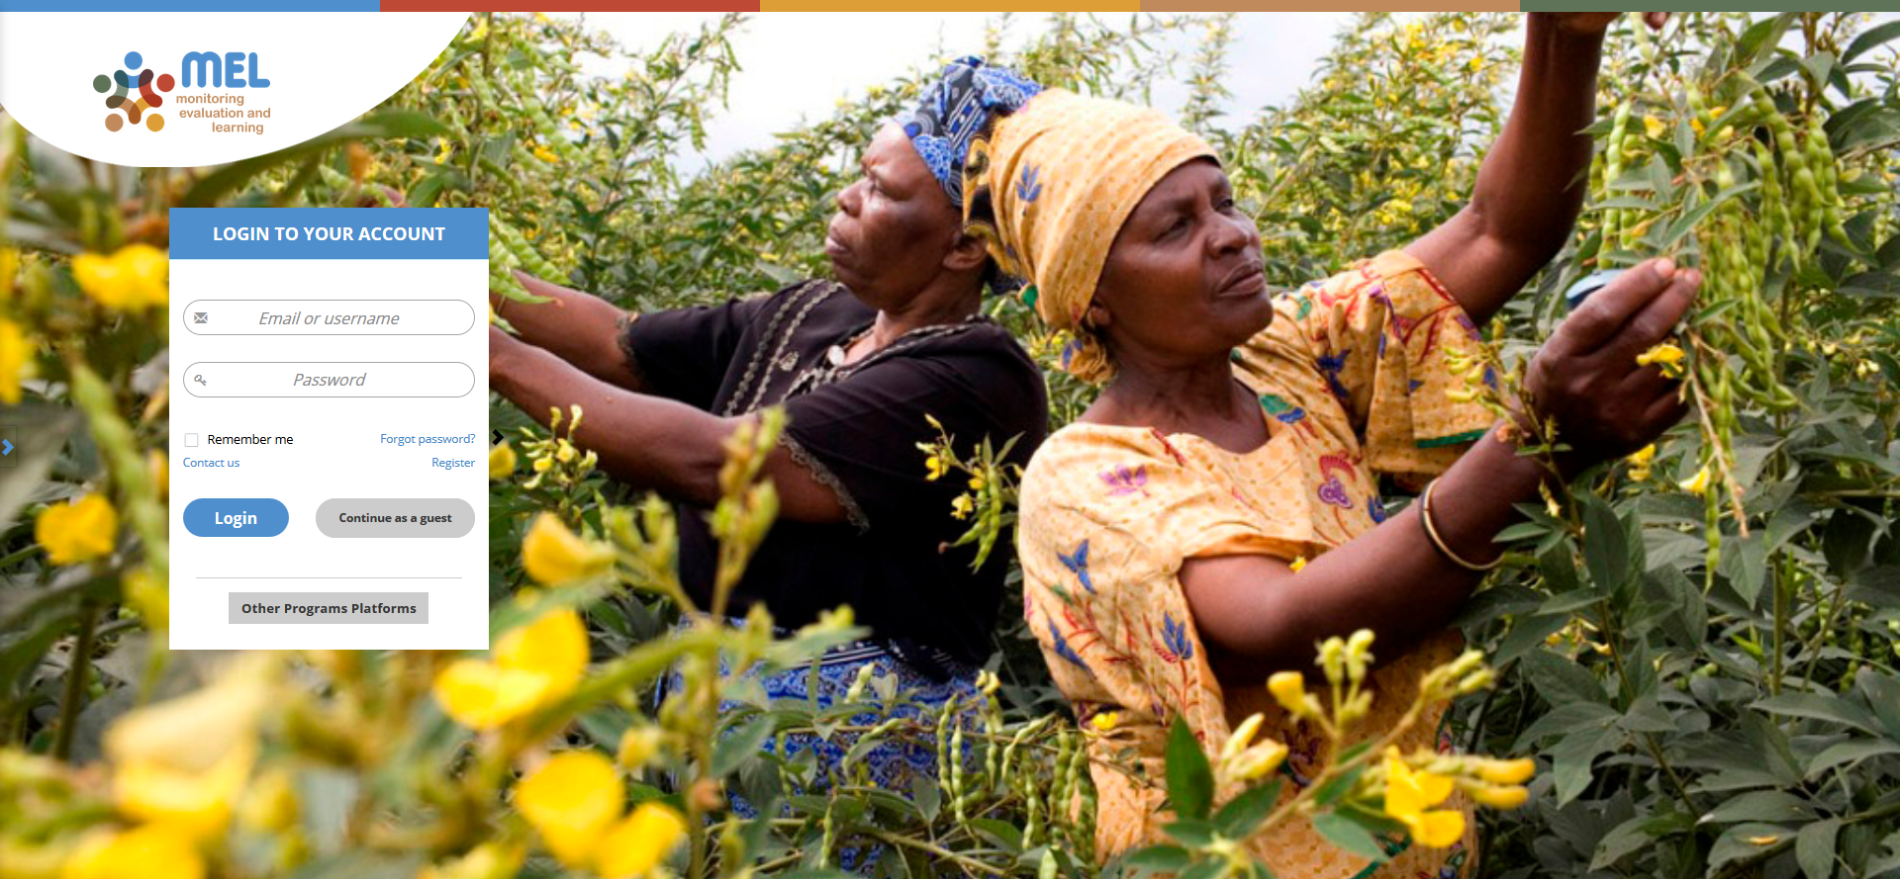
Go to mel.cgiar.org and login to your account
Use your email and password to login
Click on «Forgot password?» if you need to change your credentials

Slide 3
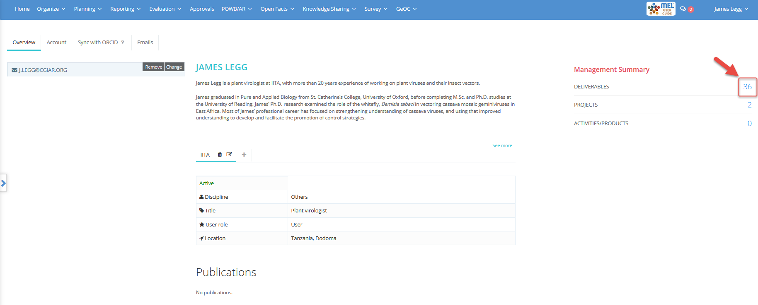
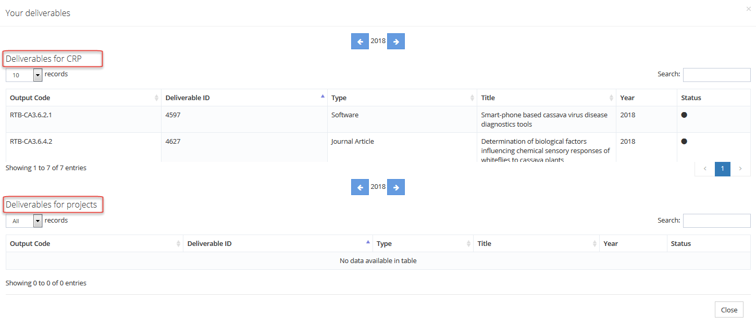
Before you start
From your Home page you may get a quick overview of the deliverables already planned. Click on the «number of deliverables» that appears in your management summary

Slide 4
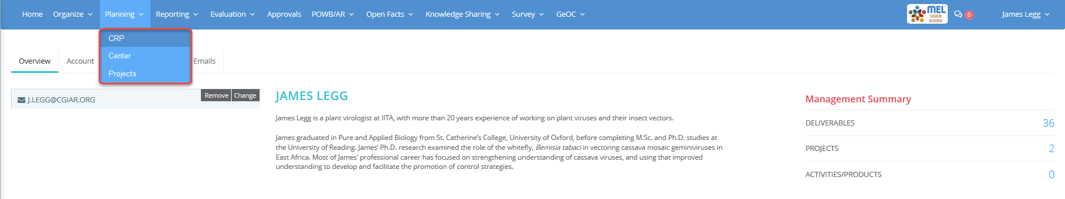
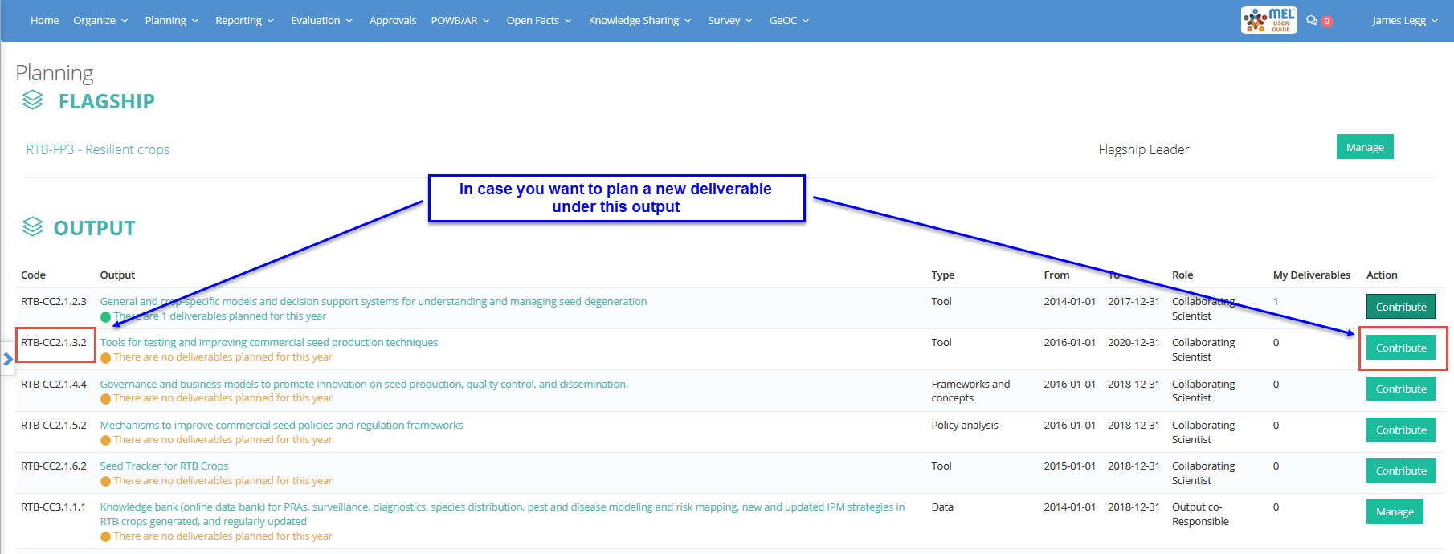
When you want to start your planning, click on the Planning menu and select the framework
You may select CRP, Center or Projects depending on the framework under which you have to plan your deliverable
In the planning dashboard, identify the output to which your deliverable will contribute and click on the action button

Slide 5
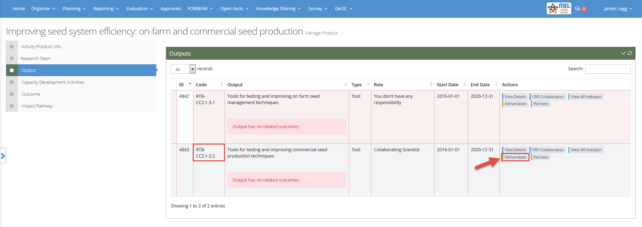
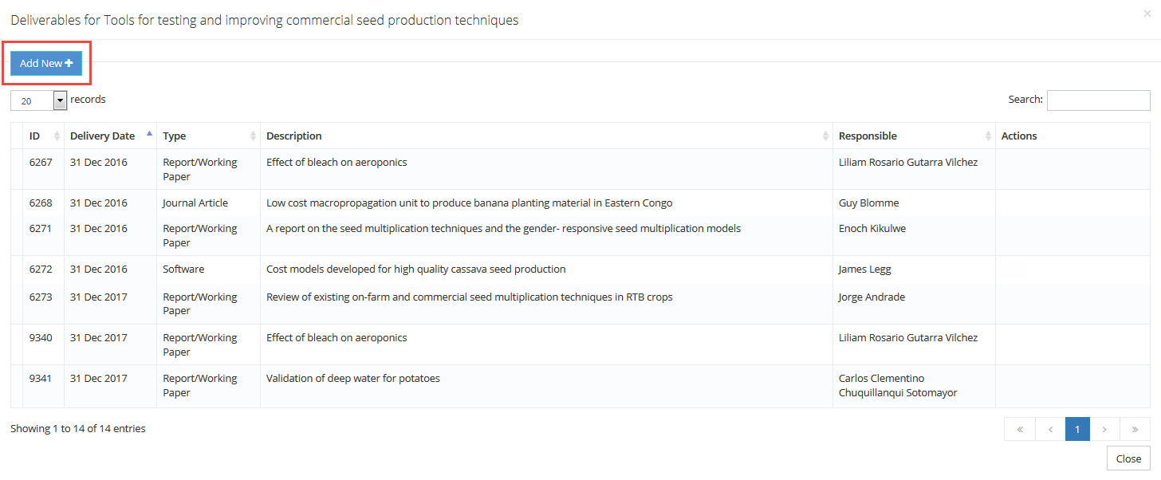
Use the column «Code» to easily find the output you selected then click on the button «Deliverables»
See here the complete list of deliverables and click on Add New to create a new one

Slide 6
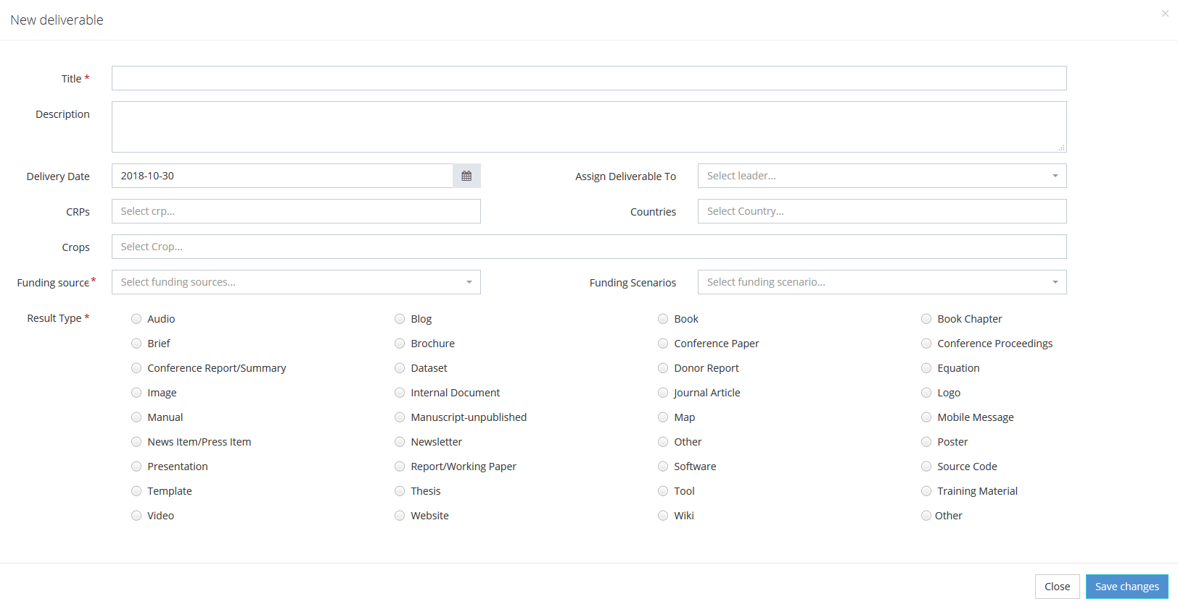
Provide the needed information to characterize the new deliverable and then save the changes

Slide 7



For more detailed information on how to use MEL please use the online guide
You need support?
Chat with us or send us and email
Thanks for using MEL

