Slide 1


Integrated Crop-Livestock Conservation Agriculture for Sustainable Intensification of Cereal-based Systems in Central and West Asia and North Africa
Enhanced crop-livestock integration in CA through optimized stubble grazing strategies and increased fodder availability
Project Final Workshop
CLCA Team
April 4th 2016
Amman, Jordan

Slide 2
Outline
Brief science background
Scheduled activities, variables and approach
Stubble biomass use and factors of variation
Preliminary stubble management tools
Sheep performances grazing stubble and consequences towards feeding strategies
Crop productivity and soil characteristics
Alternatives to summer stubble grazing: revisiting vetch
Recap of field achievements

Slide 3
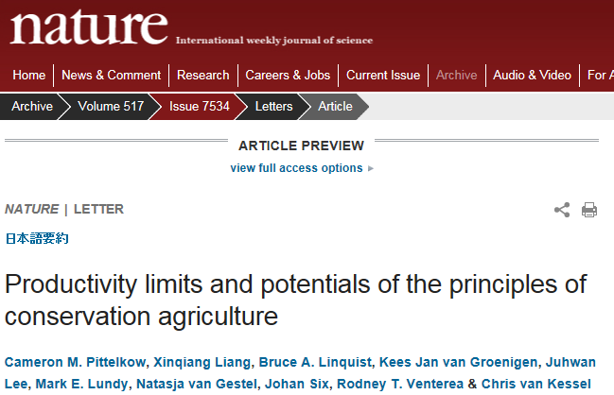
Challenges for smallholders
Pittelkow et al. (2015)
conducted a global meta-analysis using 5,463 paired yield observations from 610 studies to compare CA, with conventional tillage practices across 48 crops and 63 countries.
CA in combination with residue retention and crop rotation significantly increases rain-fed crop productivity in dry climates;
It may become an important climate-change adaptation strategy for ever-drier regions of the world;
It is precisely resource-poor and vulnerable smallholder farming systems that will have the greatest challenges adopting retention of crop residues due to strong competition for residues by livestock and other uses and this may increase yield losses rather than gains.
Smallholders dominate both crop production and livestock systems in the NENA region and most of the poor residing in rural areas raise livestock: 60 percent of smallholders in Egypt, 70 percent in Tunisia, 78 percent in Algeria

Slide 4
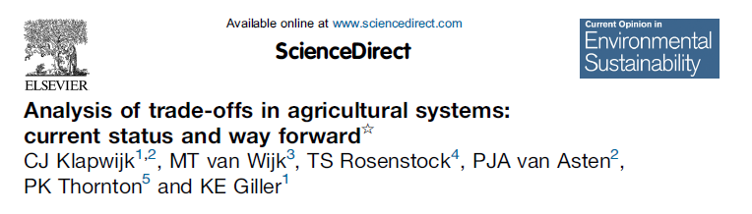
Importance of tradeoffs
According to Klapwijk et al. (2014; http://www.sciencedirect.com/science/article/pii/S1877343513001607),
the presence and significance of trade-offs in crop residue use are highly debated and extensively researched. These tradeoffs include:
Time scales (short versus long term productivity effects),
Spatial scales and levels (livestock access to crop residues on fields owned by different farmers within the community – adoption of alternative feed resources and promising forages),
Gender (who collects and sells crop residues and controls the cash income)
Environment (effects on soil carbon and pressure on grassland areas).

Slide 5
Views polarization
The debate surrounding the suitability of CA for mixed crop–livestock smallholder system has become polarized between two opposed views.
Some authors have stated that the cost of crop residue mulching is too high in relation to the potential benefits (e.g., Giller et al., 2009 http://www.sciencedirect.com/science/article/pii/S0378429009001701)
Others consider the retention of crop residues on soil as more profitable than feeding them to livestock (e.g. Sayre et al., 2001). Sayre, K.D., Mezzalama, M., Martinez, M., 2001. Tillage, crop rotation and crop residue management effects on maize and wheat production for rainfed conditions in the altiplano of central Mexico. In: García-Torres, L., Benites, J., Martínez-Vilela, A. (Eds.), Conservation Agriculture: A Worldwide Challenge, vol. II. ECAF/FAO, Córdoba, Spain, pp. 575–580.

Slide 6
Planned activities
On-station (Years one and two at Setif and Bourebiaa) and the 30 on-farm stubble grazing experiments (multi-year, 15 initiated in Year two and an additional 15 initiated in Year three), crop residue off-take through different grazing strategies will be measured.
Grazing strategies will be evaluated with regard to meeting the sheep nutritional requirements.
The effect of nutrient recycling (urine and fecal excretion) on soil fertility and crop productivity will be assessed. Too ambitious for the lifespan of the project.
Fast growing high biomass and quality fodder (shrub) species and forage legumes will be tested on-station and on-farm for compatibility with annual crops.
Appropriate feeding strategies will be developed for utilizing these species in fodder for improving livestock productivity.

Slide 7
Variables to address
Major variables to be measured include:
biomass removal,
nutritive value of crop stubble,
dry matter intake by sheep,
sheep body weight changes,
grazing behavior,
nutrient input/recycling through manure, soil fertility, and biological parameters.

Slide 8
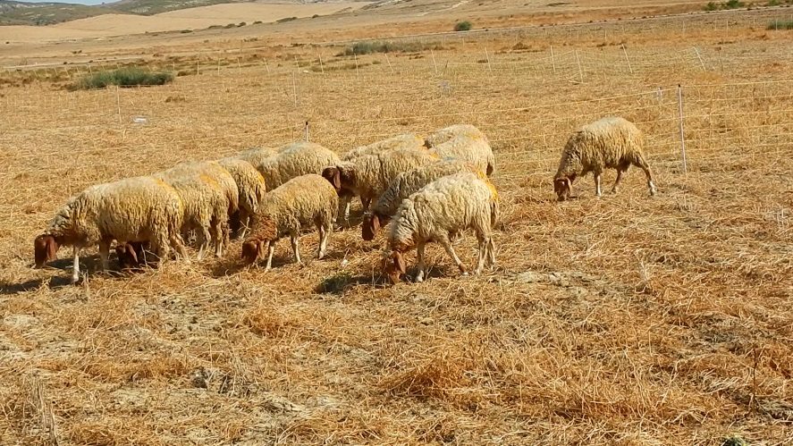
When is it important?
Stubble
Grazing
Peri-
conceptual
programming?
Ovulation
rate
Sperm
production
Embryo
survival
Organ
development
Colostrum
and Milk
Growth, finishing
(carcass, puberty)
-8
weeks
0
6
12
18
24
32
Pregnancy
Lactation
Mating
Birth
Wean
Sell

Slide 9
Approach
Grazing strategies will be first developed on-station and then the most promising ones will be implemented on-farm: Once the results are obtained from on-station experiments and from the ex-ante survey, the project will work with a smaller group of farmers (10-15) on optimizing stubble grazing practices at the target sites. This will be expanded in the third year;
The factors that influence dry matter intake by sheep to be tested are: agricultural practice (CA vs. conv. Till), grazing height, stocking rates, grazing hours per days, and total number of grazing days;
Changes in soil fertility will be monitored by assessing soil organic matter (particulate organic matter, POM), change in soil water infiltration capacity and soil bulk density;
We hypothesized similarity of the natural environments and production systems in Algeria and Tunisia: complementarity of the trials and cross relevance of the outputs.

Slide 10
Constraints
Late start of the project in 2013 and late delivery of the non-till seeders; improvised on-station summer grazing experiments in Tunisia and Algeria. This deprived the project team from 1 year comprehensive data;
CA is new to Tajikistan and therefore the focus was only on implementation of CA agronomic trials without integration of the animal component;
The vis-à-vis in Algeria is ITGC mainly working on cropping activities with no livestock specialists in their team and no livestock in their experimental stations;
Difficulties to implement grazing experiments with farmers on experimental plots as the measurements are quite labor intensive and require disciplined farmers; heterogeneity of animal categories between farms for cross references and comparisons;
Operating in an unstable political and social environment in a post-revolutionary context in Tunisia.

Slide 11
Stubble biomass use
Effect of stocking rate on stubble biomass disappearance (P>0.05)

Slide 12
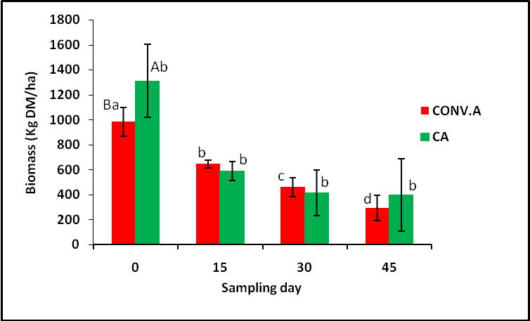
Stubble biomass use
Effect of the farming systems, Conv. vs CA (P>0.05)

Slide 13

Stubble biomass use
Effect of the grazing duration
An important grazing behavior component

Slide 14
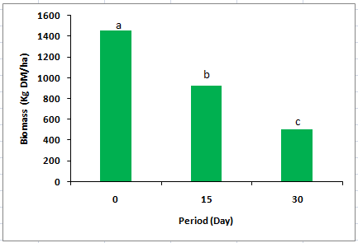
Stubble biomass use
f Biomass/i Biomass: 35%
Effect of the number of grazing days at a stocking rate of 30 ewes/ha

Slide 15
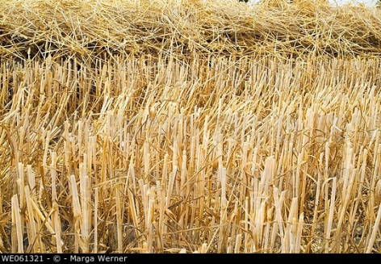
Stubble biomass use
100 %
20 - 25 %
Average area 1 ha; 3.6 T grain yield; Residual stubble rate: 0.66 T/ha

Slide 16
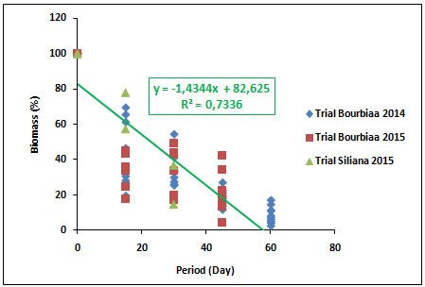
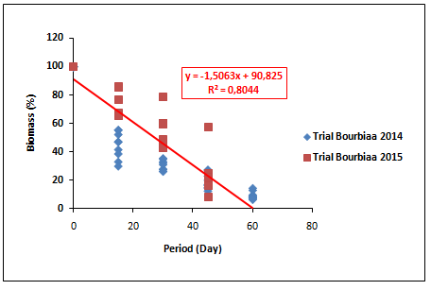
Stubble management tool
Under Conservation Agriculture
Under Conventional Agriculture

Slide 17
Sheep performances on stubble grazing
Stubble chemical composition
Parameters | Content (% DM)
Dry matter (% crude material) | 96.57
Ash (%) | 11.10
Crude protein (%) | 4.78
Crude fiber (%) | 35.30
Fat (%) | 0.48
Calcium (%) | 0.88
Phosphorus (%) | 0.04

Slide 18
Sheep performances on stubble grazing
Effect of stocking rate on live weight change of weaned lambs grazing on wheat stubbles for 46 days without supplementation.
iLW (kg) fLW (Kg) LW change (Kg)
SR15 17.82 19.30 1.479
SR30 17.76 19.24 1.483
SEM 0.38 0.46 0.61
30 g/day

Slide 19
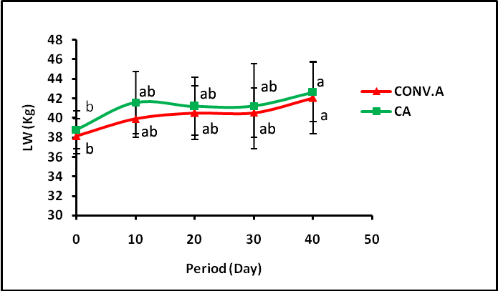
Sheep performances on stubble grazing
Effect of agricultural practice with no supplementation

Slide 20
Sheep performances on stubble grazing
250 g of cc/ewe/day
Live weight changes of ewes in mid-pregnancy stage

Slide 21
Sheep performances on stubble grazing
Live weight (± SEM) variation of Ouled Jellal ewes grazing barley stubble
without supplementation for 3 (T1) or 6 hours (T2).
Treatment | 1st weight 10/08/14 (kg) | 2nd weight 20/08/14 (kg) | 3rd weight 30/08/14 (kg) | 4th weight 09/09/14 (kg) | 5th weight 18/09/14 (kg)
T1 (3h) | 51.1 (1) | 51.2 (1) | 52 (1.2) | 51.9 (1) | 50.6 (0.8)
T2 (6h) | 53.9 (1.2) | 55.7 (1.1) | 55.9 (1.3) | 54.7 (1.2) | 53.4 (1.1)

Slide 22
Meeting the animals’ requirements
Changes in body condition score of late-pregnant ewes grazing stubble under different agricultural practices
 | Initial BCS | Final BCS
Conventional agriculture | 1.45 | 1.43
Conservation agriculture | 1.5 | 1.46
No differences in blood metabolites (glycaemia, cholesterol, urea and creatinine) were found between ewes grazing under different agricultural practices, at different stocking rates or for different grazing hours/day
Analyses are in progress to assess real stubble intake and digestibility using the internal marker method

Slide 23
Meeting the animals’ requirements
Nutritionally blood-linked metabolites variation according to stocking rate
in CA practice (g/l)
Period (Day) |  | 30 | 45 | 60 | SEM | Significance
SR15 | Cholesterol | 0.59 | 0.60 | 0.53 | 0.018 | NS
 | Creatinine | 12.17 | 12.90 | 13.23B | 0.411 | NS
 | Glycaemia | 0.44 B | 0.76 | 0.66 | 0.049 | NS
 | Urea | 0.22A | 0.25 | 0.14 | 0.013 | NS
SR30 | Cholesterol | 0.58 | 0.63 | 0.52 | 0.018 | NS
 | Creatinine | 12.37 | 12.91 | 15.84A | 0.457 | NS
 | Glycaemia | 0.57A | 0.86 | 0.66 | 0.057 | NS
 | Urea | 0.17B | 0.32 | 0.11 | 0.021 | NS
Significance |  | NS | NS | NS |  | NS
 |  | NS | NS | ** |  | NS
 |  | * | NS | NS |  | NS
 |  | * | NS | NS |  | NS
SEM: Standard error of the mean.
A,B: Values in the same column with different letters are statistically different
*: P<0.05; **: P<0.01

Slide 24
Consequences for the agro-pastoral system of semi-arid North Africa
Initial wheat or barley stubbles; 2.5 to 4 T/ha;
Residual wheat or barley stubbles: ≈ 0.6 to 1 ton/ha;
Lambs in post-weaning stage (growing at 30-70 g/day)– Ewes during mating, mid pregnancy (slightly increasing weight – maintaining constant BCS);
Daily grazing time: 6-8 hours
Stocking rate up to 30 heads/ha
Number of grazing days 30-45 days
If beyond 45 days, moderate supplementation from 250 to 300 g cc/head/day
Pull out animals if residual stubble biomass is near 0.6 T/ha

Slide 25
Effects on soil quality and crop productivity
Results are presented as part of component 3

Slide 26
Reduction of barley net blotch
Animal charge/ha
Number of spores released by barley stubble per ha in control (no grazed stubble), Ch15 and Ch30 (corresponding to stocking rates of 15 and 30 lambs/ha respectively)

Slide 27
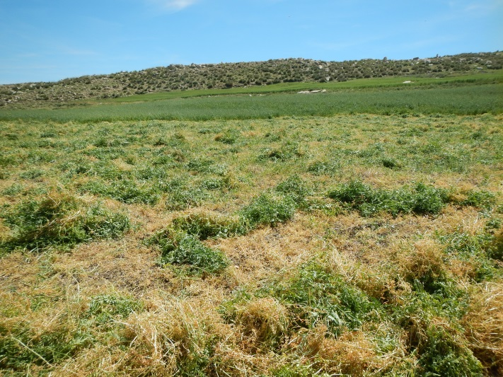
Alternative CA based summer feed: vetch grazing
Forage legumes such as vetch offer many options to producers:
It can be grazed while green in spring;
can be cut as hay and used as feed later in the season;
can be allowed to reach maturity in the field and grazed during the summer as an alternative to cereal stubbles.
Fattening of post-weaned lambs
Out-of-season mating of the flocks http://www.icarda.org/drywire/issue-3.html#a2

Slide 28
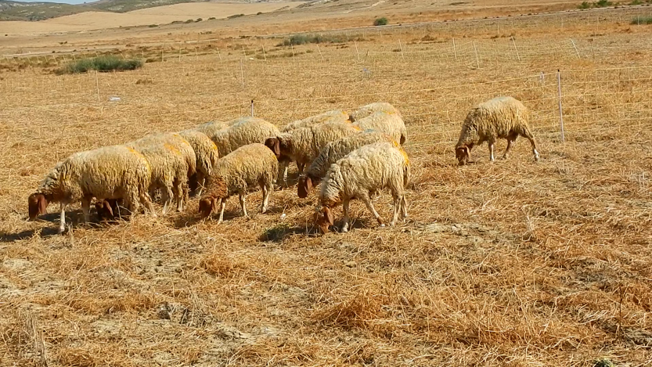
Alternative CA based summer feed: vetch grazing
R1: vetch grazing during the morning (3 h) and evening (2 h) during 47 days between June 30th and August 16th
R2: barley stubble grazing during the morning (3 h) and evening (2 h) during 47 days between June 30th and August 16th + 400 g barley grain/head/day
R3: oaten hay ad libitum + 600 g commercial cc/head/day. Concentrate composition is: 400 g barley grain + 175 g soybean meal + 25 g mineral and vitamin supplement.

Slide 29
Alternative CA based summer feed: vetch grazing
Vetch and barley stubble biomasses offtake
R1 | R2 | R3
Average daily growth (g)
64 ± 23.06 | 60 ± 4.54 | 168 ± 69.92
Feed cost (TND/kg meat produced)
1.9 | 3.3 | 3.9
When addressing the tradeoffs, there is a need to consider for any lost crop yield’s in replacing another crop with vetch.

Slide 30
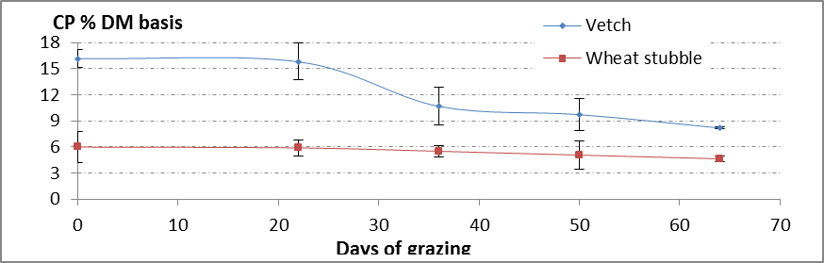
Alternative CA based summer feed: vetch grazing

Slide 31
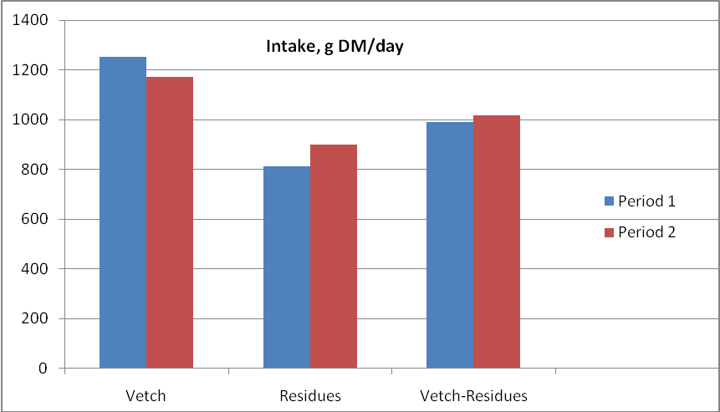
Alternative CA based summer feed: vetch grazing
(R1) Alternate grazing of vetch in the morning and wheat stubbles in the afternoon during 65 days in summer is one further option that was tested against:
(R2) full grazing of vetch
(R3) full grazing of wheat stubbles
Average daily growth (g)
R1 | R2 | R3
145ª | 138ª | 66^{b}
More than 2.5 T DM ha-1 were left on the ground after completion of the grazing period in consistence with application of the CA package

Slide 32
Alternative CA based summer feed: vetch grazing
 | Mulch (not grazed) |  | Grazing one time a day (R2) |  | Grazing two times a day (R1)
 | 0-15 cm | 15-30 cm | 0-15 cm | 15-30 cm | 0-15 cm | 15-30 cm
Vetch paddock
OM content (%) | 1.8 | 2.0 | 2.0 | 2.0 | 2.3 | 2.3
Total Nitrogen(‰) | 2.4 | 2.1 | 2.3 | 2.4 | 1.8 | 2.6
Mineral Nitrogen (ppm) | 89.6 | 105.0 | 65.8 | 77.0 | 67.2 | 92.4
Total OM (T/ha) | 90 |  | 93 |  | 105
Wheat stubble paddock
OM content (%) | 1.8 | 2.0 | 1.9 | 2.0 | 2.0 | 1.8
Total Nitrogen(‰) | 2.5 | 2.3 | 2.2 | 2.5 | 2.7 | 3.1
Mineral Nitrogen (ppm) | 49.0 | 120.4 | 63.0 | 89.6 | 103.6 | 189.0
Total OM (T/ha) | 90 |  | 92 |  | 98

Slide 33
Achieved numbers
 | Stubble grazing trials |  |  |  |  |  | Forage grazing trials |  |  |  |  |  | Alley cropping grazing trials
 | On-station |  |  | On-farm |  |  | On-station |  |  | On-farm |  |  | On-station |  |  | On-farm
 | 2013 | 2014 | 2015 | 2013 | 2014 | 2015 | 2013 | 2014 | 2015 | 2013 | 2014 | 2015 | 2013 | 2014 | 2015 | 2013 | 2014 | 2015
Algeria | 1 | 2 | 2 |  | 12 (15 ha) | 26 (24 ha) |  |  |  |  |  |  |  |  | 1 |  |  | 3 (3 ha)
Tunisia | 1 | 1 | 1 |  |  | 1 | 1 | 1 | 1 |  | 6 (10 ha) | 16 (22 ha) |  |  |  |  |  | 2 (2 ha)
Total | 2 | 3 | 3 |  | 12 | 27 | 1 | 1 | 1 |  | 6 | 16 |  |  | 1 |  |  | 5
Numbers of trials whether on-station or on-farm exceeded targets. On-going lab analysis for soil, intake, digestibility… will contribute to complete the data set

Slide 34
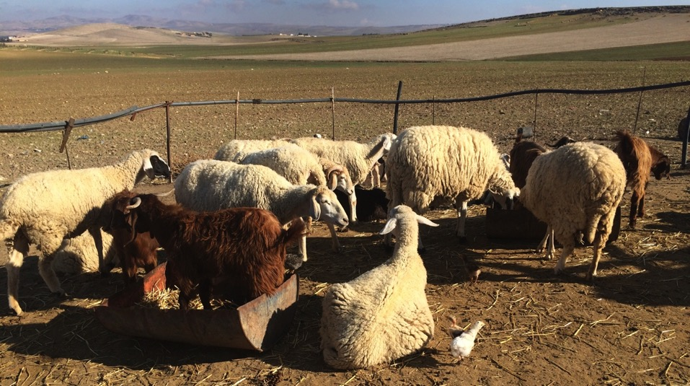
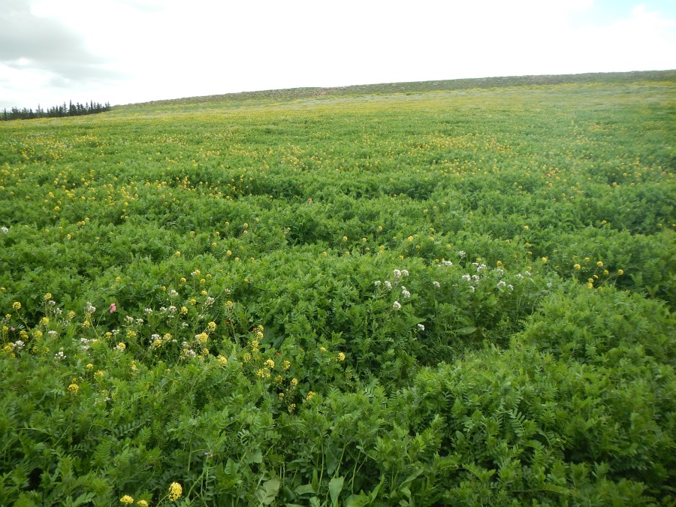
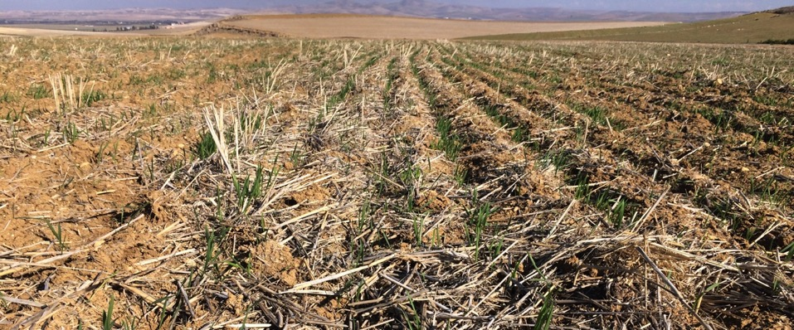
Thank you for your attention

