Slide 1
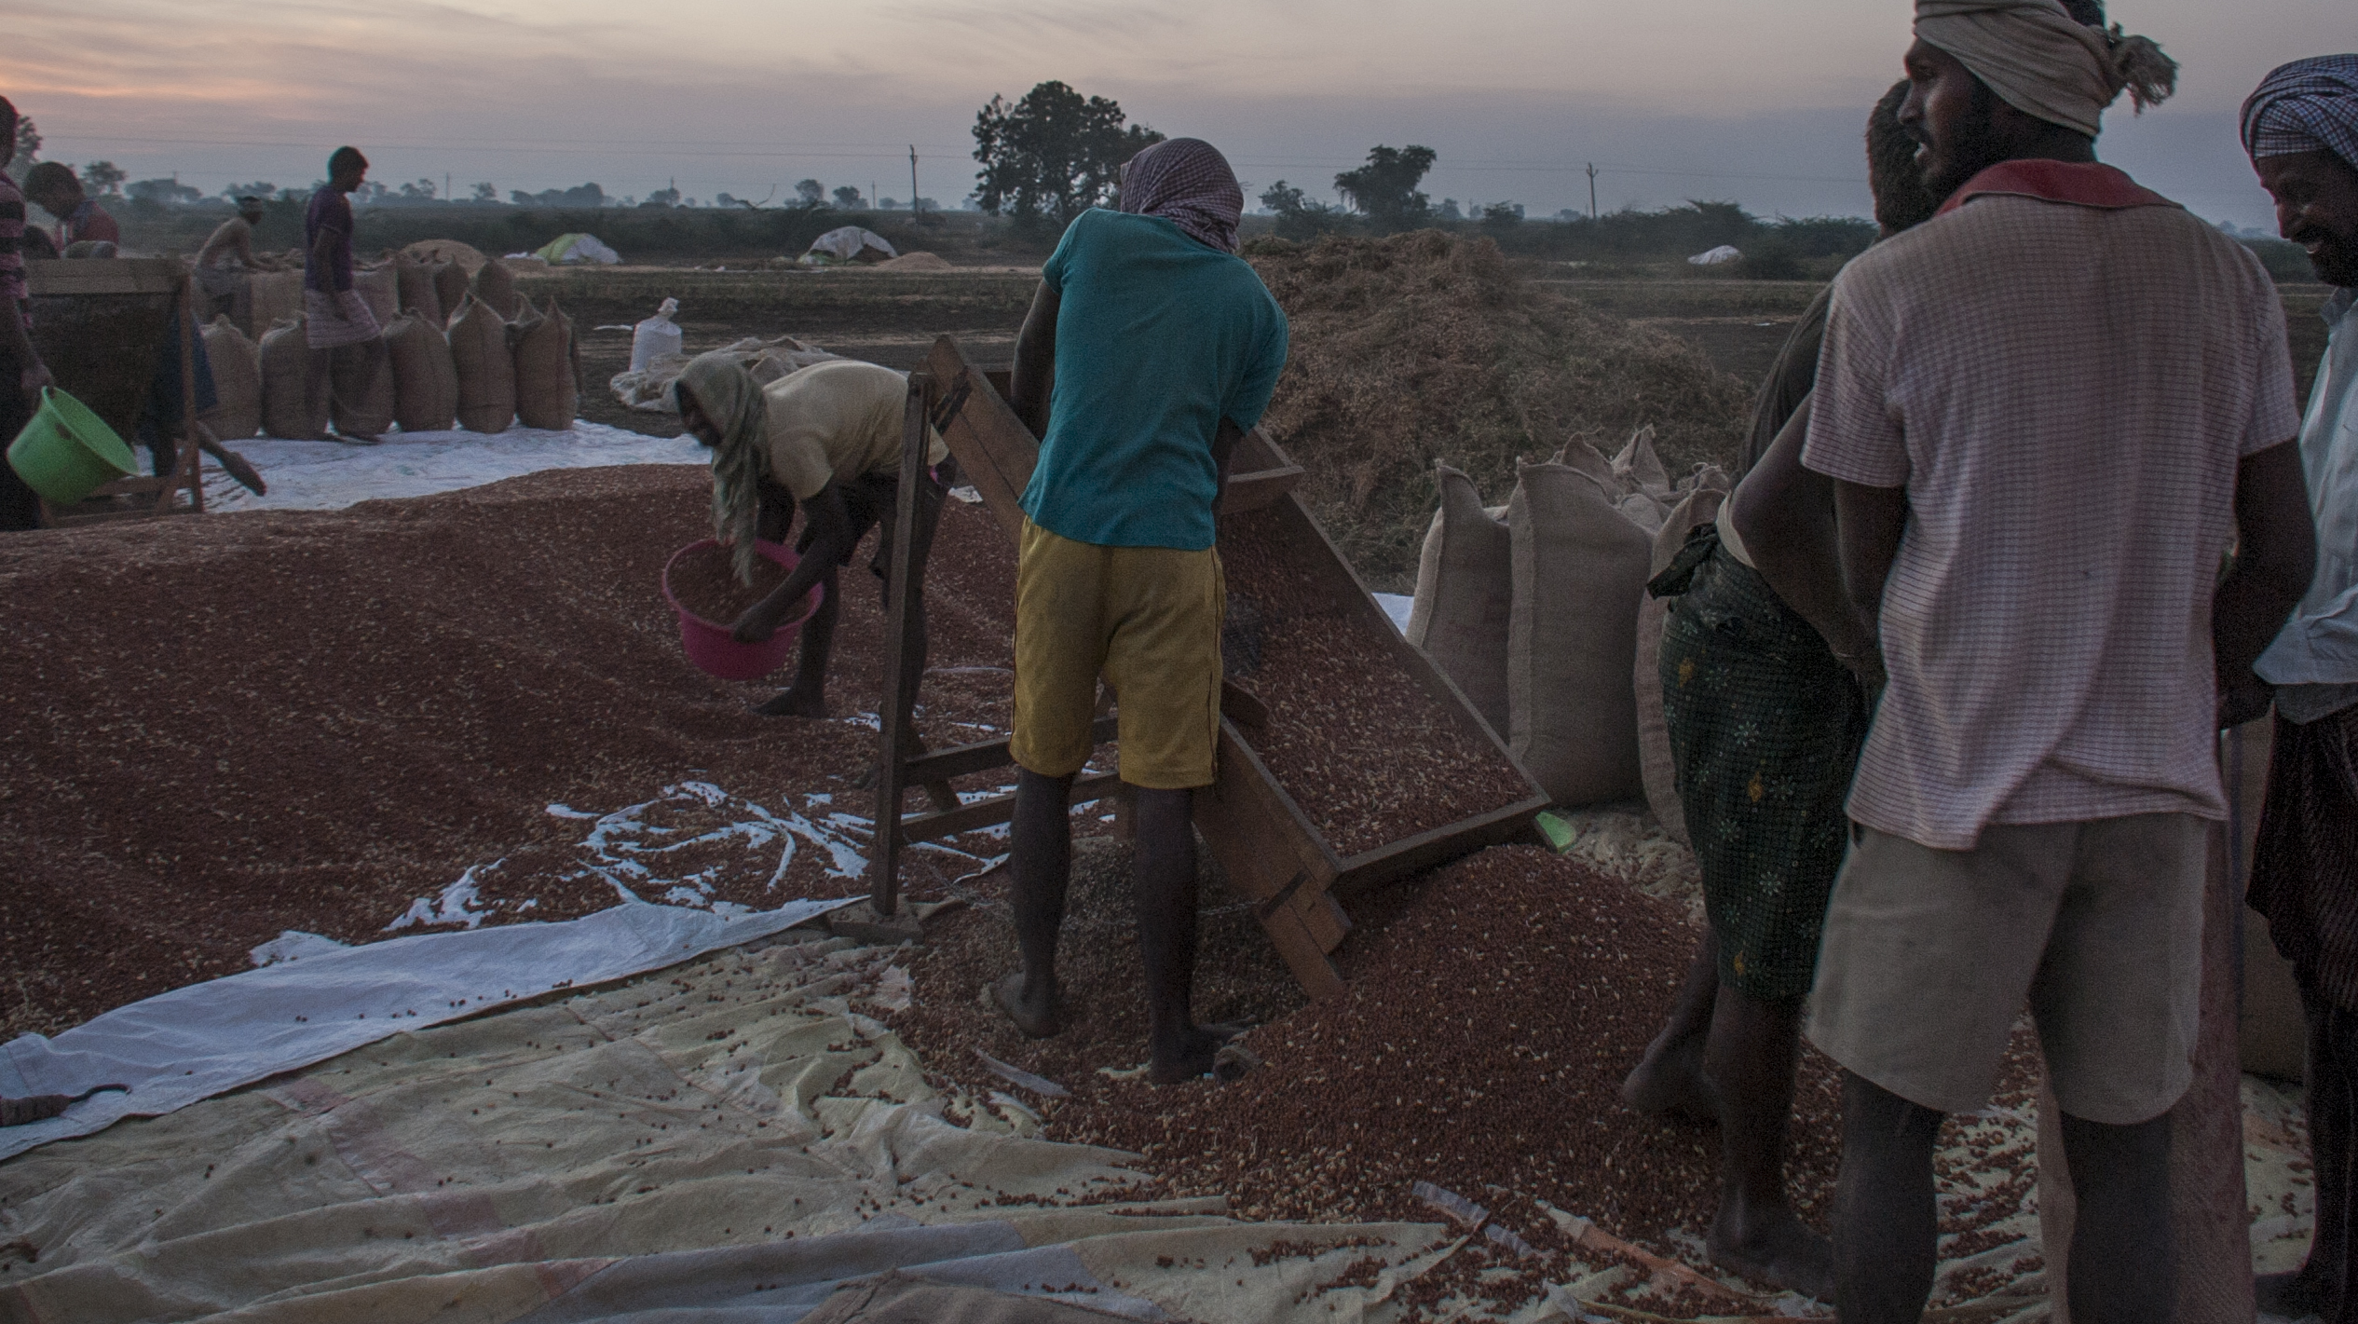
The story behind legume adoption in Andhra Pradesh, Bangladesh and Myanmar
MPAB team

Slide 2
Chickpea in INDIA
India is the largest producer, importer and consumer of pulses in the world, accounting for 25 % of global production, 15 % trade and 27 % consumption.
Among various pulse crops, chickpea dominates with over 40 % share of total pulse production followed by pigeonpea (18-20 %), mungbean (11 %), urdbean (10-12 %), lentil (8-9 %) and other legumes (20 %) (Parmar et al., 2018).
Chickpea is grown on more than 6.93 million hectares of land, and contributes to 62 % of the global production (5.6 million tonnes) and about 37% of total pulse production in the country (Shakya, Patel and Singh, 2008).
In Andhra, the area cropped to chickpea almost tripled from 0.22 million ha during 2000–2001 to 0.6 million ha by 2012–2013.
Nearly 98% of the chickpea cropped area is now under improved cultivars, with an average increase in yield of 37% over yields achieved with unimproved varieties.

Slide 3
Chickpea in Andhra Pradesh
Goal to improve chickpea set as early as 1974, but chickpea was not even a minor crop in Andhra Pradesh until 1985. It was rather originally cultivated in northern India.
Drought and disease resistance (especially to Fusarium wilt and Ascochyta blight) as most important factors when developing new varieties. Drought perceived as major constraint to chickpea yield in central and southern India.
In the 90s, there was a decline in chickpea cultivation in northern India. Expansion of irrigation and high-input agriculture led to large replacement of chickpea by wheat and other cash crops. Better irrigation allowed farmers to replace chickpea with more profitable, irrigated postrainy-season crops such as wheat and rape/ mustard. Thus, chickpea's competitiveness improved in central and southern India. ICRISAT, in partnership with the Indian Council of Agricultural Research (ICAR) and State Agricultural Universities (SAUs), developed short-duration chickpea varieties with high yield potential and resistance to fusarium wilt, which were well adapted to short season environments of central and southern India.

Slide 4
Chickpea in Andhra Pradesh
Also in the 1990s, the cotton crop failed repeatedly in many districts of Andhra Debt-ridden farmers driven to suicide. Chilli and tobacco – the other two major cash crops – were also plagued by heavy pest damage, rising fertilizer and pesticide prices, and falling prices of these crops. The Government of Andhra Pradesh declared a “tobacco holiday” which banned or discouraged tobacco production due to unfavourable global export markets.
Thus farmers began to urgently seek alternatives: the chickpea area in Andhra Pradesh expanded as farmers replaced crops such as sorghum, cotton, chilies and tobacco with chickpea, which is less labour intensive and more profitable.
The driving factor that enabled the fast uptake process was the research, extension and seed multiplication agencies in Andhra Pradesh actively joining with ICRISAT and the JNKVV Central Chickpea Research Institute. The bulk introduction and multiplication of seed by Andhra Pradesh State Seed Development Corporation (APSSDC) were complemented by the Department of Agriculture subsidy which enabled distribution of huge quantities of improved seeds to farmers.
Only public sector organizations like National Seeds Corporation (NSC), ANGRAU (Acharya N G Ranga Agricultural University) and SFCI (State Farm Corporation of India Ltd) are involved in multiplication, production and marketing in the state. None of the private seed companies are involved in seed production and multiplication.

Slide 5
Chickpea in Andhra Pradesh
The main source of information for JG 11 was fellow farmers (83%) followed by Government extension agency (12%).
Farmer-to-farmer exchange led to increased area under chickpea – by 1998, the area under chickpea in AP had more than doubled
many farmers adopted two new cropping patterns, soybean-chickpea and sesame-chickpea to replace cotton cultivation. Adopting chickpea helped farmers reduce costs of their purchased inputs such as fertilizers, pesticides, and labour
Farmers also increased their incomes - chickpea prices relatively high and stable
High-protein (20-21%) content improved nutrition
Now, in AP, most of farmers have moved from subsistence to commercial chickpea farming by mechanizing their operations except harvesting. Also due to mechanization, farmers with extra time on their hands are taking up dairy farming in addition to chickpea cultivation. This gives farmer considerable additional income.

Slide 6
A timeline – Chickpea in Andhra Pradesh
2017
1978-1985
2010
2017
1974
1993
1990s-2000s
1999
Today
First short duration improved chickpea cultivar Swetha (ICCV 2) which was released in India in 1993, but farmers do not seem to like it
Decline in chickpea cultivation in northern India: Expansion of irrigation and high-input agriculture
failure of cotton, chilli and tobacco crops leads to farmers' distress. The government declares a "tobacco holiday". Farmers in urgent need of alternatives.
ICRISAT, ICAR and SAUs work to develop short-duration chickpea varieties that are suitable for central and south India
Several public sector organizations join efforts to promote improved chickpea varieties among farmers. This led to the development of a second wave of releases starting in 1999
These improved chickpea varieties have a huge success
By 2010, more than 90 %of chickpea area in AP is covered with short- duration chickpea cultivars (especially JG 11 and KAK 2). Most farmers have mechanized their operations
Research on short duration started in 1978 when the initial investment of ICRISAT/NARS
Particular focus on:
a) Disease resistance to Fusarium wilt, Ascochyta blight;
b) Higher yields
c) short-duration varieties for short season environments that characterize Southern/central India
ICRISAT considers the improvement of chickpea varieties as one of its targets
Chickpea is not a major crop in AP, but it is rather cultivated in Northern India

Slide 7
Lentils in Bangladesh
Lentil is a vital part of the food system: not only as the "poor man's protein" as it was once understood, but now even as a rich man's dish (soup and dhal)
Poor dietary diversity associated with low food expenditures, particularly regarding non-starchy foods that are nutrient-dense but expensive, such as meat, eggs, and dairy products (Arsenault et al., 2012)
Lentil consumption is key for warding protein malnutrition off, especially in the poorer sector and contributing to a balanced diet (Shaheen et al., 2016)

Slide 8
a timeline –
Lentils in Bangladesh
2017
1970-80s
1985-1990
1990s
1996
2010s-20s
2017
Today
Since the 90s, the focus of breeding has undergone a subtle shift: resistance, suitability, and yield are still minimum breeding criteria, but breeders began to emphasize consumption qualities such as nutrient content, taste, colour, and cooking quality.
Cooperation between ICARDA and BARI led to the release, since the early 1990s, of several improved lentil varieties have been release
BARI-3 and BARI-4 were introduced. They are resistant to rust and blight, suitable in the relay cropping system (they mature in less than 115 days), and high yielding. These high-yielding and disease-resistant varieties matured in less than 115 days
As farmers discovered that these lentil varieties could be planted between rice crops using a method known as relay cropping, lentil production rebounded in transplanted rice areas.
In addition to potential human nutrition benefits, the relay system helps spread farmer resource use into formerly idle periods, stimulating agricultural intensification.
Approximately 11--12 improved varieties have been released -- BARI and BINA varieties
Level of improved pulse variety adoption for mungbean is 100%, lentil 92.78%, chickpea 65.75%, blackgram 40.17% and grasspea only 2.4%
In response to the mid-1980s crisis in lentil production, a joint lentil-breeding program between ICARDA and Bangladesh Agricultural Research Institute (BARI).
Irrigation infrastructure expanded in the 1970s and 1980s → more profitable rice production began to supplant lentils. At that point, local varieties of lentils resulted to be low-yielding and highly susceptible to diseases and insect-pests (stemphylium blight was particularly important). Overcoming this obstacle was critical.

Slide 9
Key actors for Lentil adoption in Bangladesh
Extension services were a very important for adoption(Monayem, Akter and Bakr, 2004)
The Department of Agricultural Extension is the biggest network operating at the grassroots level. Once a good variety is developed, it is very easy to disseminate it through this effective system. It includes the Bangladesh Agricultural Development Corporation, which is the government agency for multiplying and disseminating seed.
A second important channel was BARI - especially the On-farm Research Division. Whatever promising technologies they develop, they pass them on for field testing and demonstration. They use farmer-managed trials. The good varieties spread quickly through that route.
These channels were good feedback mechanisms to report problems with varieties back to the breeders and contribute to further improvement of varieties.

Slide 10
Chickpea in Myanmar
Myanmar is the world’s third-largest producer of pulses after India and Canada. Farmers produce 18 kinds of pulses, of which the most important are black gram, green gram, pigeonpeas, and chickpeas (World Bank, 2019).
Even if Myanmar has become a net exporter of rice and pulses , with approximately 800,000 tonnes of rice and 630,000 tonnes of pulses exported annually during recent years, the country has high levels of under nutrition and food insecurity among its people (Rammohan and Pritchard, 2014; Wong & Wai, 2013)
About two-thirds of pulse production takes place during the dry season (in rotation with monsoon-season paddy) and is concentrated in the regions of Sagaing (25%), Bago (21%), Magway (18%), and Ayeyarwady (14%) (World Bank, 2019).

Slide 11
Chickpea in Myanmar
Adoption of improved varieties and improved crop production practices has led to remarkable increase in chickpea yields and production.
The area, production and yield of chickpea in Myanmar from 2007/2008 to 2011/2012 have increased by 19%, 34% and 12%, respectively.
Adoption of improved varieties was enhanced by knowledge empowerment of farmers (training, interactions, demonstrations, field days, literature, etc) and improving their access to seed

